Slide 1
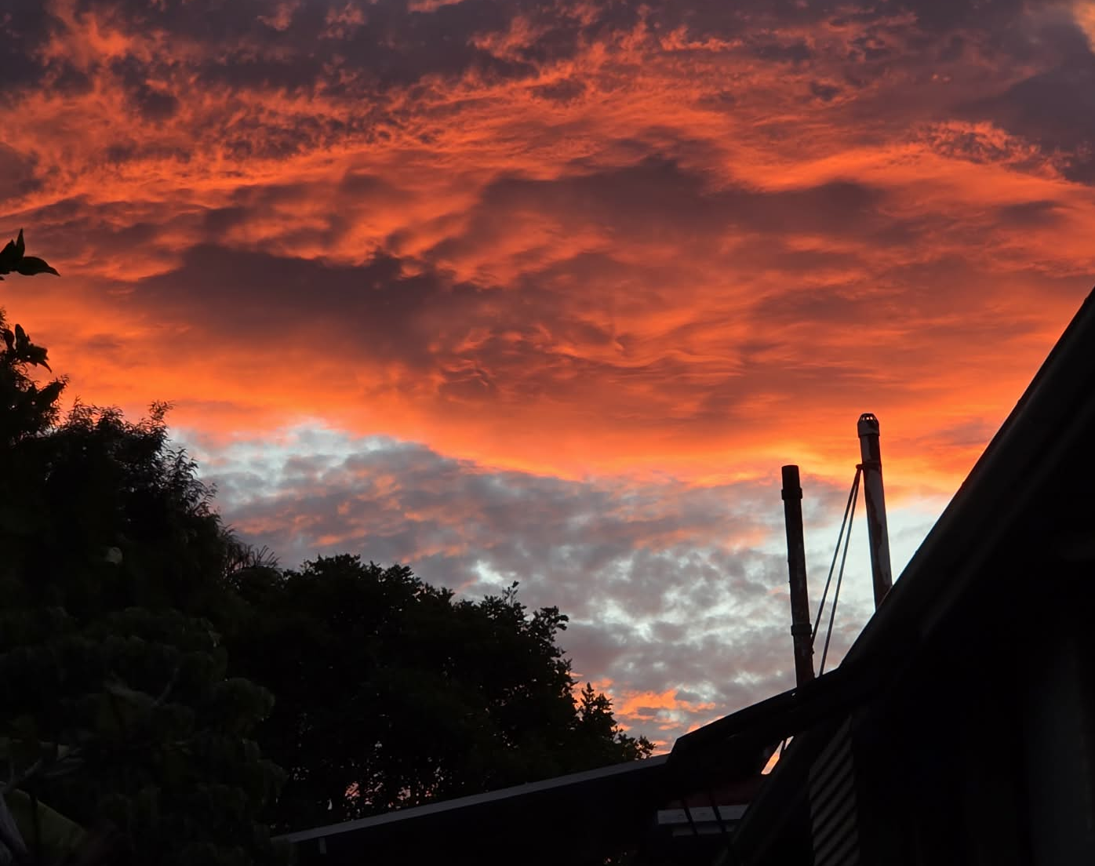
Inflammatory bowel disease
Ivan Cloud L.Ac, DCCM

Slide 2

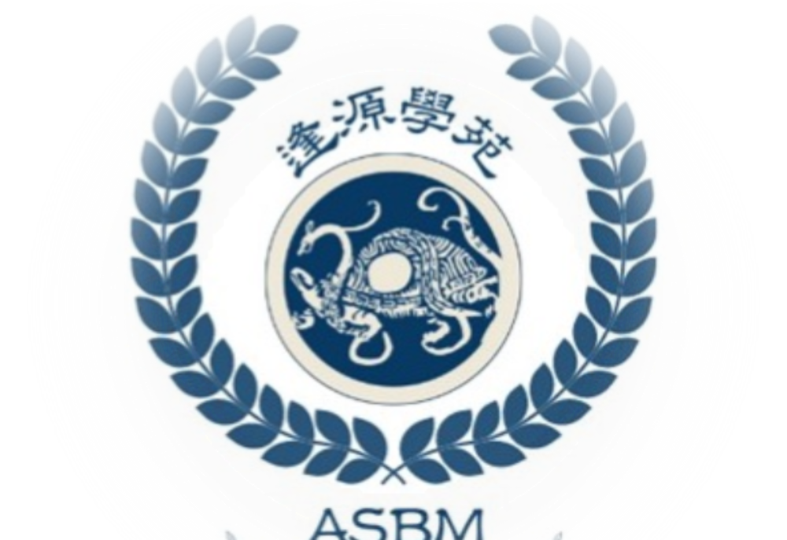

Slide 3
Thanks
Global Branches for Hosting this Class, please check out other classes that I’ve done for GB.
Tung acupuncture Foundations
Classical Acupuncture treatment for Andrology
Classical Acupuncture treatment for Stroke
Classical Acupuncture treatment for Oncology
5-part Autoimmune series
Part 1: (Rheumatoid arthritis, fibromyalgia)
Part 2: ( Lupus erythematosus, Sjögren’s syndrome)
Part 3: (Multiple sclerosis, Myasthenia gravis)
Part 4: (Psoriasis, scleroderma, Raynaud’s phenomenon, granuloma)
Part 5: (Crohn’s disease, and Ulcerative colitis)
Also be sure follow me on:
1. Ivan Cloud (FB page) and
2. Academy of Source Based Medicine on Instagram and Facebook

Slide 4

Follow the Cloud
Follow me on:
1. Ivan Cloud (FB page)
2. Academy of Source Based Medicine on Instagram and Facebook
https://www.facebook.com/sourcebasedmed
https://www.instagram.com/asbmcm

Slide 5
Western Pathophysiology
Crohns Disease
Key mechanism: Dysregulated innate immunity + Th1/Th17 dominance, leading to failure to properly clear bacteria, with chronic penetration and deep inflammation
Pathophysiology: Defective barrier + innate immune response (e.g. NOD2 dysfunction). Subsequently bacteria penetrate, macrophage activate leading to granuloma formation. Elevated Cytokines TNF-α↑ IL-12, IL-23 and Th1/Th17 axis, with transmural inflammation (full thickness of bowel wall). Resulting pattern: “Skip lesions” (patchy) Fistulas, strictures (due to deep tissue damage) and Fibrosis from chronic repair
Ulcerative Colitis
Key mechanism: Abnormal adaptive immune response (Th2-like) causimg superficial mucosal inflammation driven by immune overreaction
Pathophysiology: Intact but dysregulated barrier, the immune response targets mucosa (not deep invasion). Elevated Cytokines IL-5, IL-13 (Th2-like response) with No granulomas.
Resulting pattern: Continuous inflammation (starts at rectum), limited to mucosa and submucosa ulceration, leading to bleeding, mucus and crypt abscesses

Slide 6
Clinical differentiation
Disease: Crohn’s Ulcerative Colitis
Pattern: Skip lesions Continuous
Starting point: Anywhere Rectum
Depth: Transmural Mucosal
Granulomas: Yes No
Fistulas: Common Never
Strictures: Common Rare
Ileum involvement: Common No

Slide 7
Imaging
Both rely on colonoscopy as the central diagnostic test, to differentiate also need MRI / CT enterography because Crohn’s disease is not just a mucosal colon disease, it’s a transmural, whole-bowel disease, often extending beyond what a colonoscopy can see.
Crohn’s commonly affects Ileum and Jejunum. These areas are invisible to colonoscopy. Since Crohn’s has inflammation through entire bowel wall, imaging shows the Wall thickening, edema, deep ulcers.
The defining features of Crohn’s are Fistulas (abnormal connections), Strictures (narrowing), Abscesses, “Comb sign” (menentery vascular inflammation, engorged and dilated vasa recta, mesentery blood vessels in the shape of a comb)
A colonoscopy cannot see outside bowel, Fistula tracts, Abscess pockets/
Also imaging helps differentiate from Ulcerative colitis, which stays in colon, and stays superficial. If imaging shows small bowel disease, fistulas, transmural thickening, this strongly supports Crohn’s

Slide 8
Labs
Serology (sometimes used): Both: have CRP, ESR (inflammation)
Stool: Calprotectin elevated (intestinal inflammation)
Crohn’s , elevated ASCA = Anti–Saccharomyces cerevisiae antibodies. Targets components of yeast cell walls (mannan)Yeast = part of normal gut/environment exposure, signinifying immune system is reacting against luminal microbial antigens
Ulcerative colitis, look at marker of p-ANCA, perinuclear anti-neutrophil cytoplasmic antibodies
Targets proteins inside neutrophils. Seen in autoimmune-type reactions

Slide 9
CM nosology
These type of disease fall under dysenteric disorders (痢疾类)
Dysenteric disorder — lì jí 痢疾 General term for dysentery with abdominal pain, tenesmus, and abnormal stools.
Blood dysenteric disorder — xuè lì 血痢 Dysentery characterized by blood in the stools, often with heat, toxin, or blood stasis.
Chronic dysenteric disorder — jiǔ lì 久痢 Long-standing or recurrent dysentery, typically involving Spleen deficiency, lingering pathogen, or damage to qi and blood.
Intestinal wind (blood in the stools) — cháng fēng 腸風Bleeding from the intestines attributed to wind stirring in the intestines, often painless bleeding; classically contrasted with hemorrhoidal bleeding.
Intermittent dysenteric disorder — xiū xī lì 休息痢 Dysentery that alternates between remission and relapse, commonly due to incompletely resolved pathogen with underlying deficiency.
Intestinal afflux — Cháng pì 腸澼 A classical term referring to chronic intestinal leakage/oozing, often overlapping with chronic dysentery, tenesmus, and persistent abnormal stools.

Slide 10
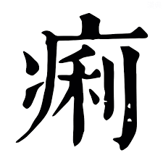
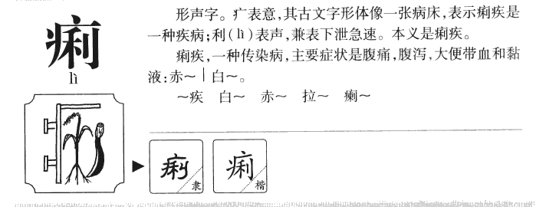

Slide 11
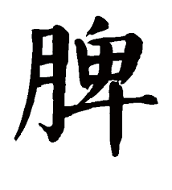
Pi Wei 脾胃
Since the time of the Han dynasty, the Spleen stomach were seen as the Root of Hou Tian/ Postnatal 脾胃為「後天之本」
And the Source of Life and Transformation「生化之源」
In pulse diagnosis, when the body loses the Qi of the spleen and stomach reflected in the physiology of Gu qi/ Grain qi 穀氣, then the pulses loses the moderate 緩和 quality, and becomes a true visceral pulse 真臟脈
It is important to note, that in the Neijing-Suwen, the spleen stomach are the only Zang fu pair that has their own dedicated chapters
29. 太陰陽明論 Discourse on Taiyin and Yangming
30. 陽明脈解 Explanation of Yang Ming vessel
These organs represent the image of the center 中央, which Suwen chapter 8 Discourse on the Secret Canon of the Numinous Orchid.” Líng Lán Mì Diǎn LùnT《靈蘭秘典論》states the Spleen and Stomach are the officials of the granaries; from them the five flavors emerge “脾胃者，倉廩之官，五味出焉”

Slide 12
Death pulse 死脈
A moderate pulse with stomach qi is described as a gentle breeze brushing willow branches, or like chicken stepping on the ground. If it resembles a sparrow pecking, the stomach qi is defeated, this is a death pulse 脉缓…脉如微风拂柳，如鸡践地曰缓（如雀啄则胃气败，死脉）

Slide 13

Zang fu vs Liu Jing
Remember in Zang fu pairing, there is Yang earth (Stomach) and Yin earth (spleen).
In Liu jing pairing, i.e. Taiyin and Yangming, there is the pairing of Taiyin Metal (Lung) and Taiyin Earth (Spleen).
Yangming is encompassed by Yangming Metal (Large intestine) and Yangming Earth (Stomach)
Similarly, for the Small intestine (Yang fire), in Zang fu it is paired with the Heart (Yin Fire). And in Liujing, Small intestine is paired with the Urinary Bladder, which signifies that exterior illnesses can affect the intestinal tract. Hence, why formulas such as Gui zhi tang, Ge gen tang and its variants all can treat digestive illnesses. Even urinary bladder formulas like Wu Ling san can treat diarrhea, that is explained through the Taiyang connection.
In Master Tung acupuncture, we see points in the back such as Wu Ling DT. 04 (Mountain ridges) and Hou Xin DT.11 (Back of the heart) with treating cholera/ sudden turmoil Huo Luan 霍亂. Even points like Bo Qiu 77.04 (Catching the Ball) which is Urinary bladder is indicated for Sudden Turmoil

Slide 14
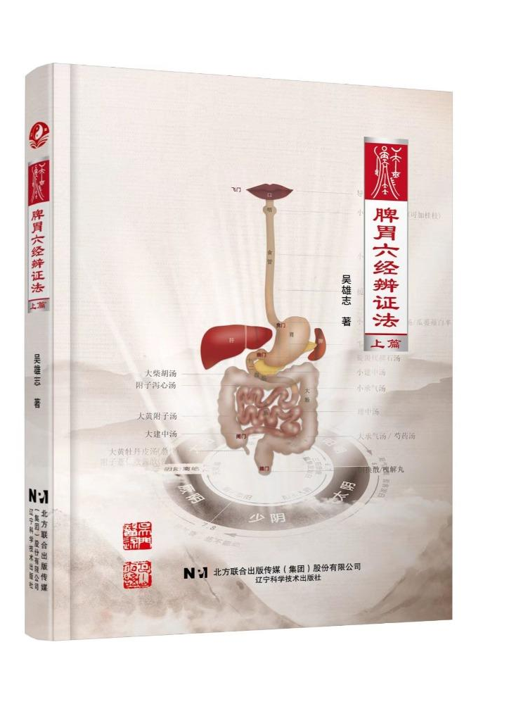
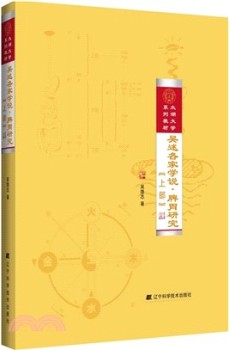
Modern Pi Wei books
Modern scholar clinician, Wu Xiong Zhi 吳雄志, has two significant contributions to Pi wei study.
The first is a two part volume:
Wu’s Exposition of the Doctrines of the Various Schools: Research on the Spleen and Stomach (Two part book)
The second, which is also a two part volume is called
2. Wu Xiongzhi, Six-Channel Pattern Differentiation of the Spleen and Stomach

Slide 15
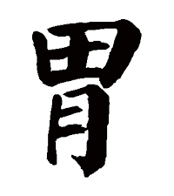
Spleen stomach anatomical distinctions
Anatomically, per Wu Xiong Zhi, the digestive tract is distinguished by Yangming and Taiyin, which alatente their position along the digestive tract pathway, thus known as yin yang displacement 陰陽易位
Taiyin Metal--- Mouth, pharynx, esophagus
Yangming Earth- Stomach
Taiyin Spleen (Small intestine)
Yangming Large intestine (Large intestine and anus)

Slide 16
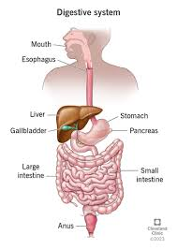
Mutual increase of Vacuity and Repletion
Second characteristic of the spleen and stomach is alternation of vacuity and repletion within the digestive tract. When the stomach is replete, the intestines are vacuous. When the intestines are replete, the stomach is vacuous.
Per Wu Xiong Zhi, this is in tandem with the Western medical perspective of Gastrointestinal motility which occurs as segmental sequential movement, with each segment consisting of a series of processes including motility and secretion. Acitivity in the upstream segment affects activity in downstream segments.
When the upstream is replete it promotes emptying of the downstream tract (vacuity). When the downstream digestive tract becomes active (repletion) it inhibits upstream digestive activity (vacuity)

Slide 17
Mutual dependance of Ascending and Descending
The final characteristic of the spleen and stomach is that ascending and descending depend on one another, giving rise to greater reversal 逆 and greater compliance 順.
Clear yang ascends from below, transferring to the Lung and returning to the Heart, closely related to absorptive processes. Ascending movement is called reversal, because it moves from bottom to top.
Turbid yin descends from above, undergoing transformation and excretion, closely related to digestive processes. Descending movement is called compliance, because it moves from top to bottom
Ascending and descending mutually influence one another.If clear yang fails to ascend, turbid yin cannot descend. If turbid yin fails to descend, clear yang is further hindered from ascending. This is called “mutual dependence of ascent and descent.”

Slide 18
Taiyin and Yangming physiological distinctions
Since Taiyin and Yangming have Different Yin–Yang Natures, they must also have Different Substance and Function
One is Yin Earth and Yang Earth: Different Ascending, Descending, Intake, and Transport
The stomach governs intake of food. The spleen governs transportation and transformation. When The spleen is healthy when it ascends; the stomach is harmonious when it descends. When yin earth is diseased, clear yang fails to ascend. When yang earth is diseased, turbid yin fails to descend. However, in Taiyin disease there are cases where extreme descent reverses into ascent, and in Yangming disease there are cases where extreme ascent reverses into descent.
Just like different parts of the planet has different preferences for moistening and drying. Yangming yang earth prefers moistening and dislikes dryness.When moistened, intake and downward flow proceed smoothly; when dry, blockage occurs and food cannot enter.Taiyin yin earth prefers dryness and dislikes dampness.When dry, transformation and ascent of clear qi occur; when damp, abdominal fullness and spontaneous diarrhea result

Slide 19

Dampness and dryness
Taiyin is inherently damp; Yangming is inherently dry. Not only can there mixed patterns of dampness and dryness, but also extreme dryness resembles dampness, and extreme dampness resembling dryness.
Wu Xiong Zhi states: “Extreme dryness resembling dampness can be seen in colon and rectal cancer patients: there is often a red tongue with greasy coating, poor appetite, and dizziness, and neither aromatic transformation, bitter drying, nor bland percolation methods are effective. Extreme dampness resembling dryness is seen in Wu Ling San patterns: despite clear water-damp retention, symptoms include constipation, scanty urination, fever, and thirsty”

Slide 20
Vacuity-Repletion tendencies
When yang earth is diseased, there is mostly repletion and heat, Yangming stomach and large intestine patterns are predominantly excess and hot. Thus it is said:“Repletion belongs to Yangming, the yang pathway is replete; the Shang Han Lun states:“Yangming disease is stomach-domain repletion.”“
When yin earth is diseased, there is mostly vacuity and cold Vacuity belongs to Taiyin, the yin pathway is vacuous. Taiyin disease presents with abdominal fullness and vomiting, inability to eat, profuse spontaneous diarrhea, and occasional abdominal pain
This is primarily because minor fire generates earth, and there is a distinction between sovereign fire and minister fire. Yang earth is generated by sovereign fire, which easily becomes excessive and produces repletion heat; therefore stomach fire should be weak rather than strong. The Xie Xin Tang formulas of the Shang Han Lun treat stomach fire with epigastric focal distention by draining sovereign fire of the Heart.
Yin earth is generated by minister fire, which easily declines and gives rise to vacuity cold; therefore spleen yang should be strong rather than weak..”.. Therefore, acquired Taiyin spleen vacuity often damages pre-heaven kidney yang, transmitting into Shaoyin, and may be treated with Si Ni Tang or Fu Zi Li Zhong Wan.

Slide 21
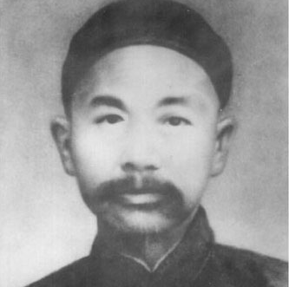
Tang Zong Hai on the Small intestine
Qing dynasty physician Tang Zong Hai唐宗海 elucidates on small intestine physiology, stating it”
Transform refined juices, to move upward and offer (them to) the Heart, and transformed into blood. 化精汁，以上奉於心而化血
He states “The Small Intestine is the official of receiving and containing; from it transformation emerges.Above, it connects with the Stomach; below, it connects with the Large Intestine.It is externally–internally related to the Heart: when residual heat remains, the urine becomes turbid and unclear.It is linked and affiliated with the Spleen: when Earth is deficient, water and grain cannot be transformed 小腸者，受盛之官，變化出焉，上接胃府，下接大腸，與心為表裏，遺熱則小 水不清；與脾相連屬，土虛則水穀不化

Slide 22
Small intestine anatomical connections
Due to Western medicine influence, Tang Zong Hai connected small intestine physiology to making blood, while also still holding the importance of the spleen
In Tang Zonghai’s discourse, the Small Intestine, like the Spleen, also communicates with other organs through interconnected networks (連網) of membranes. ,“the entire organism is connected through oily membranes; even pancreatic juice and bile both enter the Small Intestine via these oily membranes 全體皆與油膜相 連，甜肉汁、膽汁皆從油膜中入小腸也。
Nevertheless, such connections are still unable to replace the functional role of the Spleen. Tang states:
“Diseases of the Spleen are mostly due to the fire of the Small Intestine steaming and assisting damp qi.” 唐言；：「脾病多是小腸之火蒸助濕氣
Conversely, the Small Intestine’s“ability to transform substances without stagnation relies entirely on the Spleen’s dampness to moisten it. What Western medicine calls the entry of sweet-flesh juice into the intestines to transform substances is indeed correct.” 所以化物不滯，全賴脾濕有以濡之。西醫所謂甜肉汁入腸化物是矣。

Slide 23
Small intestine physiology
Tang Zonghai further elaborated that since the Heart channel and the Small Intestine channel are mutually related as exterior–interior On the basis of this relationship, the oily membrane enveloping the Small Intestine is able to communicate with the membrane surrounding the Heart, that is, the Pericardium.Such an understanding of “exterior–interior” correspondence cannot be explained on the level of anatomical form and substance; however, this kind of correspondence constitutes a crucial pivot in Chinese medical visceral physiology, whereby the function of one viscus links with another so as to complete the operation of the organism as a whole. 又如唐宗海申論到，心的經脈與小腸的經脈是互為「表裏」的，基於這種關 係，包裹小腸的油膜，就可以和心臟外面的膜，即心包絡交通。這種「表裏」的 意義，放在解剖形質上是說不通的，但是這種對應的關係卻是中醫臟腑生理中由 一個臟腑的功能，到連結另一個臟腑，以致完成全體生理運作的一個關鍵點
Tang maintained:“The Small Intestine receives and contains the five grains, transforming them into refined fluids, which are then conveyed upward to serve the Heart and be transformed into blood. Therefore, the Small Intestine is the palace of the Heart. When Heart fire fails to disseminate, the dregs of the Small Intestine are not transformed, resulting in diarrhea.When Heart fire is excessively exuberant, residual heat is transmitted to the Small Intestine; within the oily membranes, this heat steams the fluids, and when ingested water passes through the oily membranes it is steamed into yellow- or red-colored dysenteric disorders. Failure of the dregs to transform, with filthiness, greasiness, pus, and blood, is entirely a disease of Heart heat being transferred to the Small Intestine.”Since the Small Intestine is able to “transform refined fluids and convey them upward to the Heart to form blood,” how, then, could one claim that the Small Intestine is unimportant? 唐認為：「小腸受盛五穀，使化精汁，以上奉於心而化血，故小腸為心 之府，心火不宣，則小腸之糟粕不化，是以泄；心火太盛，則遺熱小腸，油膜中 為熱所蒸，飲水從油膜中過，則被蒸為黃赤色痢證。糟粕不化，垢膩膿血，全是 心移熱於小腸之病。」 我們看到小腸能「化精汁，以上奉於心而化血」，

Slide 24
Membranes and digestive processes
Tang Zonghai, on the basis of the relationship between the Spleen and Oily substances (膏油), explains:“The Oily substance upon the membranes is precisely a product of the Spleen. When the membrane-oil is cold, it cannot steam and transform the water and grain within the intestines; therefore, food cannot be ingested.When the oily substance is warm, the blood does not congeal or stagnate, and the qi within the membranes flows freely.” 唐宗海基於脾與膏油的關係，說明「膜上之膏油，即脾之物也。膜油寒，不 能薰化腸中水穀，故不能食。」若是「膏油既溫，則血不凝滯，而膜中之氣自暢。
The proper functioning of oily substances depends on the warming power issued by the Heart, for only with such support can they exert their full effect (Fire engenders Earth).When “the Spleen fails in transportation and transformation,” the unctuous substance declines, becoming weak and flaccid. This results in laxity and loss of containment in the membrane networks of the Triple Burner, causing the large and small intestines to descend downward.Tang held that this principle explains the statement:“The intestines are connected to the membrane networks, and the membrane networks in turn rely upon the oily substances to fill them and secure them.”The Spleen’s oily substance is able to transform water, while the qi of the unctuous oils is able to transform water and grain. This constitutes Tang Zonghai’s distinctive insight」 膏油要靠著心發出的溫力支持，才能發揮良好效用（火生土）若是「脾不健 運」，膏油就會衰弱變成虛軟，造成三焦膜網弛縱不收，大小腸往下墬。唐認為 此理說明了：「腸連於膜網，而膜網又賴有膏油，以充攝之也。」脾之膏可化水， 而膏油之氣則可化水穀，這是唐的獨見

Slide 25
Membrane inflammation
Western medicine attributes the signs of inflammation to the accumulation of tissue fluid from within the blood vessels that gathers in the flesh outside the vessels. This may correspond to what Tang Zonghai referred to as “Oily substances” (gaoyou) and “oily membranes” (youmo).
西醫將發炎的症狀歸於血管內之組織液機聚在血管外的肉中，這點與唐宗海所指 之「膏油」、「油膜」之處或有符合；但炎證在腸中則會造成瀉痢

Slide 26
Zhang Zhong Jing 張仲景
While many are familiar with the Jin Yuan dynasty’s Pi wei school/ Spleen stomach school, in actuality, the beginning of spleen stomach theory predates this school.
If we pay attention to the Shang han Lun, most of ZZJ’s formulas have a variety of medicinals that protect the spleen and stomach
Sheng Jiang/ Gan Jiang– Warm spleen/ center yang, dries the earth
Zhi Gan cao– Moderate urgency, supplements Ying by banking earth, Purges Heart Fire (see article from Will Ceurvels, “How Gan Cao works, The Lantern”)
Da zao- Builds blood in the spleen as an offering to the Heart (see article from Will Ceurvels, New Analysis of the Pharmacomechanism of Da Zao
Ren Shen– Cooling, sweet medicinal in the Shen Nong Ben Cao Jing. To rescue fluids and preventing the death of blood after sweating, diarrhea, vomiting
Ban Xia- Purgation of Rheum in the center to free up the flow of Wei qi axis

Slide 27
Li Dong Yuan 李東垣
Li Dong-Yuan is a leading physician and scholar during the Jin and early Yuan dynasties (1115–1368) and is counted among the Four Great Masters of the Jin–Yuan Medical Era. He is widely recognized as the founder of the Earth School of Chinese medicine (補土派).
During the Mongolian and Song dynasty conflict, there was great famine happening due to Mongol warfare tactics. Some scholars such as John Welden (see To Bring Order Out of Chaos: Literati Medicine of the Jin dynasty 1115-1234), see Li Dong Yuan medical ideas as a reflection of historical political discourse.
Center collapse representing Chinese conquest, Yin fire representing the “Barbarians” usurping the emperor. His tactics on “supplementing the center, boosting the qi, and ascending the center qi” representing language of battle morale tactics and cultural spirit of that time.

Slide 28
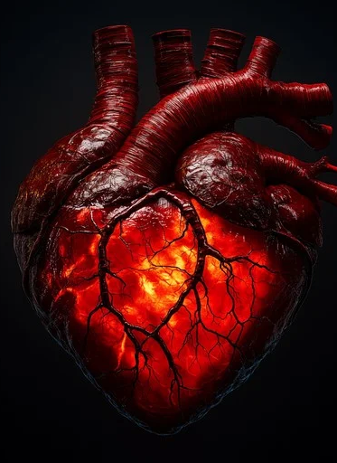
Yin Fire 陰火
This theory can be seen as a further elaboration of ministerial fire theory from Li Dong Yuan of the Spleen stomach school. The key factor is that the Spleen qi ascent of the clear, relies on ministerial fire. In this syndrome, the spleen cannot raise leading to collapse and evils in the lower burner that revolt in a coup d'état to usurp the heart.
Some postulate the reason it cannot raise is because is liver is depressed and knotted transforming to fire 肝氣鬱結>化火. The spleen qi since it relies on wood ascent collapses and the fire brews in the lower which then flares and usurp the sovereign fire.
This is called Yin fire. Its progression per Master Tung second gen. disciple, Yu Sheng Tze, is as followed:
“肝> 心包> 三焦> 相火> 脾> 肺> 腎> 心”
Liver---Pericardium--- San jiao---Ministerial fire--- Spleen---Lung---Kidney--- Heart
In other words, Jueyin, shaoyang, taiyin, shaoyin… When it begins to strike the other zang, that is the autoimmunity component (as the ministerial fire is striking the affected viscera in terms of whichever is weakest)..
In this theory Spleen is the weakest, then as the spleen gets weak its child the lung is affected (autoimmune skin and pulmonary diseases), this is Yin fire affecting the postnatal.
Then it begins to affect the prenatal (first the kidney, the source, and ultimately usurping the heart, the sovereign fire of all control).

Slide 29
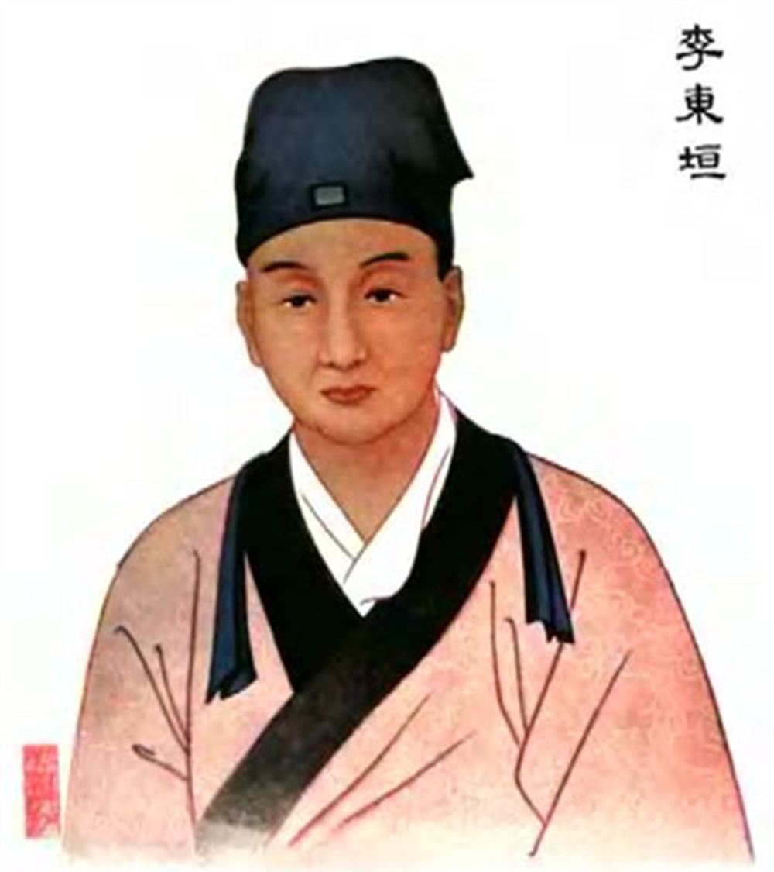
Yin Fire Orthodox Mechanism
Li Dong Yuan archetypal formula for Yin fire is Bu zhong qi yi tang, these are purported mechanisms:
1) Central qi fall leads to lower burner qi dynamic depression leads to heat causing fever (Deng TIetao)
2) Middle burner insufficiency leads to original yang vacuity leads to yang straying outward (Ouyang Qi)
3) Qi vacuity leads to insufficiency in the source of transformation leads to blood vacuity leads to heart yang blazing upward (Li Sifu)
4) Spleen qi vacuity causes grain qi and dampness to spill downward into the lower burner where the stagnate and cause yin fire (Liu Duzhou)
5) Spleen vacuity leads to non-transformation of water and grain leads to vacuity of ying-yin leads to yin fire (Yi Yong)
6) Vacuity of the spleen and stomach allow invasion/generation of evil qi, evil qi and correct qi fight, causes fever (Peng Hanfang)

Slide 30
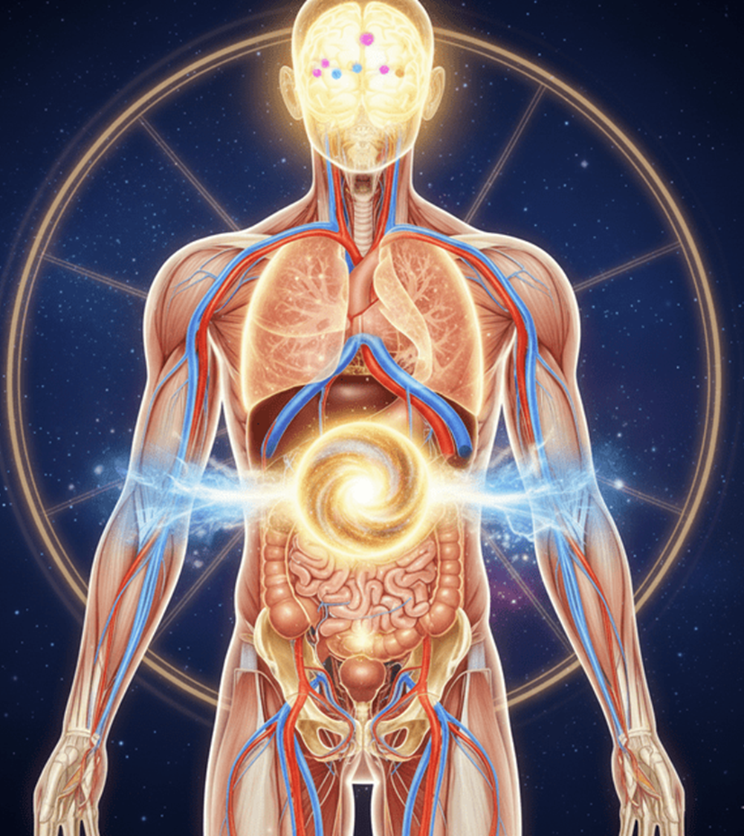
Yin fire from the Small intestine
Yin-Fire is developed from Yuan-Qi insufficiency of spleen and stomach. Spleen collapse and gallbladder not ascending.
Some postulate the pathophysiology of Yin-Fire is in the small intestine. Yin fire according to Li Dong Yuan comes from the lower burner and ministerial fire usurping physiological heart fire. Heart fire no longer governs. Xiang huo is the fire of the Bao luo of the lower burner, the thief of Yuan qi.
There is vexation, 4 limb heat, dry mouth.
Small intestine and its pair heart fire usurping the position of a weakened spleen and stomach, which then also furthermore doesn't generate earth, and conversely also invades metal. Since earth is weak it also doesn’t engender metal leading to heart fire scorching it.
Heart fire can also make its mother replete wood, the liver further weakens earth.
Source: 李東垣脾胃論元氣陰火學說的研究

Slide 31
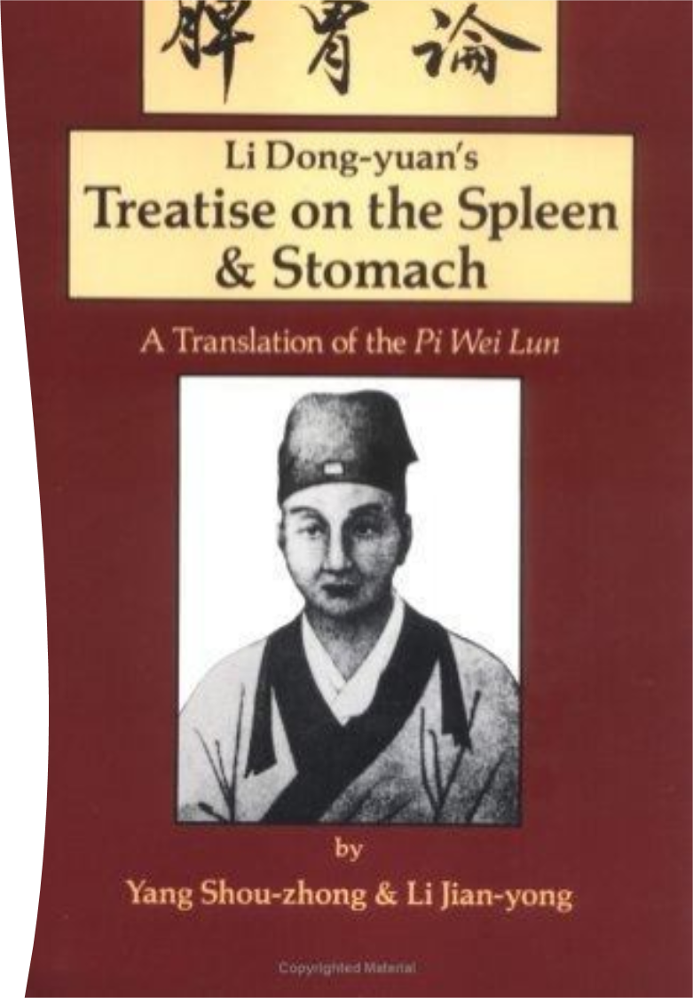
Bǔ Pí Wèi Xiè Yīn Huǒ Shēng Yáng Tāng
補脾胃瀉陰火升陽湯
Supplement the Spleen stomach, drain the yin fire, raise the yang decoction
Huang qi 1liang 黃耆1兩
Cang zhu 1 liang 蒼朮泔浸炒1兩
Zhi gan cao 1 liang 甘草炙1兩
Qiang huo 1 liang 羌活1兩
Sheng ma 8 qian 升麻8錢
Chai hu 1.5 liang 柴胡1.5兩
Huang lian 5 qian黃連酒炒5錢
Huang qin 7 qian 黃芩炒7錢
Ren shen 7 qian 人參7錢
Shi gao, use as needed 石膏少許長夏微用過時去之
Also a good follow up to Gan cao xie xin tang (similar formula structure) but more focused on Taiyin and clearing the root, Yin fire. Wu Xiong Zhi argues this formula derives from Zhang Zhong Jing’s Hou Shi Hei San

Slide 32
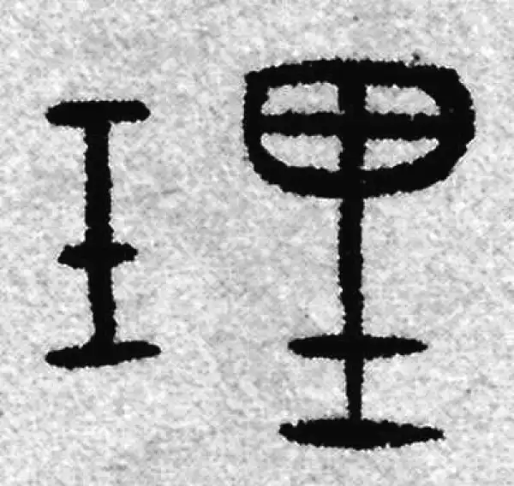
Three principles-三理
Wu Xiong Zhi states the Three Major principles of Li Dong Yuan come from Zhang Zhong Jing.
補中升陽 Supplement the center, raise the Yang (Huang Qi Jian Zhong Tang)
升陽散火 Raise the Yang, disperse Fire (Hou shi hei san)
升陽除濕 Raise the Yang, eliminate dampness (Fang ji huang qi formulas)

Slide 33
Tung 77-88 region
Several Tung disciples, such as Young Wei Chieh 楊維傑 states the Pi Wei influence on Master Tung acupuncture. Source: 董氏奇穴(兼論十四經穴)與脾胃論治 (一)論理篇
Many of these points are in the Stomach and Spleen channels, and fulfill the principle of Using the Postnatal to regulate the Prenatal 以後天調理先天, and often regulating the middle for treating Hard to treat cases 疑難雜症/ yí nán zá zhèng
For example Si ma/ The 4 Horses, Tong Tian/ Penetrating Heaven group are in Foot Yangming
Tong shen/ Penetrating Kidney group, and Xia san Huang/ Lower three emperors are in Foot Taiyin

Slide 34
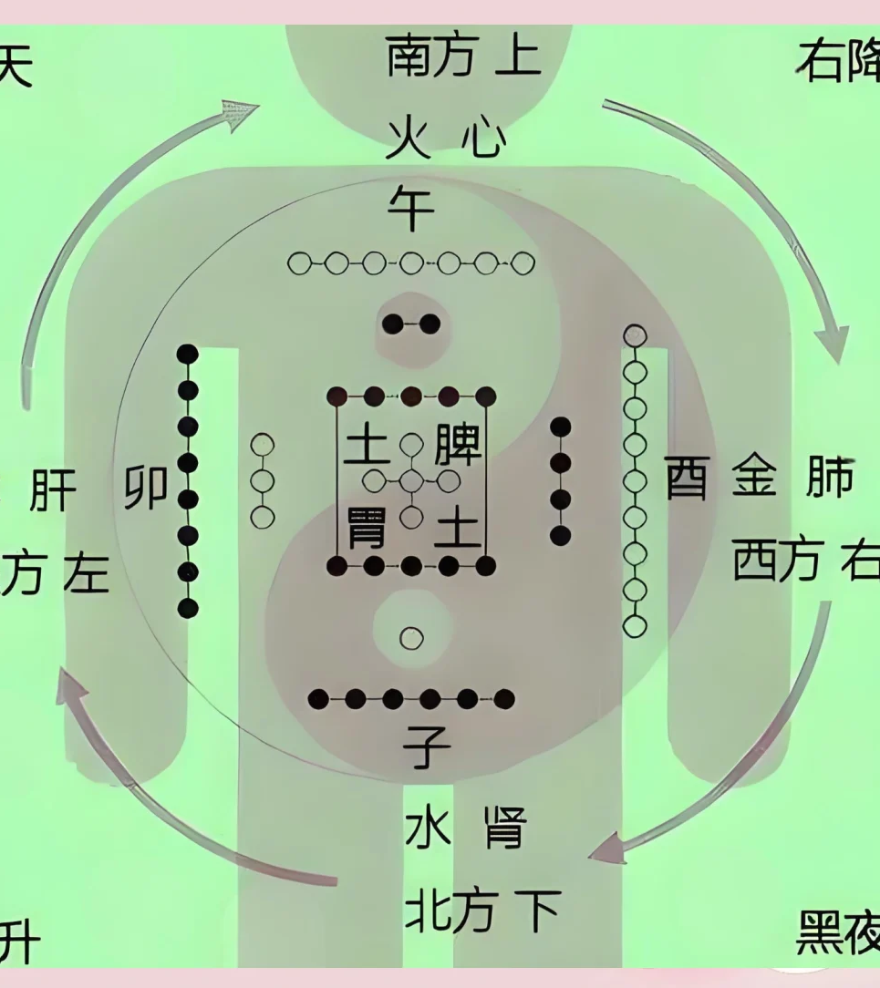
Complex diseases
Why treat the Spleen stomach in complex diseases?
The Spleen stomach is the center axis of ascending and descending 升降 the Pure and Turbid. We can use the Earth to ascend and descend Fire 降升火
Spleen ascends the Clear Yang, Stomach descends the Turbid Yang
Chinese Medicine has the axioms of
百病痰作祟 In hundred diseases, phlegm is the culprit
怪病多痰 Bizarre diseases are often phlegm.
3. 脾胃為生痰之源Spleen and Stomach is the source of the engenderment of Phlegm,

Slide 35
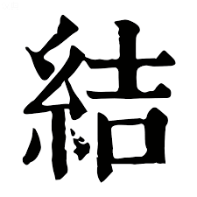
First resolving binds 先解結
Neijing premise that before attuning Yin and Yang, we must first resolve Binds.
These are sites where evil qi has long-term binded 邪氣久結之処
One must move the Evil qi, this is called Pursuing the Qi 追氣 (Zhui qi)
Look for Stirring 動 (Dong)，Hard 堅 (Jian)，Painful 痛 (Tong) areas

Slide 36
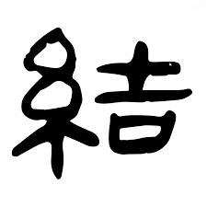

Slide 37
Nanjing Abdominal Map
One can also palpate the abdomen (per the Nanjing) to find which zone can correlate the Ji with a particular viscera. One looks at the associative region after the finding the root visceral diseased quality in the pulse. Physician ought to palpate the whole pulse bilaterally with three fingers of both hands simultaneously, looking for the overall pulse sensation.
Liver pulse– Urgent wiry is Liver evil (needle the left side)
Heart pulse- Floating surging big (epigastrium)
Spleen- Relaxed soggy (needle the center)
Lung- Short, stagnant, choppy (needle the right side)
Kidney- Deep tight (below the umbilicus)
Also if pulse is forceful, needle the Luo point. And if pulse is Forceless, needle the source point of the associated Zang

Slide 38
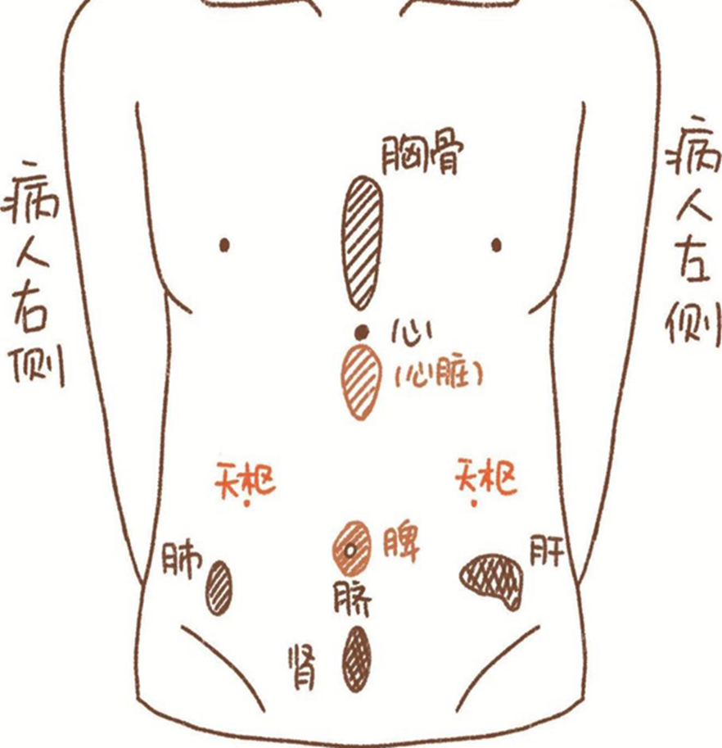
Nanjing pulse map
Top of Abdomen= Heart
Lower abdomen= Kidney
Center= Spleen
Right= Lung
Left= Liver

Slide 39
Tu Xing 土興 Tu Xing (unnumbered)
興 Xing has many meanings, can mean Prosper, revive, arousal, etc
So can be rendered as Earth Prosper, Earth revival, Earth arousal..
Location: Palm side, on the middle finger. In the center of the first proximal phalange, go down 3 fen is Tu xing Yi. 3 fen above is Tu xing er.
Shen jing: Spleen stomach shen jing for both Tu xing Yi and Er, liver branch shen jin for Tu xing er
Indications: Chronic stomach cancer, gastritis, acute enteritis, splenomegaly, hypochondriac pain, stomach fire pain, forehead pain, tooth and gum pain
慢性胃腺癌，胃炎，急性腸炎，脾腫大，兩脅痛，胃火牙痛，前額頭痛，齒齦痛

Slide 40
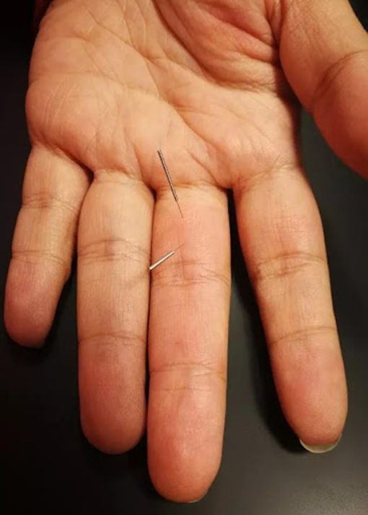
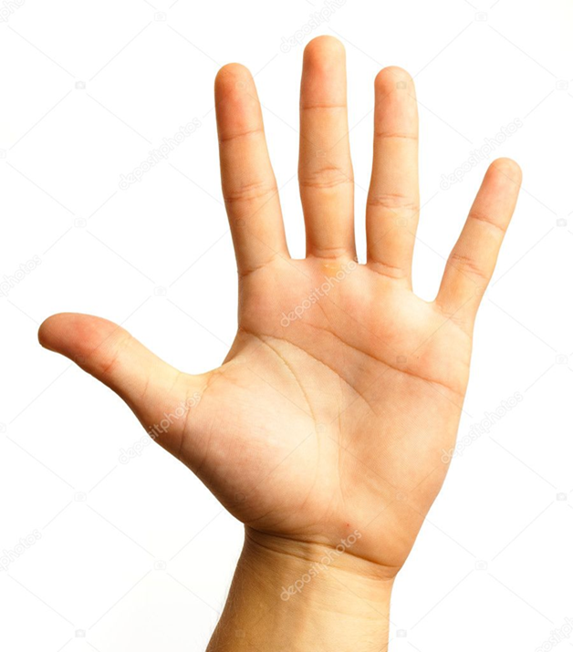

Slide 41
Tu Hang 土航 Earth Boat (two points)
Shen Jing: Spleen shen jing
Location: Palm side, center of distal and second phalange of Ring finger.
Center of distal phalange is Tu Hang Yi, center of middle phlange is Tu Hang Er
穴位：手掌，無名指第一節正中央點
Indications: Head dizziness, vomiting, stomach distention, asthma, foot numbness, lower leg outer side pain, abdominal pain, dizziness/ cloudy head
主治：頭昏、嘔吐、胃脹、氣喘, 腳麻、小腿外側痛、腹痛、頭昏 (Special effect Abdominal pain 特效主治：腹痛)

Slide 42
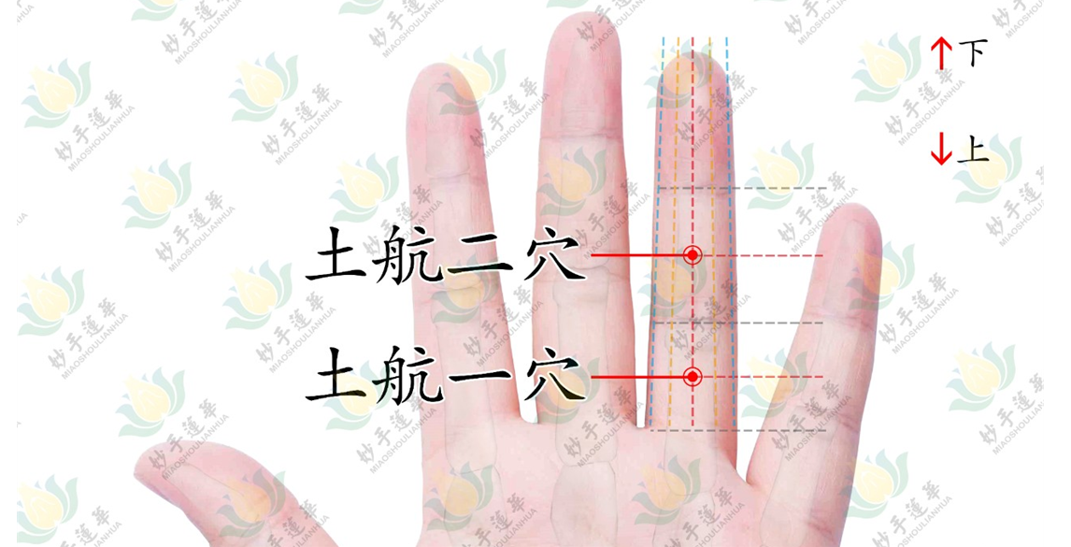

Slide 43
Finger Stomach 指胃
Tung channel: Lung branch, and Six fu
Indication: Gastritis, Gastric ulcer

Slide 44
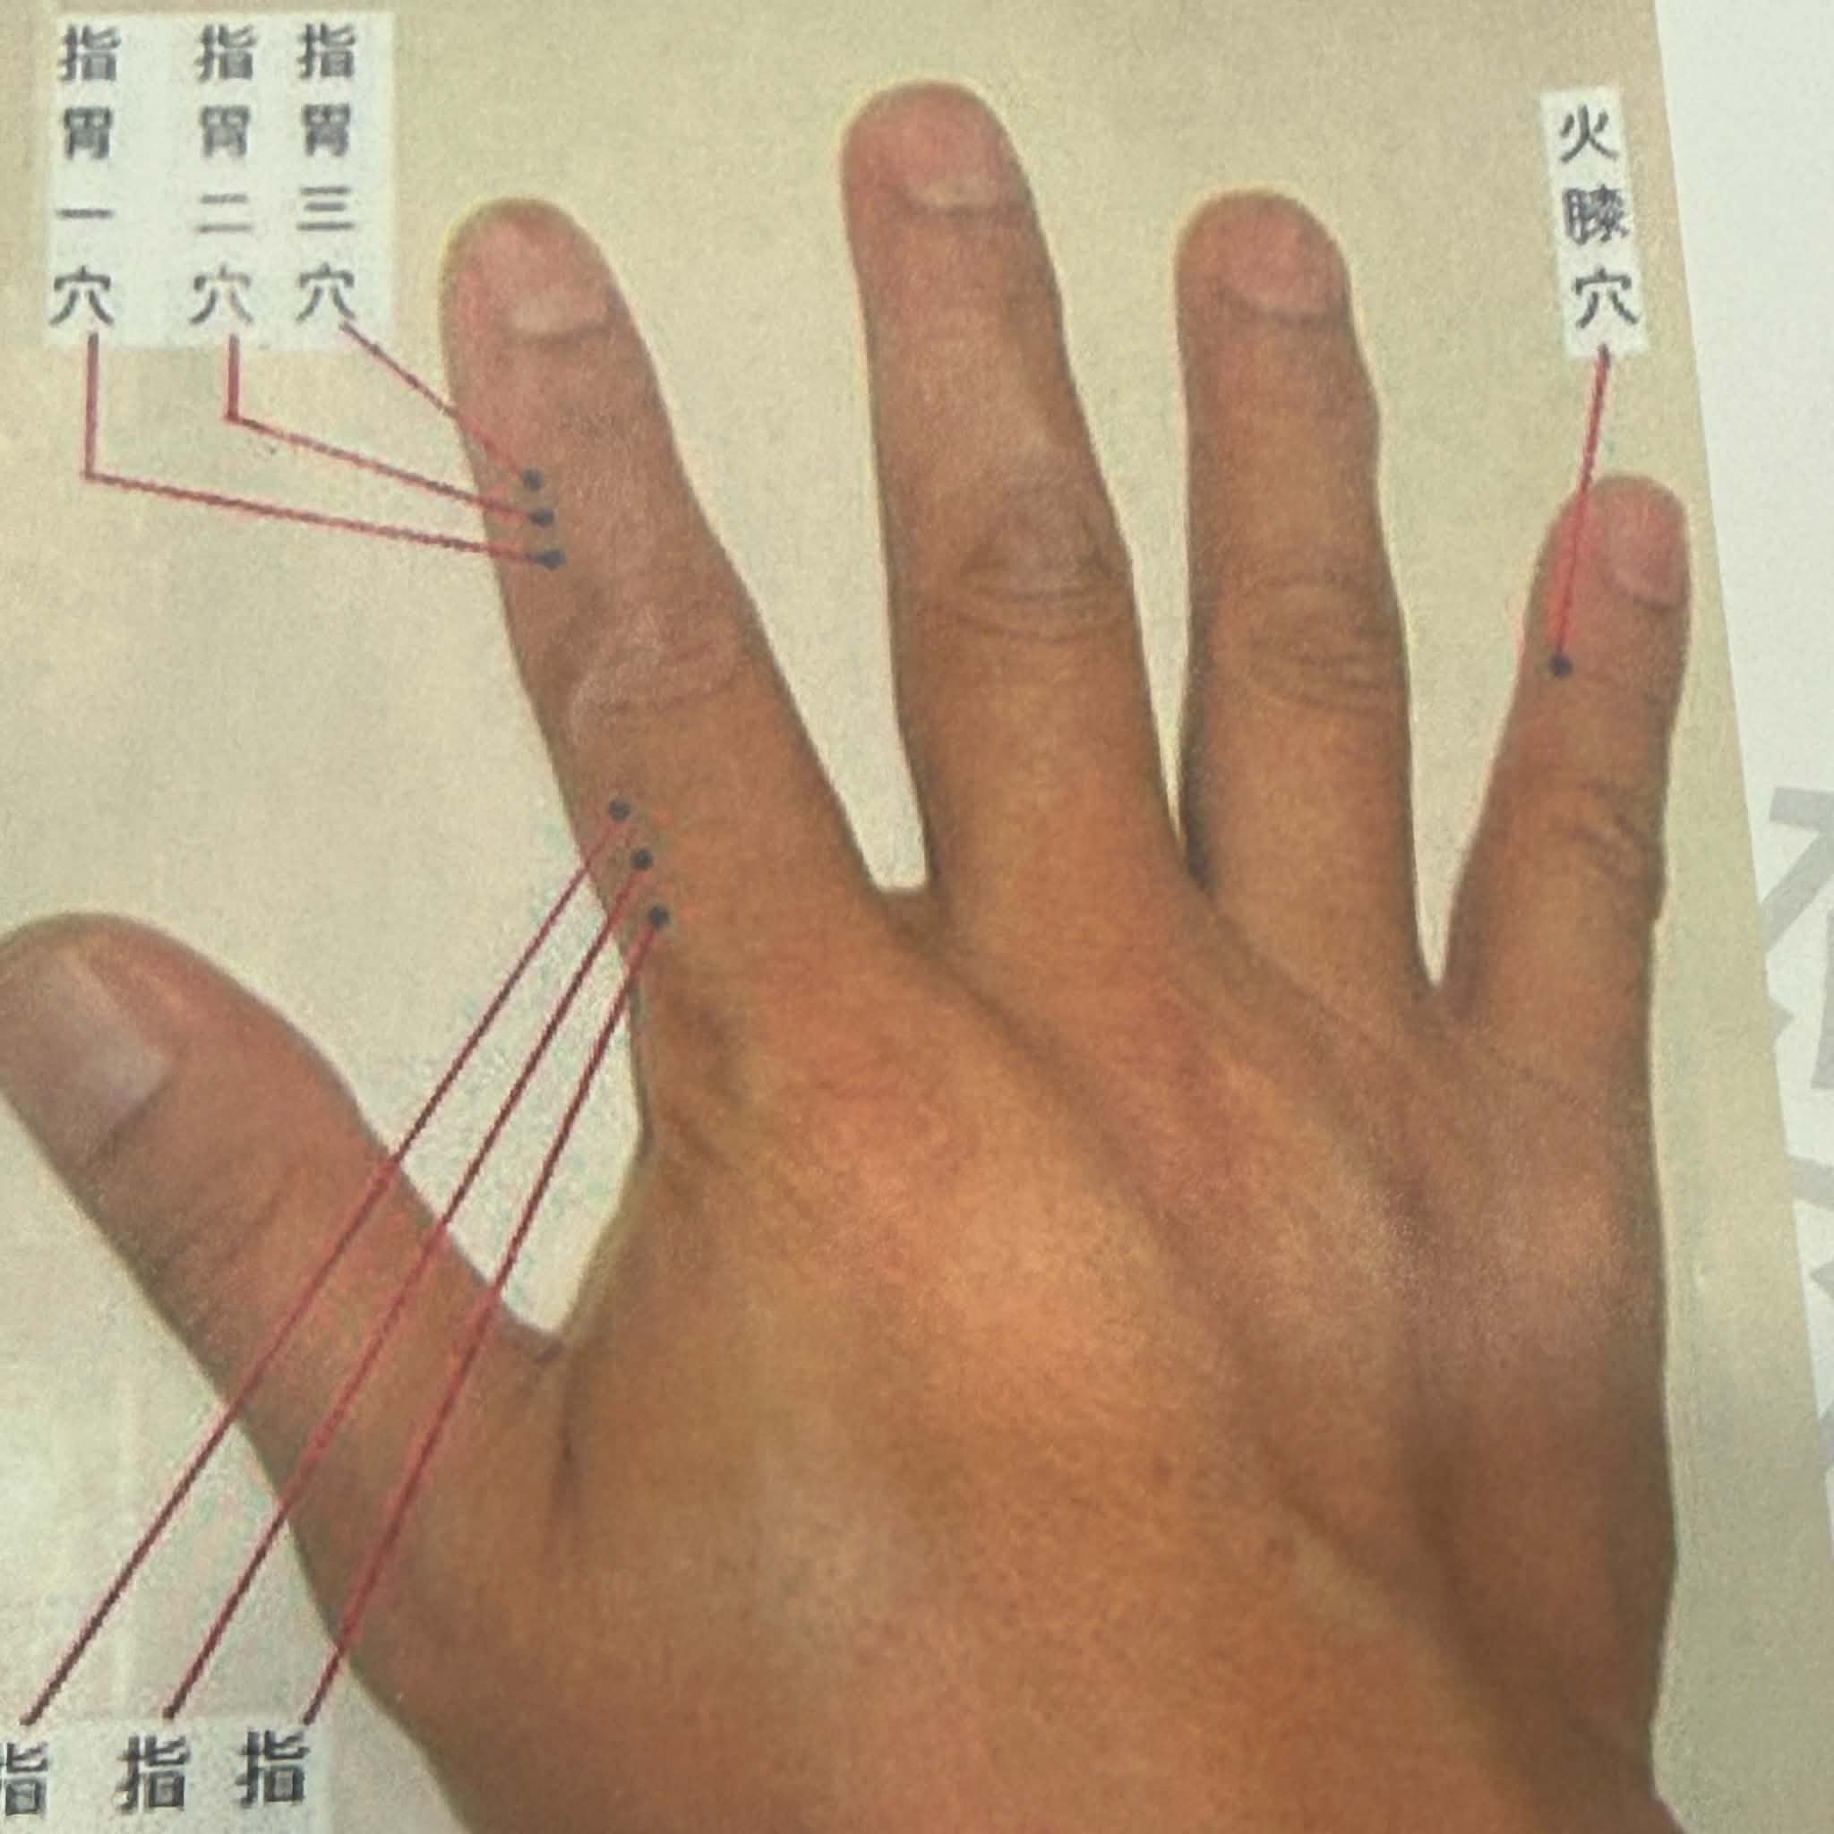
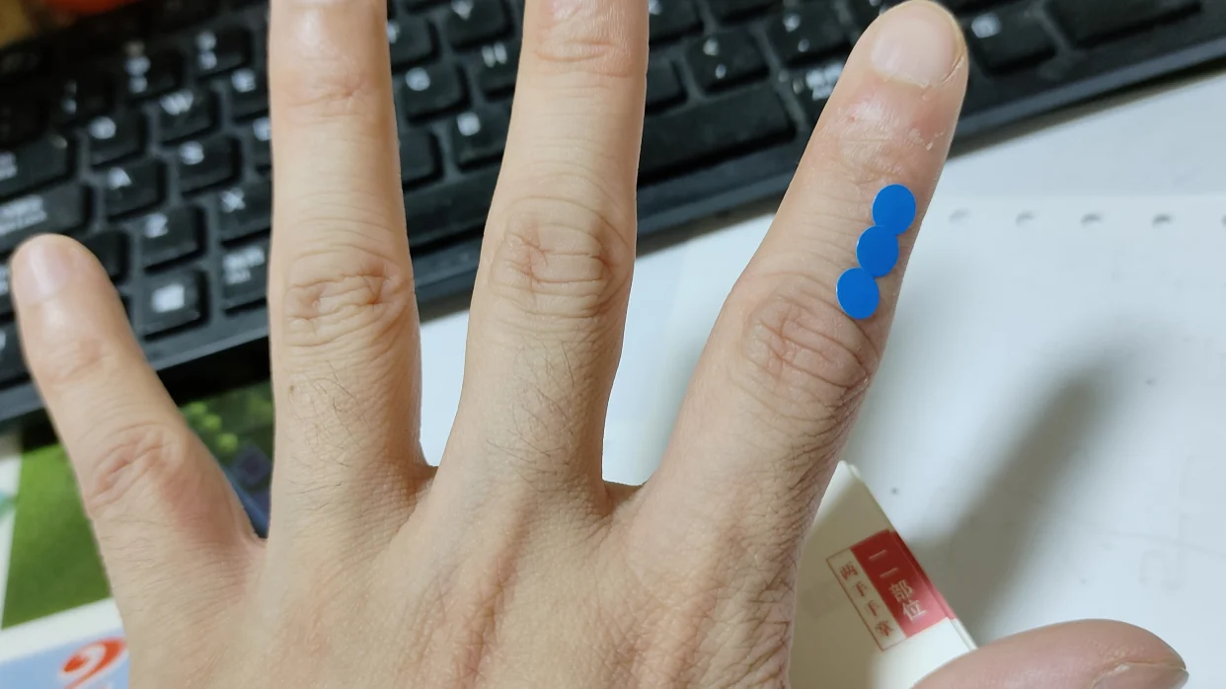

Slide 45
Zhi Wu Jin/ Finger 5 gold
11.08
Lung branch 肺分支神經
Pattern: 肺虛胃冷 (Lung vacuity, stomach cold)
First, lower abdominal pain.There are many causes of abdominal pain; using Zhi Wu Jin and Zhi Qian Jin can all alleviate it.Of course, for specific diseases, we must carry out pattern differentiation and treatment (辨證論治), and treat according to the pattern.
Second, acute and chronic enteritis.The symptoms of acute and chronic enteritis are many, such as abdominal pain, diarrhea, and increased frequency of bowel movements

Slide 46
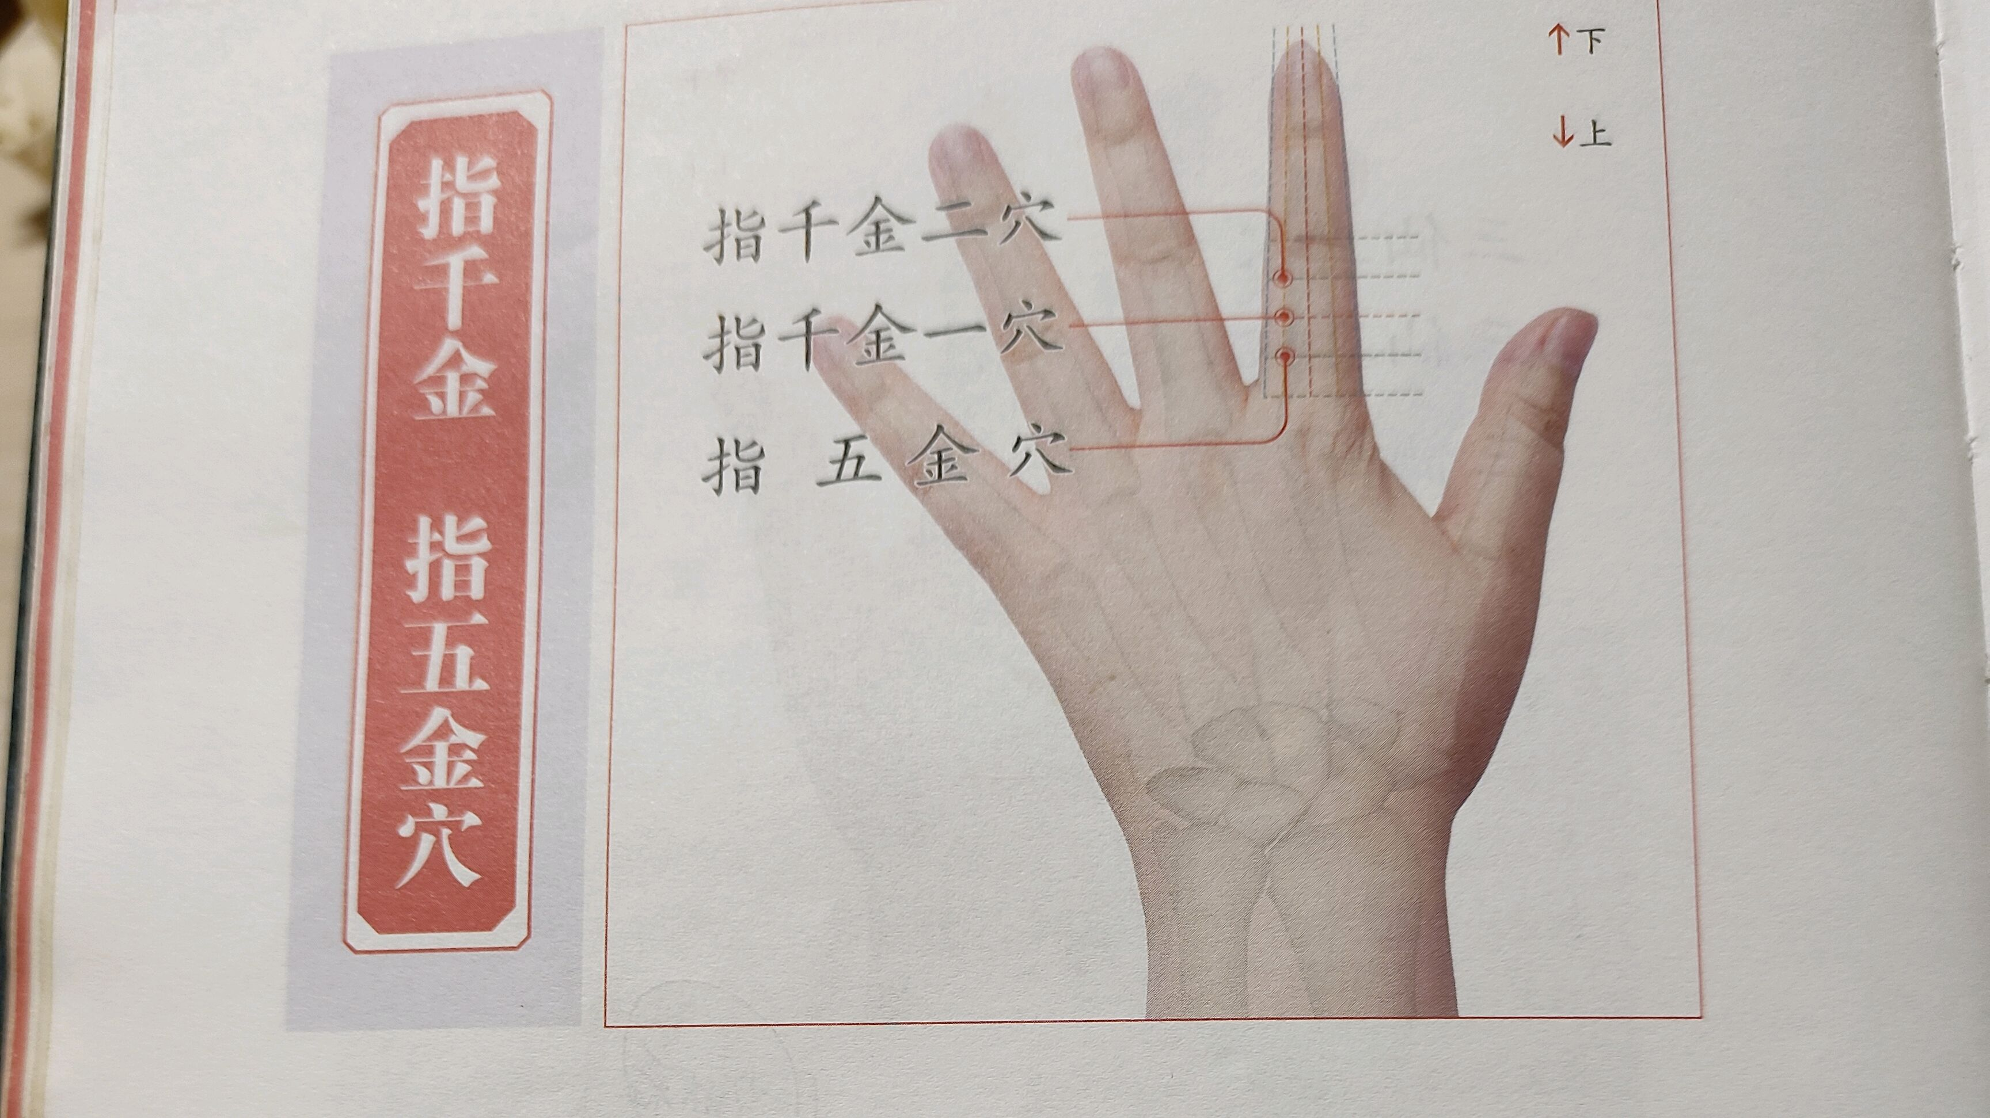

Slide 47
Zheng Tu 正土/ correct earth
Spleen shen jing
Indication: Abdominal pain, intestinal cancer, duodental cancer, gastritis, pancreatitis, vomiting
Often paired with Qi men

Slide 48
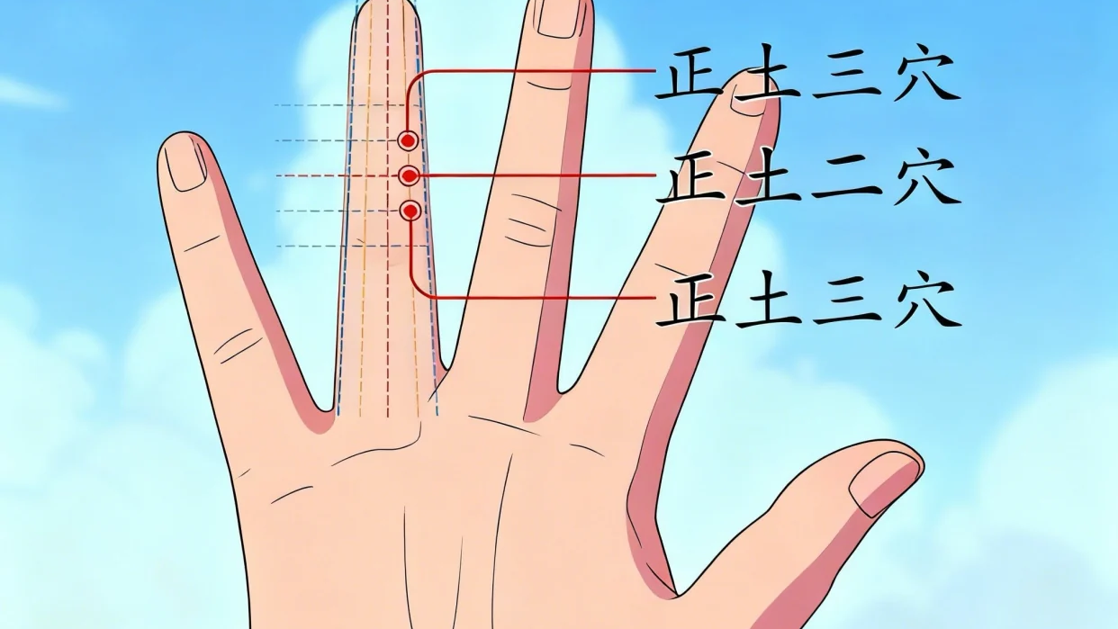

Slide 49
Tu Shui 土水
22.11
Spleen kidney sub-branch shen jing
Location: Palmar surface, at the thumb’s metacarpophalangeal lateral boarder
Functions: Regulate the spleen and stomach, regulate the middle jiao, clear and diffuse lung qi, penetrate the Jing and invigorate the Luo 調理脾胃，調理中焦，清宣肺氣，通經活絡
Indications: whole body bone swelling and pain, periosteal inflammation, sciatica, waist pain, bilateral inner leg muscle pain, acute or chronic gastritis, long-lasting stomach disease, coughing, asthma, tonsilitis 全身骨腫痛，骨膜炎，坐骨神經痛, 腰痛，兩腿内側肌肉痛，急慢性胃炎，久年胃病，咳嗽，氣喘，扁桃腺炎
Lai jin xiong used this point for weight loss

Slide 50
Tu shui bing ji
This point treats Kidney and spleen dual vacuity. The spleen and kidney vacuity lead to lack of engendering and transformation leading to damp water swelling in the limbs and joints, and also weakness of the 4 limbs since spleen governs the limbs. Think of the thumb as relating to the spleen primarily according to Wang Chuan Min.
Liu Yi states to use it when the Spleen pulse in the right guan is weak. Already when there is weakness already in the Spleen taiyin, the Liver wood can overwhelm and cause pain. This leads to a weak wiry right guan. When the liver is invading earth, the lung metal tries to retake order since metal controls wood, hence why this point is in Hand Lung Taiyin
This area according to the postnatal eight trigram 後天八卦 theory in the hand relates to Gen palace 艮宮, which relates to the Tian liu palace 天留 which corresponds to Li chun 立春 （the beginning of spring, i.e. the 1st of the solar terms of the 24 jie qi). This signifies this whole area corresponds to Wind, in particular Violent wind/ Xiong feng 兇風. This is because when there is Kidney and spleen vacuity, the lung is susceptible to wind pathology. Lingshu chapter on the “9 palaces and eights wind 九宮八風“ states that this Xiong feng comes from the northern direction 北方來 , and when it injures people it internally houses in the large intestine 内舍于大腸.

Slide 51
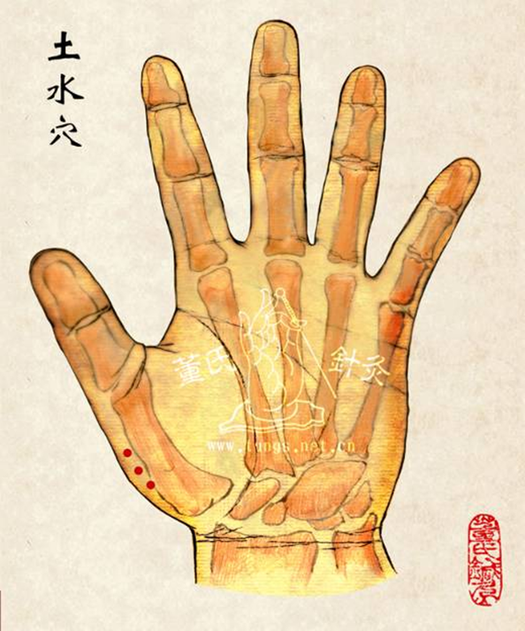

Slide 52
Ling gu, da bai, Zhong bai combo
22.04-22.05, and 22.06 combo
Chronic stomach pain, and stomach ulcer, combine Ling gu, da bai, with zhong bai
Ling gu Da bai- Warm the yang by moving the Qi (In hand yangming)
Zhong bai- Deep weak right guan, for defeated stomach
These three combined, supplement and warm all 5 zang

Slide 53

Dao of Zu san li

Slide 54
Wu dang Daoist, Fei Yi 非遺, on Zu san Li
Zu san li is the lower He-confluence point of the stomach, in humanity is the Center. If humanity lies in the center of Heaven Earth, this is Human harmony 足三里為胃之下合穴，在人為中。 如同人位於天地之中，是為人和。
The Li-interior, is Li-rectification. It can attune and rectify the Qi of Heaven Earth Humanity and the three talents. On account of the stomach location in the middle jiao and governing the center, it serves as the meeting and birth of Above and Below, Heaven and Earth, Yin and Yang, and two qi. Also can [bring] union and peace (Tai hexagram of Heaven below-Earth above) in Heaven Earth, Yin and Yang, and two Qi, by causing Yin and Yang to harmonize without partiality. Zu san li is the earth point of Center earth, is it the point of True earth. Also known as the Lower confluence of the Stomach channel corresponding with the Root bowel of the Stomach. Therefore, this point for the treatment of stomach of disease is the most common point. Its effect excels in treating stomach root bowel diseases. Ling shu chapter 4 states: As for stomach disease, the abdomen swells. The stomach duct at its center has pain. Above propping fullness in the flanks, diaphragmatic and throat obstruction, food and drink cannot descend, choose Zu san li. This is Nei jing is treatment of interior bowels choosing the He-confluent
裡者，理也，可以調理天地人三才之氣。 因為胃位於中焦主中，為上下天地陰陽二氣交合而生，亦能交泰天地陰陽二氣，以使陰陽中和無偏。 足三里為土中土穴，是為真土之穴，又為胃經下合穴，對應胃之本腑，所以此穴為治療胃病最常用的穴位。 其功效長於治療胃本腑疾病。 《靈樞邪氣臟腑病形篇第四》：”胃病者，腹真脹，胃脘當心而痛，上支兩脅，膈咽不通，食飲不下，取之三里也“。 此為內經“治內腑取之於合”。

Slide 55
Zu san li continued
Stomach disease refers to when the stomach root bowel has disease, the disease symptoms lies in the stomch and not in the yangming channel. Abdominal swelling, is the idea of the abdominal region with distention and fullness. That is the region of the middle jiao and stomach cavity have abdominal fullness and uncomfortable (sensation). Suwen chater 5 states: When the clouds turbid qi exists above then it engenders abdominal distention. When the turbid qi properly descends, the clear yang properly ascends. When the stomach’s turbid qi cannot harmonize and descend becoming abdominal distention Can use Zu san li. Zu san li can strengthen spleen and harmonize the stomach. Eliminate food (stagnation) and descend qi, unblocking and descending the acquiescent bowel qi of the intestines and stomach 胃病者，指胃本腑有病，病症在胃而不是在陽明經。 腹真脹，為腹部脹滿的意思，也就是中焦胃脘部位脹滿不舒。 《陰陽應像大論》雲“濁氣在上，則生真脹”。 濁氣當下降，清陽當上升，胃中濁氣不能和降則為腹脹，可取足三里。 足三里可健脾和胃，消食降氣，通降腸胃之腑氣和順。

Slide 56
Zu san li summary
Ling shu chapter 22 states: “When evil in the spleen and stomach, then there is diseases such as pain in the muscles and flesh. When yang qi has superabundance, the yin is insufficient, causing heat in the center and tendency to hunger. When yang qi is insufficient and yin qi has superabundance, it causes cold in the center with intestinal rumbling, abdominal pain. When both yin and yang have superabundance or both are insufficient, it causes sometimes cold sometimes heat, all can be attuned/ regulated with Zu san li.” Evidently, from this passage, regardless if there is yang qi superabundance of yangming, or a hot center of yin qi insufficiency of the spleen channel, or if there is spleen yin qi superabundance, a cold center of yang qi insufficiency of the stomach channel. Or if there is unregulated cold and heat of sometimes cold, sometimes hot, all are appropriate to choose Zu san li. One can observe Zu san li regulates the exterior and interior, spleen and stomach, yin and yang and the cold heat complex caused by a loss of regulation of the center burner’s ascending and descending. San li point can be used to calm it. Zu san li can regulate the Qi of Heaven, Earth, Humanity, and Three talents. This is the most important point to balance yin and yang.
《靈樞五邪第二十》：“邪在脾胃，則病肌肉痛，陽氣有餘，陰氣不足，則熱中善飢；陽氣不足，陰氣有餘，則寒中腸鳴、腹痛；陰陽具有餘，若俱不足，則有寒有熱，皆調於三里”。 從這段經文可知，不管是陽明的陽氣有餘、脾經的陰氣不足的熱中，還是脾中陰氣有餘、胃經陽氣不足的寒中；或有寒有熱的寒熱不調，皆當取足三里。 可見足三里調和表裡脾胃陰陽與中焦升降失調導致的寒熱夾雜，三里穴皆可以平之。 足三里可調和天地人三才之氣，是為平衡陰陽第一要穴。
In Shang han lun prescriptions point pairing 单玉堂伤寒论针灸配穴 from Shan Yu Tang 单玉堂.
Zu san li is often with Guan Yuan, for Yuan qi insufficiency 元氣不足. Zu san Li treating the Postnatal and Guan Yuan treating the Prenatal.
Huang Long Xiang states that Zu san li is the He Sea of the Qi aspect of the San jiao, in addition to being the Lower He sea of the Stomach

Slide 57
Wu dang Daoist on Yang ling quan/ GB 34
Yang ling quan is Shaoyang gallbladder channel’s Yang qi ascending and effusion, Gallbladder is shaoyang, its qi is warm. To then warm yang, and disinhibit water. If one uses the supplementing method, then its effect is like Gui zhi, having an effect of raising yang, transforming water, evaporating and raising to heaven. Its like the Azure dragon of the Eastern direction, bestowing shaoyang the qi of the east ascending rising sun. When the sun ascends, then it can move clouds and distribute rain, evaporating earth’s qi and water qi to ascend upwards transforming and becoming mist.
If one uses the draining method, then one can clear heat and disinhibit damp in the two channels of gallbladder and stomach. Or if treating the damp heat pattern of the warm disease school, the damp heat of Heaven also emerges out of the mist, rain, and damp qi of heaven.
This point supplemented can warm and ascend and moistens from shaoyang. Draining it then cools and ascends and dries from yangming.
“Qian Jing Fang states: Yang ling quan governs enuresis and incontinence, with lack of self-awareness” Enuresis and incontinence is Yang vacuity with lack of transformation of water rheum. Yang ling quan has an effect of warming yang and transforming water.
陽之陵泉者，為少陽膽經陽氣升發（膽為少陽，其氣溫），進而溫陽利水穴，如用補法，則其效如桂枝，有昇陽化水蒸騰於天之功，一如東方之青龍，秉少陽旭日東昇之氣，日昇則能行雲布雨，蒸騰地氣與水氣上升化為雲氣；如用瀉法，則可於膽胃二經清熱利濕，或治療溫病學之濕溫證，天之濕熱者，亦出於天之雲雨濕氣。
此穴補則溫升而潤從少陽，瀉之則涼降而燥從陽明。
《千金方》：“陽陵泉主遺尿失禁不自知。”此遺尿失禁為陽虛不化水飲也，陽陵泉有溫陽化水之功。

Slide 58

Tong Tian 通天
On Foot Yangming channel
Tung channel: Heart commanding zhengjing
Strategy:
The Child can make the mother replete 子令母實
Supplement Earth to Fill Fire 補土實火
Supplement Earth to Hide Fire 補土伏火法

Slide 59
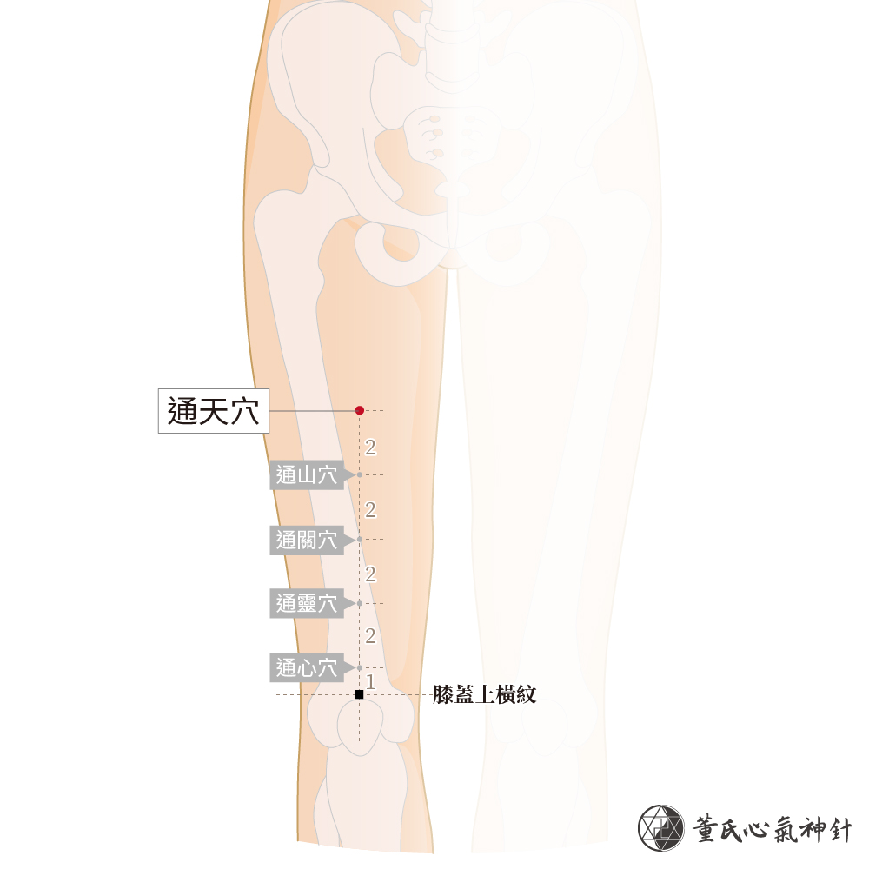

Slide 60
Tong Chang 通腸
Tong Chang 通腸 Penetrate intestine
Unnumbered, set of 3 points. Tong chang yi, Tong chang er, Tong chang san
Location: From Tong Tian go superior 1 cun and laterally 5 fen, that’s Tong Chang Yi. Tong chang er is 2 cun above. Tong chang san is another 2 cun above.
六腑神經、心肺交叉神經。Six bowel shen jing, heart and lung intersecting shen jing
Indications: Acute enteritis, constipation, stomach pain, high blood pressure, palpitations, costochondritis, peritonitis, nasal obstruction, sinusitis.
主治：急慢性腸炎、便秘、胃痛、高血壓、心悸、肋膜炎、腹膜炎、鼻塞、鼻炎

Slide 61
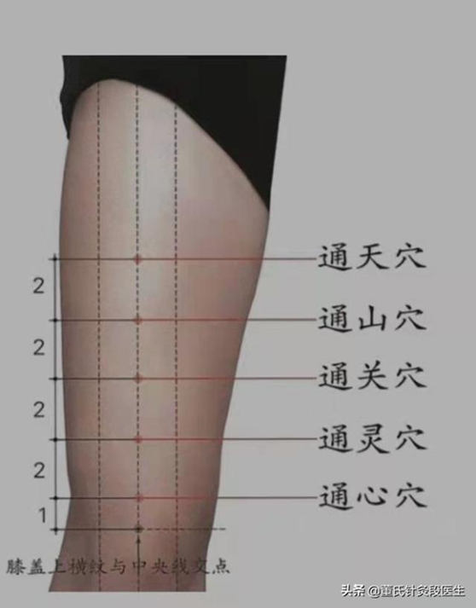

Slide 62
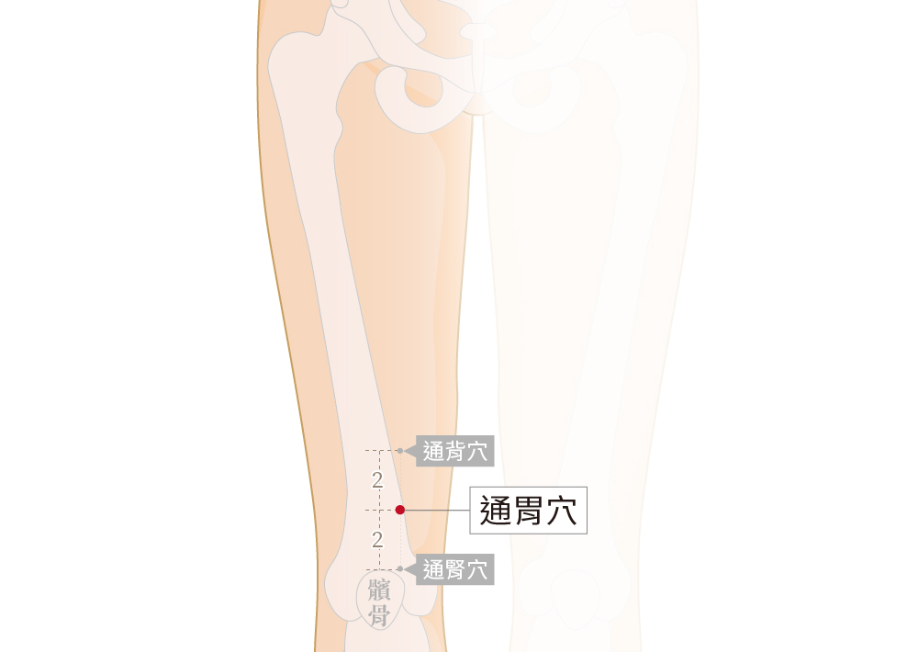
Tong Wei 通胃
Penetrate Stomach
The underlying mechanism since its in the spleen vessel is Qi deficiency, that has led to damp heat to sink below, affecting kidney metabolism leading to yin deficiency.
This is a common complex pattern we see in diabetics for example.
Kidney heat can float upward and disturb the stomach

Slide 63
Tong wei commentary
Dr Liu Yi (Wang Chuan Min) disciple looks at this points as revving up a “fluid engine 津液發動機.”. This siginifies that though the mouth might be dry, the whole-body skin might be peeling 脫皮, the cause might be spleen damp flooding 脾濕汎濫. This spleen damp then sinks due to underlying 氣虛, the damp mixes with the mingmen of the kidney becoming damp heat and then obstructing the kidney’s fluid metabolism.

Slide 64
Chang Men 腸門
Chang men functions: Course and drain the intestines 疏洩腸腑。
Ganmen functions: Course the liver and regulate the qi 疏肝理氣
Xin men functions: Unobstruct the heart luo 通暢心絡
Indications:
Chang men: Acute or chronic inflammatory bowels/ colitis, head dizziness, blurry vision, cholecystitis, nausea or vo,iting 急慢性腸炎，頭暈眼花，膽囊炎，嘔吐
Gan men: Acute hepatitis (special effect) Acute or chronic gastritis and colitis, chest oppression, chest pain, flank pian, inner leg pain (instantly eliminated) 急性肝炎 （特效）急慢性胃腸炎，胸悶，胸痛，兩脅痛，腿内側痛 （立除)
Xin men: Heart disease, pericarditis, palpitations, chest oppression, nausea and vomiting, liver cholera 心病, 心臟内膜炎，心悸亢進，胸悶嘔吐，肝霍亂

Slide 65
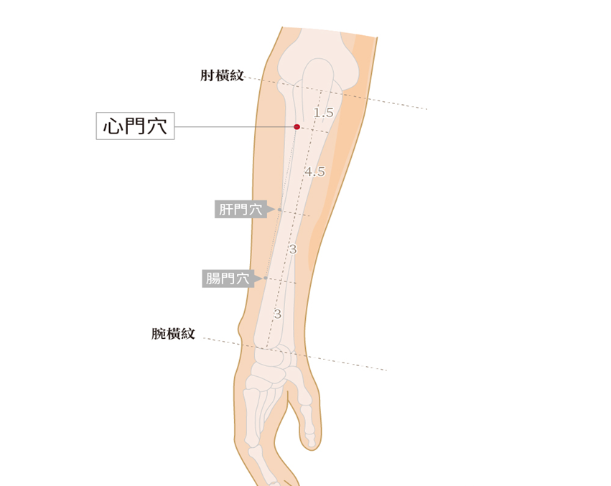

Slide 66
San Qi 三其
San qi is between Hand shaoyang and Hand Yangming. And since this Hand yangming large intestine shares an exterior interior relationship with the Lung, it is assigned with a Lung branch zheng jing, as well as having its 用 functions targeting. Therefore to diagnose San qi pathology we look to the right cun (slippery and forceful).
San qi treats Damp heat disease that is affecting that is the Lung, or large intestine as in lower dampheat (consuming qi) 下焦濕熱（耗氣). This consuming qi signifies that it will lead to Qi exhaustion.

Slide 67
San Qi continued
San qi is described by Liu Yi as a Sagely point to discharge toxin 排毒聖穴. Due to modern lifestyle of rich food, psychological stress, nervousness, pressures, excessive taxation, overeating, all resulting in qi stagnation and blood stasis, and food accumulation damp toxin. It also treats phlegm rheum and water damp toxin.
San qi has the nature of Wood Fire 木火之性 reflecting San qi type of diseases: Red white leukorrhea, constipation, hemorrhoidal pain.
San qi has 3 layers to its function:
1. Lung large intestine connection and diseases- Lung branch nerve
2. Draining san jiao fire and large intestine depending on needle technique
3. Balancing wood fire causing Lung calmness 木火平則肺安 (Azure Dragon and Vermillion bird affecting the Western White Tiger)

Slide 68
San qi precautions
Do not use 3 needles, often only need one needle, sometimes can use two needles.
The needle direction is 平刺 transverse to the skin, using a slanted/ oblique insertion 斜刺 parallel to the skin, 2-5 fen deep.
when needled from yangming to shaoyang it can treat acute hemorrhoids and rectal prolapse by draining the fire qi of shaoyang and large intestine yangming, this includes gastroenteritis and red white leukorrhea. Best for gynecological illnesses with abdominal distention.
When needled to hand shaoyang it drains san jiao fire, look for a slippery right chi, for large intestine fire needle toward Yang xi (LI 5- the fire point), one is going against the channel 迎瀉針法. One can also slightly bleed 微出血

Slide 69
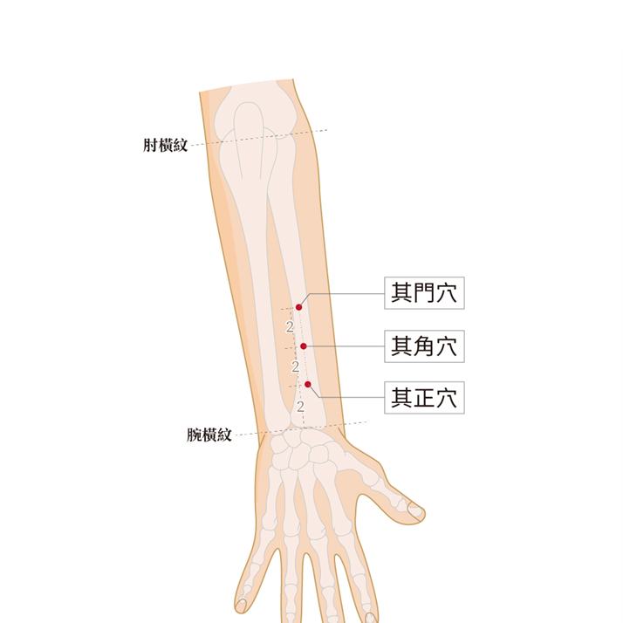

Slide 70
Tu Wei 土胃/ Earth stomach
Spleen Shenjing
Tǔ Wèi 1: On the palmar aspect of the forearm, 2 cun directly distal to Shaohai (HT3) from the elbow crease.
Tǔ Wèi 2: On the palmar aspect, 4 cun below Shaohai (HT3), or 2 cun below Tuwei
Tǔ Wèi 3: On the palmar aspect, 6 cun below Shaohai (HT3), or 2 cun below Tuwei 2.
Indications: Disorders of the digestive system, including gastritis, gastric ulcer, duodenal ulcer, colitis, and related conditions.
This is on the Hand shaoyin, near the water point, therefore this is a Shaoyin fire affecting the stomach. Think of the formula Huang lian ejiao tang or Yu Nu Jian

Slide 71
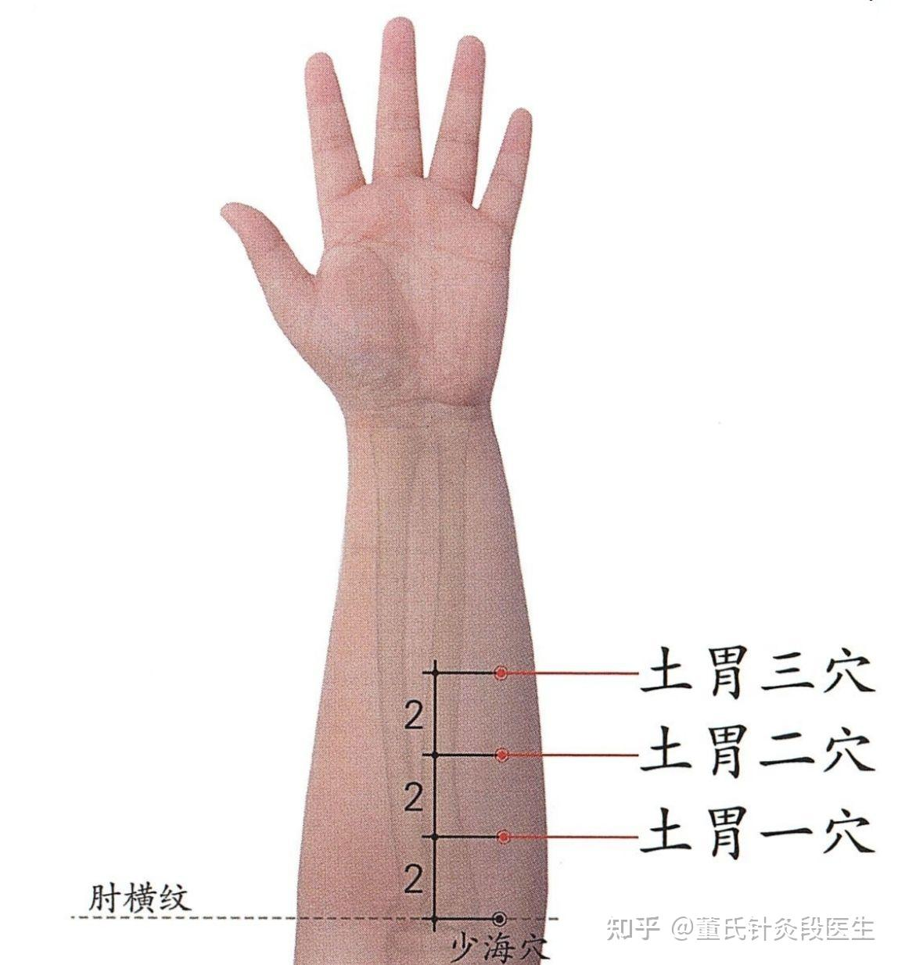

Slide 72
Men jin 門金
66.05
Shenjing: Duodenum shenjing, Stomach branch shenjing, uterus shen jing
Location: At the lower junction between the second and third metatarsals. 4 fen posterior to Xian gu (stomach 43).
Indications: Throbbing pain of menstruation from beginning to end (special effect), labor pains (special effect), enteritis, gastritis, abdominal swelling, abdominal pain, appendicitis 月經前後抽痛陣痛（特效）、腸炎、胃炎、腹部發脹、腹痛、盲腸炎

Slide 73
On Men Jin
The golden aspect represents Wu yun liu qi theory of Yangming’s metal qi 金氣, where the Gate represents the entrance of the Gu shen 穀神/ Grain-spirit.
Hence, Men jin structure lies in Foot yangming/ Stomach and its functions lies in the depurative downbearing of metal qi.
Men Jin is often needled with Xian gu (Stomach 43), i.e. descending valley. Zhen jiu da cheng 針灸大成 states that Xian gu treats Facial and eye swelling, and water disease, tendency to belch, rumbling intestines, abdominal pain, excessive heat disease, sweat without rising, and trembling cold malaria.
Xian gu is the Wood point, when yangming does not descend, metal does not control wood so wood ascends leading to surge of yang qi.
Men jin can affect the intestinal mobility, when the intestines or digestion is compromised it alters the immunological system affecting the brain. Men jin can even change’s one brain chemistry by descending the turbid.
Stomach governs the decent of the turbid. Immunoneuroendocrine effect

Slide 74
Liáng qiū (梁丘) Beam Mound
Stomach 34- Xi cleft of the stomach
Acute gastric pain, combine with Diji (Spleen 8, Xi cleft) for bleeding.
Rectal bleeding, combine with Kong Zui (Lung 6)

Slide 75
San mao 三毛
San Mao= Three Hairs
Lung branch shen jing, stomach intestines shen jing
Location: Palm facing up, in the center of the second metacarpal joint is San mao er, 5 fen distally is San mao yi. 5 fen promixal is San mao San.
Indications: Stomach ulcer, duodenal ulcer, gastric cancer, tuberculosis, lung cancer, nose cancer, bronchitis, asthma, tonsilitis, lung disease 胃潰瘍，十二指腸潰瘍。胃腺癌，肺結核，肺癌，鼻癌，支氣管炎，氣喘，扁桃腺炎，肺病
Note from Hu Wen Zhi: Can choose points from both sides, choose to needle the location where the coloring is green blue for extraordinary effect. San mao is in the lung line is close to the stomach and duodenum aspect of palm diagnosis. This represents stomach and large intestine disease that is affecting the lung. Good for gastritis that affects the skin, combine with San xian (Three immortals, see dermatology lecture)

Slide 76
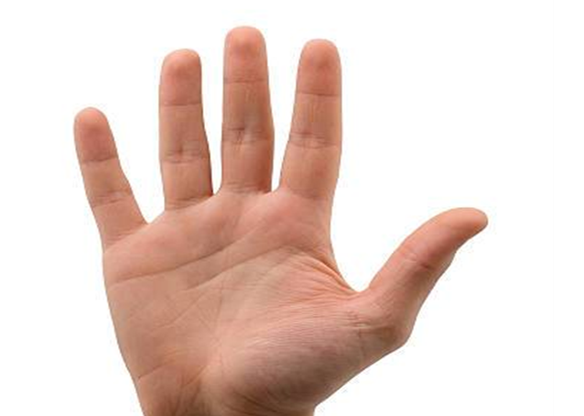

Slide 77
Cooling the abdomen
22.21 and 22.22 (One of the 72 resolving points)
Upper Tall and Lower Tall
Shenjing: Kidney and Brain shen jing
Location: 5 fen proximal to Shou jie er is Shang gao. 1 cun proximal is Xia gao.
Functions: Course the channels, regulate the qi, supplement kidney and harmonize stomach 疏經調氣，補腎和胃
Indications: Costal membranitis, peritonitis, appendicitis, ovaritis, acute small intestine inflammation, increases height 肋膜炎、腹膜炎、盲腸炎、卵巢炎、急慢性小腸炎、增高
Special effect for Peritonitis. Also has the function of promoting pituitary gland, growth hormone and cerebral cortex excretion, therefore increasing height 同時具備促進腦下垂體、生長激素、腦神經皮質分泌之作用，故又可以增高. Best results are between 16-20 years old, after 20 chances become smaller. Twenty times of treatment can increase height 5-10 cm.
下針二十次約可增高五～十公分，有六成機率，超過二十歲以後，效果較小。十六歲～二十歲效果最好。

Slide 78
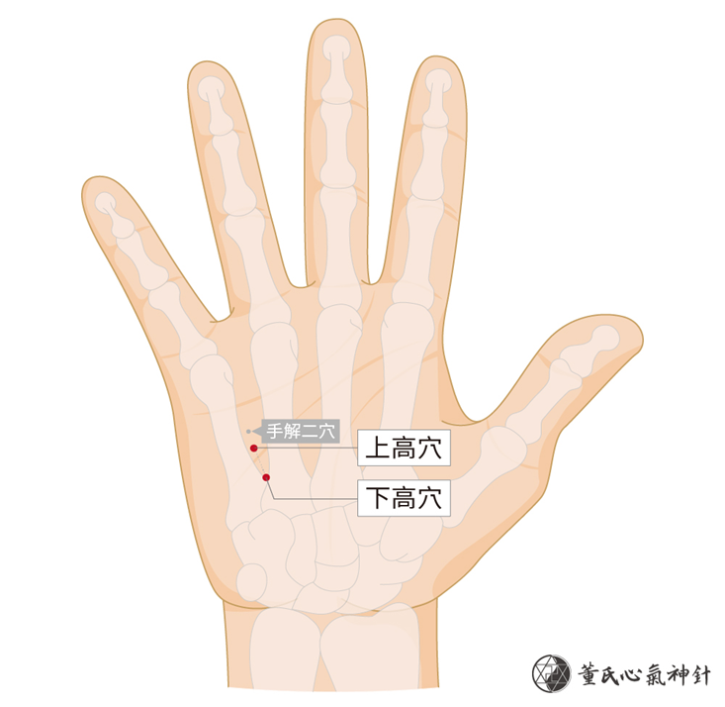

Slide 79
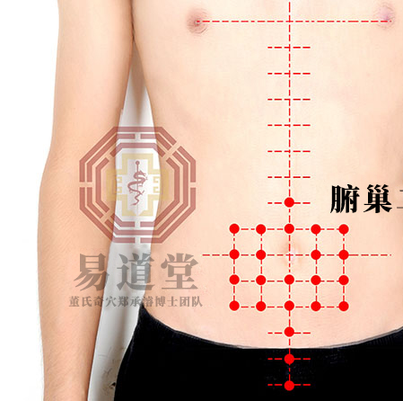
Fu chao 腑巢
Direct treatment of the abdominal membranes

Slide 80
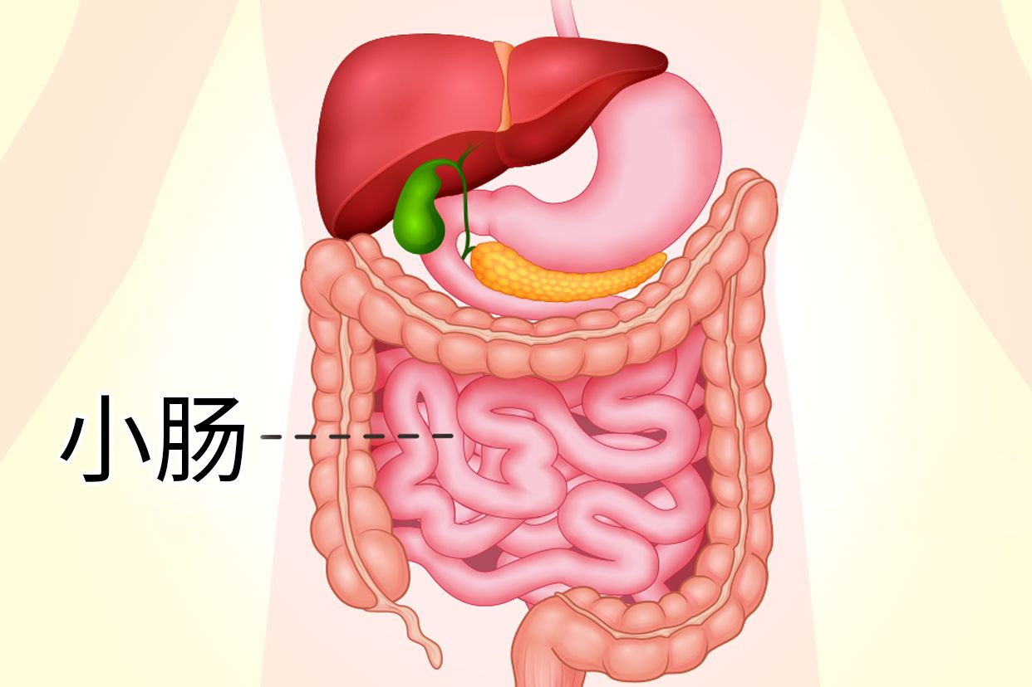
Jin Gui on the intestines
When there is cold in the large intestine, it often results in duck stools/ watery. If there is heat, the stool becomes sticky and malodorous. When cold affects the small intestine, the person experiences a sensation of heaviness in the lower abdomen with bloody stools; when heat is present, hemorrhoids will inevitably occur. 大腸有寒者，多鶩溏；有熱者，便腸垢。小腸有寒者，其人下重便血，有熱者，必痔

Slide 81
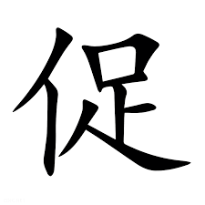
Ge gen qin lian tang
Yangming-shaoyang
太陽病，桂枝證，醫反下之，利遂不止。脈促者，表未解也；喘而汗出者，葛根黃連黃芩湯主之。
In Taiyang disease with Gui Zhi syndrome, if the physician mistakenly administers precipitation, diarrhea will persist without stopping. If the pulse is rapid (cu), it indicates that the exterior pattern has not resolved; In cases of panting with perspiration, Ge Gen Huang Lian Huang Qin Tang is the principal treatment.
Ge gen 24, Zhi gan cao 6, Huang qin 9, Huang Lian 9

Slide 82
Huang qin tang 黃芩湯
Shaoyang
太陽與少陽合病，自下利者，與黃芩湯；若嘔者，黃芩加半夏生薑湯主之。
When Taiyang and Shaoying diseases combine, and spontaneous diarrhea occurs, Huangqin Tang should be administered; If vomiting is present, Huangqin Jia Banxia Shengjiang Tang governs
Huang qin 9, Bai shao 6, Zhi gan cao 6, Da zao 6
傷寒脈遲六七日，而反與黃芩湯徹其熱。脈遲為寒，今與黃芩湯，復除其熱，腹中應冷，當不能食；今反能食，此名除中，必死。
In shanghan, a slow pulse for six or seven days, yet followed by administration of Huangqin Tang to elimiante the heat. A slow pulse indicates coldness; now, administration of Huangqin Tang has eliminated the heat, so the abdomen should be cold and appetite lost; if there is instead an ability to eat, this is called Eliminated center/ chu zhong, inevitable death (CONFUSION of Jueyin for Shaoyang)
Treatment should have been Gan jiang Huang Qin Huang Lian Ren Shen Tang (line 359), 3 liang across

Slide 83
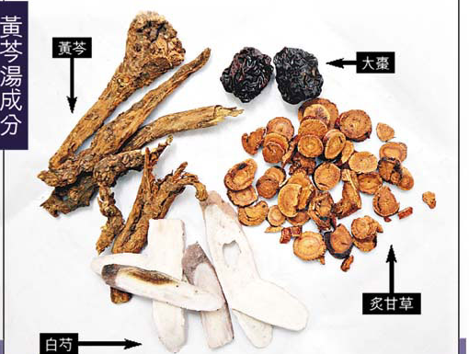

Slide 84
Yi Yi Fu Zi Bai Jiang San 薏苡附子敗醬散
Primary Taiyin- secondary Yangming
腸癰之為病，其身甲錯，腹皮急，按之濡如腫狀，腹無積飛，身而熱，脈數，此為膿內有癰膿，薏苡附子敗醬散主之。
The disease of intestinal abscess is characterized by a dry and rough skin, taut abdominal skin, softness upon palpation as if there were swelling, no accumulation or obstruction in the abdomen, fever with hot body, rapid pulse. This indicates pus inside; it is treated with Yiyi Fuzi Baijiang San (Job's tears, fuzi, and patrinia herb powder).
Yi Yi Ren 10 (go up to 30 for pus), Fu zi 6 (30 for cold), Bai jiang cao 5 (can go up to 15)
+Fu zi li zhong wan (if pronounced diarrhea)

Slide 85
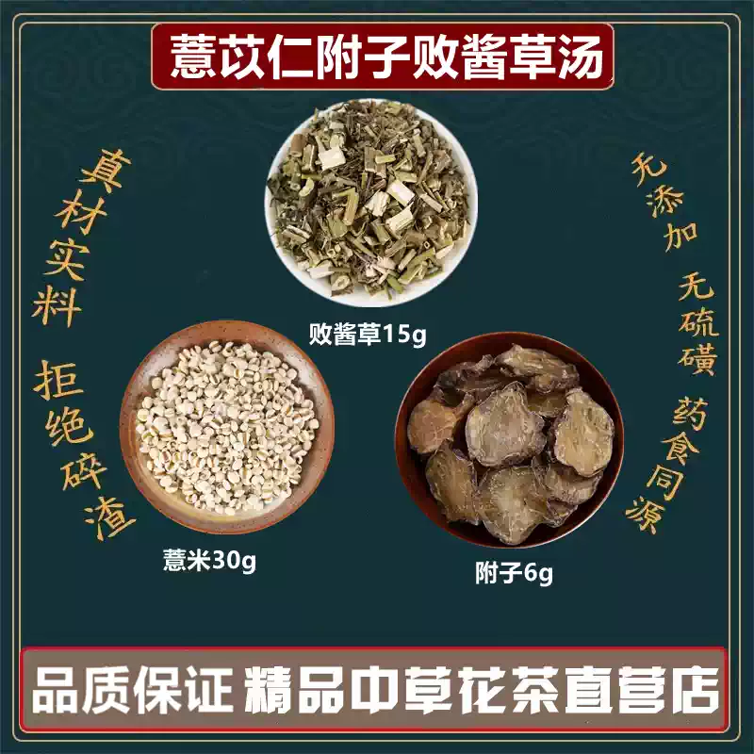

Slide 86
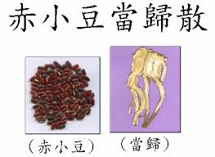
Chi xiao dou dang gui san 赤小豆當歸散
Blood stasis with heat
病者脈數，無熱微煩，默默但欲臥，汗出。初得之三四日，目赤如鳩眼；七八日目四眥黑。若能食者，膿已成也。赤豆當歸散主之。
The patient's pulse is rapid; there is no heat effusion but slight vexation, desire to only sleep, and sweating. In the initial stage of three or four days, the eyes appear red like those of a turle dove (think ren 15/ jiu wei). After seven to eight days, the whites of the eyes turn black. If the patient is able to eat, pus has already formed. Chidou Danggui San governs
Chi xiao dou 48, Dang gui 9

Slide 87

Bai tou weng
白頭翁
Jueyin-Yangming
Bai tou weng 6g, Huang bai 9, Huang Lian 9, Qin Pi 9
熱利下重者，白頭翁湯主之。
For hot-type diarrhea with a sensation of heaviness in the rectum, Baotouweng Tang governs
下利，欲飲水者，以有熱故也，白頭翁湯主之
When there is diarrhea with a desire to drink water, this means there is heat. BTW governs
If there is extreme vacuity (and bleeding), add Gan cao and Ejiao

Slide 88

Tao hua tang
桃花湯
少陰病，下利便膿血者，桃花湯主之。
In Shaoyin disease where diarrhea with pus and blood occurs, Tao Hua Tang (Peach Blossom Decoction) is the recommended treatment.
Chi shi zhi 48, Gan jiang 3, Jing mi 30

Slide 89
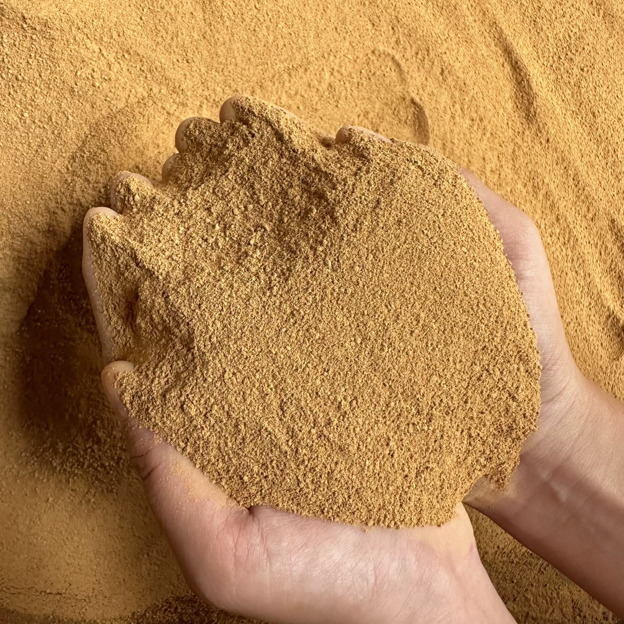
Huang Tu Tang
黃土湯
Jueyin complex disease
When lower body bleeding manifests in bleeding after defecating, this is distal bleeding
下血，先便後血，此遠血也，黃土湯主之
Huang Tu 24, Fu zi, Sheng di, E Jiao, Bai zhu, Huang qin, Gan cao 9

