Slide 1
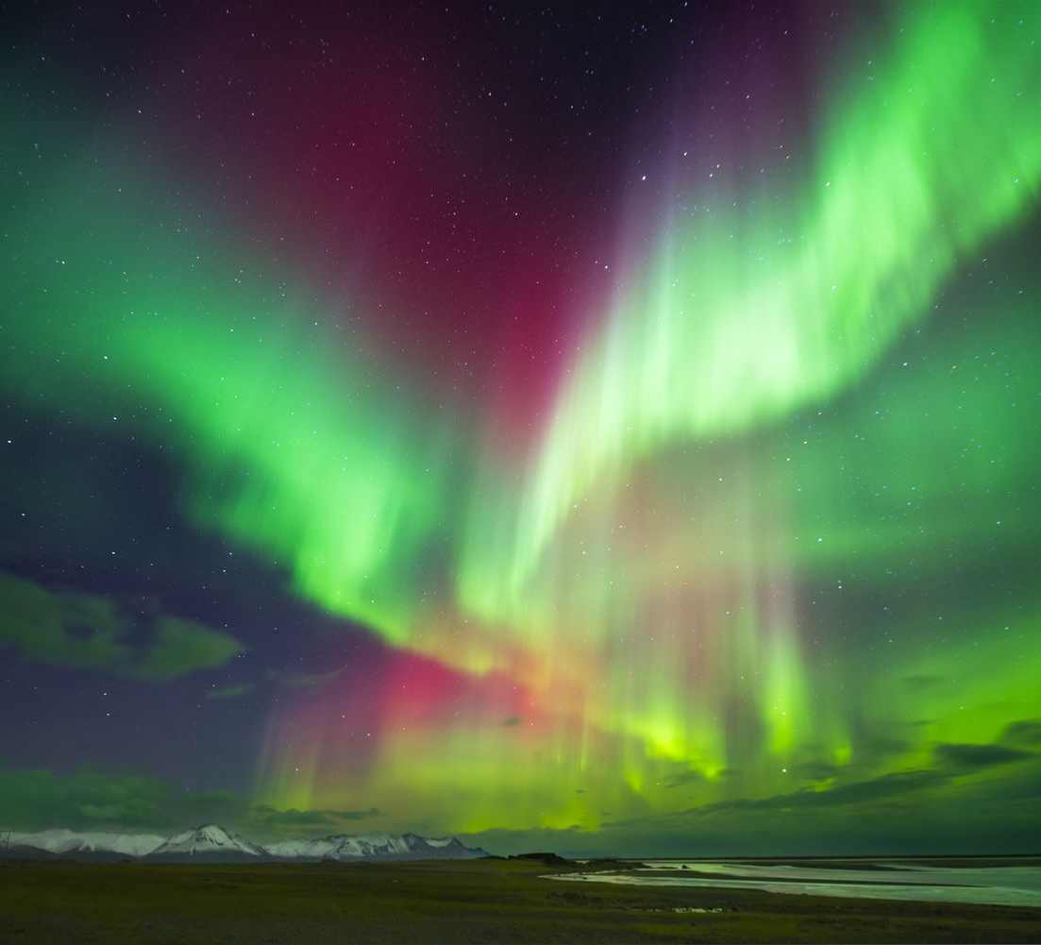
Lupus Erythematosus & Sjögren Syndrome
Autoimmune Series Part 2
By
Ivan Zavala L.Ac, DCCM

Slide 2
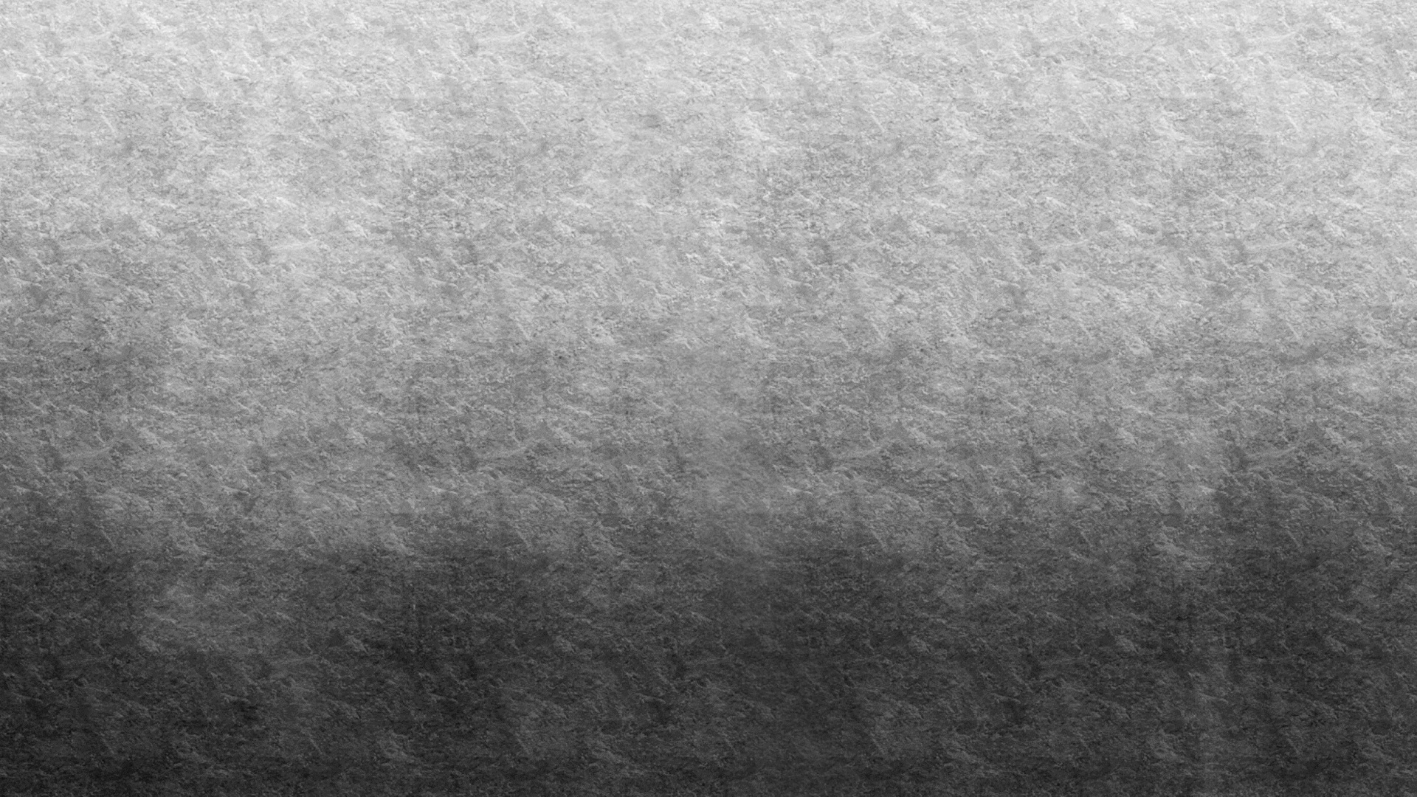

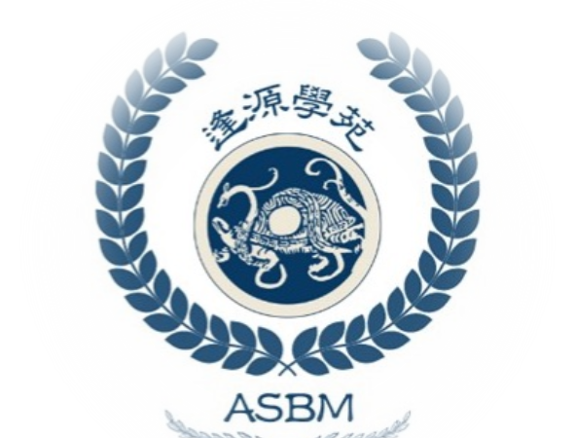
THANKS
Global Branches for Hosting this Class, please check out other classes that I’ve done for GB.
Foundational Tung acupuncture pathomechanism
Classical Acupuncture treatment for Andrology
Classical Acupuncture treatment for Stroke
5-part Autoimmune series
Also be sure follow me on:
1. Ivan Cloud (FB page) and
2. Academy of Source Based Medicine on Instagram and our personal educational platform: https://asbmcm.thinkific.com/

Slide 3
Disease names
Lupus:
紅斑性狼瘡 / hóngbānxìng lángchuāng
Full term:系統性紅斑性狼瘡 (xìtǒngxìng hóngbānxìng lángchuāng)= Systemic Lupus Erythematosus (SLE)
Literal meaning 紅斑/红斑 = red rash (erythema)性 = suffix denoting nature/type. 狼瘡/= "wolf sore" old term based on the disfiguring facial rash that resembles a wolf bite
Sjögren’s:
乾燥綜合徵/ Gānzào zōnghézhēng.
Literal meaning 乾燥/干燥 = dryness. 綜合徵= syndrome.
Thus, “乾燥綜合徵” means “dryness syndrome,” describing the key symptom of Sjögren’s.
Also 舍格伦氏症 (shěgélún shì zhèng) Sometimes used to mimic the name "Sjögren" phonetically

Slide 4
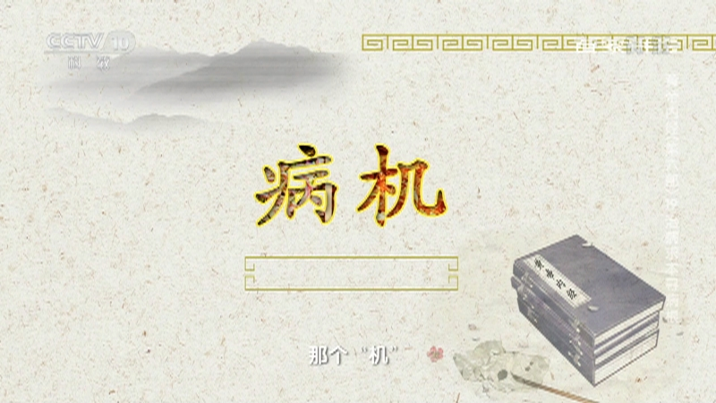
Western Pathophysiology of Lupus
Systemic Lupus Erythematosus (SLE) is primarily a Type III Hypersensitivity (immune complex-mediated), but there is also Type II Hypersensitivity (autoantibodies against cell-surface antigens)
There is loss of self-tolerance due to genetic susceptibility (e.g., HLA-DR2/DR3, human leukocyte antigen (HLA) class II alleles that are strongly associated with an increased risk of developing various autoimmune diseases). As well as environmental triggers (UV light, viral infections, medications).
Defective clearance of apoptotic cells → nuclear antigens (e.g., DNA, histones, ribonucleoproteins) are exposed to the immune system.
Autoantibody formation: ANA, anti-dsDNA, anti-Sm, antiphospholipid antibodies.
Immune complex formation: Circulating antigen-antibody complexes deposit in tissues (skin, kidneys, joints, etc.), activating complement and triggering inflammation.
Complement deficiency (C1q, C4, C2) may worsen clearance of immune complexes. This is where the body lacks sufficient levels of certain complement proteins, which are crucial for fighting infections

Slide 5
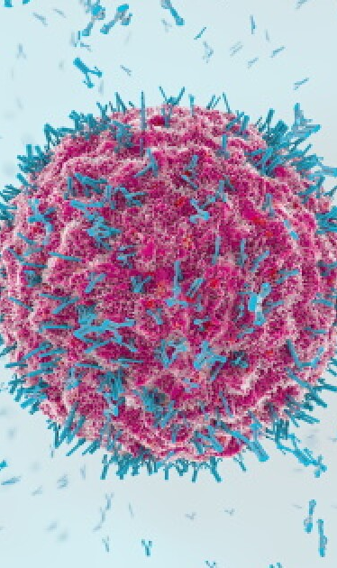
Antibody testing
Many of the antibodies are used to confirm a specific Lupus diagnosis
Anti-nuclear antibodies (ANA): 98% of people with systemic lupus have a positive ANA test, making it the most sensitive diagnostic test for confirming lupus diagnosis. Most sensitive (98% of SLE cases). Positive in many autoimmune diseases; not specific to SLE. A screening test. If negative, Lupus is unlikely
Anti-double-stranded deoxyribonucleic acid (Anti-dsDNA): This refers to antibodies against the genetic material of the cell.. Specific for SLE. Associated with lupus nephritis. High titers suggest active disease.
Anti-Sm: This may occur in people with lupus. Highly specific for SLE. Seen in 30% of SLE patients. Rare in other disease
Anti-U1 ribonucleoprotein (RNP): This antibody occurs in autoimmune diseases, including lupus. Found in SLE and Mixed Connective Tissue Disease (MCTD). Not specific to SLE alone. often coexists with other antibodies.
Anti-Ro/SSA and anti-La/SSB: If these antibodies are present, it can indicate that someone is having lupus complications. Present in SLE, but also in Sjögren's syndrome. Associated with photosensitivity, subacute cutaneous lupus, neonatal lupus, and congenital heart block.
Anti-histone antibody test: Detects the presence of anti-histone antibodies in the body, which mistakenly target histones, essential components of DNA. Seen in drug-induced lupus over idiopathic SLE. Especially high in hydralazine-, procainamide-and isoniazid-induced lupus. Also found in some idiopathic SLE cases.

Slide 6
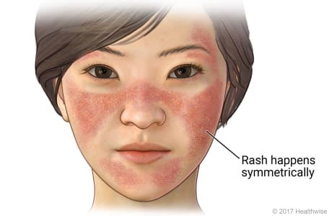
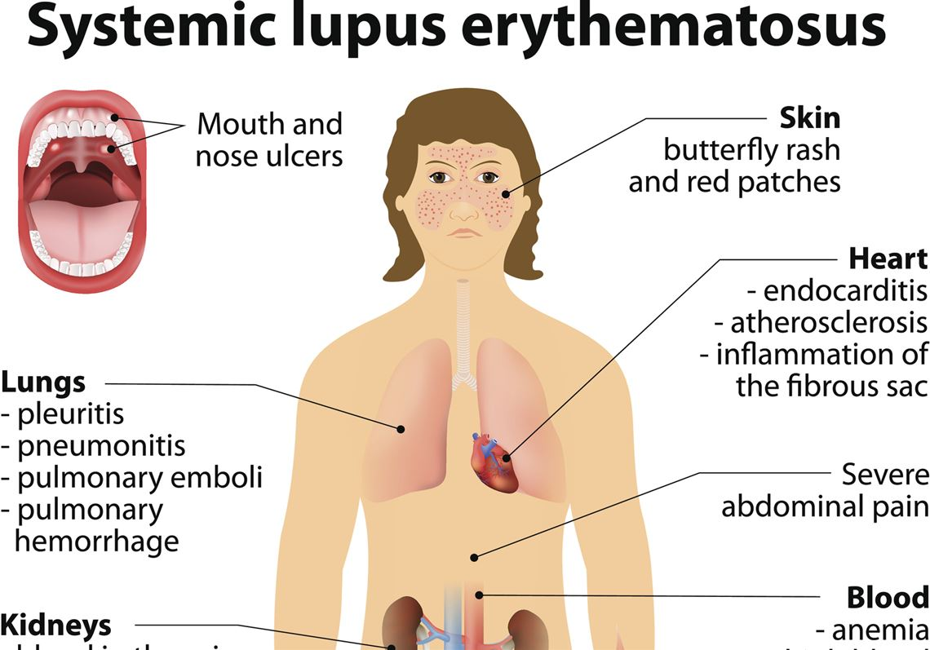
Lupus symptomatology
Lupus affects the body systemically
Skin: butterfly rash, photosensitivity
Kidneys: lupus nephritis
Joints: non-erosive arthritis
CNS: seizures, psychosis
Blood: cytopenias from autoantibody-mediated destruction, etc
Lungs: Pleural effusion, etc
Heart: Endocardits, etc

Slide 7
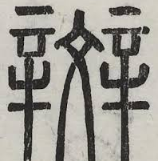
Bān/ 斑 Macule
紅斑 (hóng bān) – erythema, red macule
紫斑 (zǐ bān) – purpura, purple macule
丘疹斑 (qiū zhěn bān) – maculopapular rash
麻疹樣斑 (má zhěn yàng bān) – measles-like macules
Often involved in the Blood layer 血分. Think of the formula, Hua Ban tang 化斑湯 from the Wen bing tiao bian
Ingredients: Shi Gao 30g, Zhi Mu 12g, Sheng Gan Cao 10 g, Xuan Shen 10g, Shui niu Jiao 30-60 g, Jing Mi 9 g.

Slide 8
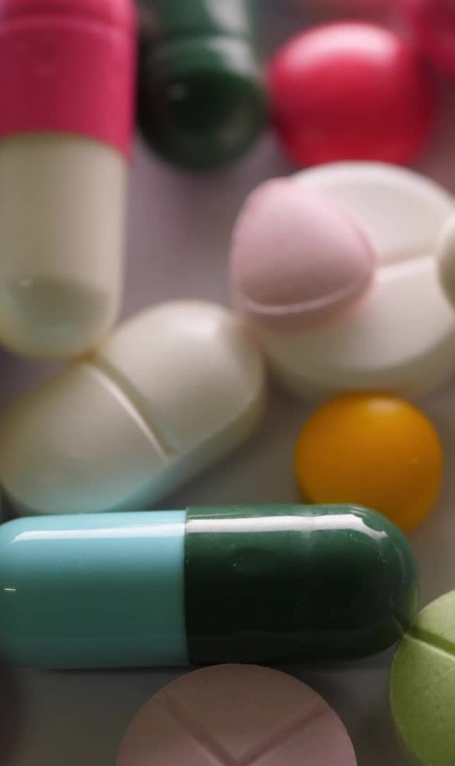
Lupus types
There are different Lupus types, such as:
1. SLE-Multi-organ systemic disease
2. Cutaneous lupus. Skin-limited, with subtypes (discoid, subacute, acute)
3. Drug-induced lupus. Milder, drug-triggered, resolves after stopping medication
4. Neonatal lupus. Transferred maternal antibodies, risk of heart block
5. Overlap syndromes. Shares features with other connective tissue diseases
Rare forms
6. Lupus panniculitis: Affects subcutaneous fat
7. Bullous lupus: Blistering skin disease in lupus
8. Lupus cerebritis: CNS involvement (typically included in neuropsychiatric SLE)

Slide 9
Sjögren’s pathophysiology and symptomatology
Primarily a Type IV Hypersensitivity (T-cell mediated destruction of exocrine glands)
Autoantibody-mediated (though less immune complex–driven than SLE)
Pathophysiology: Chronic lymphocytic infiltration, a long-standing immune process where lymphocytes, particularly CD4+ helper T cells, accumulate in tissues and cause inflammation and damage.
In Sjogren's accumulation into exocrine glands, particularly lacrimal and salivary glands. Destruction of glandular tissue leads to dry eyes (keratoconjunctivitis sicca) and dry mouth (xerostomia).
Autoantibodies are common: anti-SSA (Ro) and anti-SSB (La), ANA, and rheumatoid factor.
The disease Can be primary (isolated syndrome) or secondary (associated with SLE, RA, scleroderma).
B-cell hyperactivity/ increased risk of non-Hodgkin B-cell lymphoma. Other systemic manifestations: interstitial lung disease, vasculitis, neuropathy, renal tubular acidosis.

Slide 10
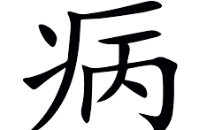
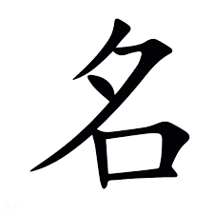
Nosological classification
Lupus and Sjogren‘s can both be seen as Fu Xie 伏邪 (Latent pathogens). Fu xie theoretical basis was heavily outlined in the First Autoimmune course “R.A. and Fibromyalgia”. For Lupus, there is often a discussion on 暑邪 Shǔ xié/ Latent Summerheat evil
Lupus traditional classifications are 蝴蝶瘡 (Húdié Chuāng) and Red butterfly sores 紅蝴蝶瘡 (Hóng Húdié Chuāng)
Related Classical Disease Names and Concepts: (Many of these are first outlined in the Jīn Guì Yào Lüè 金匱要略)
瘧 (Nüè) – Intermittent fevers/ Malaria-like disorders (recurring fever patterns, possible analogy to autoimmune flares)
陰陽毒 (Yīn Yáng Dú) – Yin-Yang Toxin
歷節病 (Lì Jié Bìng) – Digit Articulation Disease, which can be seen as a specific manifestation of 痺證 (Bì Zhèng)
虛勞 (Xū Láo) – Vacuity Taxation, which includes 骨蒸勞熱 Gǔ zhēng láo rè, Steaming bone vacuity fever, often characterized with Nighttime heat and morning coolness 夜熱早涼Yè rè zǎo liáng

Slide 11
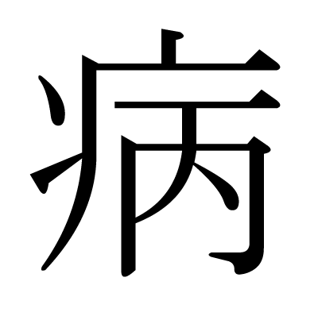
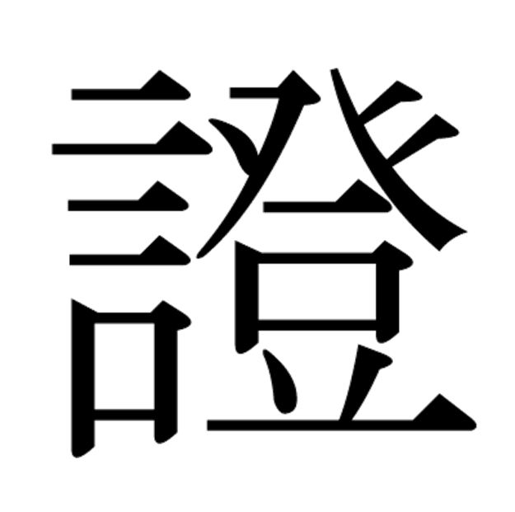
TCM common etiologies
Standard TCM often classifies the syndromes of SLE an Sjogrens as:
熱毒症 (Rè Dú Zhèng) – Heat Toxin Syndrome
陰虛旺火 (Yīn Xū Wàng Huǒ) – Yin Vacuity Hyperactive Fire (usually Liver and Kidney)
燥證 (Zào Zhèng) – Dryness Syndrome
"津液虧虛 (Jīn Yè Kuī Xū) – Depletion of Body Fluids
陰虛燥熱 (Yīn Xū Zào Rè) – Yin vacuity Dry-Heat
While these are syndromes to consider, they are presuming Yang is stirring simply because of Yin vacuity, which then causes Yang predominance 陰虛陽盛. But these conditions can also be due to Yang vacuity with Yin exuberance 陽虛陰實

Slide 12
Qing gu san 清骨散 and Qing Ying tang 清營湯
These nutritive level formulas can often be combined with Shaoyang prescriptions
Qing gu san is for steaming bone, with a pattern of Yin effulgent heat 骨蒸勞热, ingredients:
Yin chai hu, Hu huang lian, qin jiao, bie jia, di gu pi, qing hao, zhi mu, gan cao
Think of lymphomas, but also immune responses often exacerbate at night as they affect the blood layer and consume the yin
Qing ying tang: Shui niu jiao, Sheng di huang, Xuan shen, Jin yin hua, Lian qiao, Huang lian, dan shen, mai men dong, zhu ye xin
Qing ying tang treats warm disease where evil heat has transmitted into the Ying (nutritive level), the body fever worsens at night. The patient may be thirsty or not, occasionally having delirious speech, vexation and insomnia, possibly with faint macular rashes. The tongue is crimson and dry, and the pulse is thin and rapid.溫病邪熱傳營，身熱夜甚，口渴或不渴，時有譫語，心煩不眠，或斑疹隱隱，舌絳而乾，脈細數

Slide 13
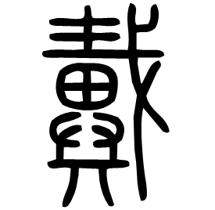
Dai Yang 戴陽/ Upcast Yang
This often described as True cold with False heat. This person often has a “floating red” complexion with tidal reddening. This pattern corresponds to a Tong mai si ni tang or a Gan jiang fu zi tang
The SHL states “After precipitation, and again sweat effusion, in the day there is vexation, agitation and inability to sleep, and at night there’s tranquility. There is no nausea, no thirst, and without an exterior syndrome. The pulse is deep and faint, the body without great heat, Gan jiang fu zi tang governs 下之後，復發汗，晝日煩躁不得眠，夜而安靜，不嘔不渴，無表證，脈沉微，身無大熱者，乾薑附子湯主之
Gan jiang fu zi tang: 1 liang of Gan jiang, and 1 piece of Sheng Fu zi, broken into pieces) (乾薑附子湯方：乾薑一兩，；附子一枚，生用，去皮，破八片)
In Shaoyin disease, there is diarrhea with clear grain, interior cold with exterior heat, the hands and feet with reversal cold, the pulse faint and on the verge of expiring. The body contrarily is without aversion to cold. The person’s facial complexion is red, sometimes there’s abdominal pain, sometimes dry retching, sometimes throat pain, sometimes the diarrhea stops, and when the pulse doesn’t come out, Tong mai si ni tang governs 少陰病，下利清穀，裏寒外熱，手足厥逆，脈微欲絕，身反不惡寒，其人面赤色，或腹痛，或乾嘔，或咽痛，或利止，脈不出者，通脈四逆湯主之。
In diarrhea with clear grain, with interior cold and exterior heat, there is sweat emerging and Jue-reversal, Tong mai si ni tang governs 下利清穀，裏寒外熱，汗出而厥者，通脈四逆湯主之。

Slide 14
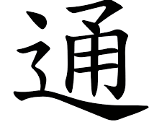
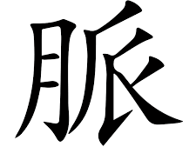
通脈四逆湯方 ingredients and modifications
2 liang of Zhi Gan cao, Sheng Fu zi 1 piece, Gan jiang 3 liang, and can strengthen by adding 4 liang 甘草二兩，炙；附子大者一枚，生用，去皮，破八片；乾薑三兩，強人可四兩。
Use 3 Sheng of water, and reduce to 1 sheng. 1 sheng=200 ML
If the pulse emerges immediately, the condition is resolving. 其脈即出者愈
If the complexion is red, add 9 stalks of Cōng bai (葱 – scallion stalks).面色赤者，加葱九莖
If there is abdominal pain, remove Cōng and add 2 liǎng of Sháo Yào (芍藥 – peony root).腹中痛者，去葱，加芍藥二兩
If there is vomiting, add 2 liǎng of Shēng Jiāng (生薑 – fresh ginger).嘔者，加生薑二兩
If there is sore throat, remove Sháo Yào and add 1 liang of Jie Gěng (桔梗 – Platycodon root).咽痛者，去芍藥，加桔梗一兩
If the diarrhea has stopped but the pulse does not emerge, remove Jie Gěng and add 2 liǎng of Rén Shēn/ ginseng.利止脈不出者，去桔梗，加人參二兩

Slide 15
回陽 Hui Yang/ Returning Yang
The issue with Tong mai si ni tang, is that it is a very warming strategy but it doesn’t Foster the Yin 育陰 to submerge Yang 潛陽. This is where we can use Li Ke’s formula, Wēn shì Bēntún 温氏奔豚湯, instead
Wen’s Bentun/ Running piglet Decoction is a legacy formula 遺方 from the renowned veteran physician Wen Biquan of the Shanxi Provincial School of Traditional Chinese Medicine. Li Ke was an expert in using it.
The formula, composed of Fu Zi (Aconite), Rou Gui (Cinnamon bark), Hong Shen (Red Ginseng), Chen Xiang (Aquilaria), Sha Ren (Amomum), Shan Yao (Chinese Yam), Fu Ling (Poria), Ze Xie (Alisma), Niu Xi (Achyranthes), and Zhi Gan Cao (Honey-fried Licorice).
This formula is derived from Renshen Sini Tang with Gan Jiang removed, combined with Gui fu Lizhong Tang minus Bai Zhu, and from Guifu Bawei Wan with Shu Di, Dan Pi, and Wu Zhu Yu removed, and Chen Xiang, Sha Ren, and Niu Xi added.
This formula is purely Yang and Boost Fire to rescue from collapse and peril. Its warming effect is agile and dynamic, reaching both upper and lower regions, circulating through the twelve channels, both exterior and interior. . 是一首純陽益火，救困扶危妙方。溫熱靈動，徹上徹下，通行十二經表裡內外

Slide 16
Wenshi Bentun tang functions
Its functions include: Warming and nourishing the true Fire of the Gate of Life (Mingmen. Reviving and rescuing the waning Yuan Yang (source yang) Consolidating Yuan Qi to prevent desertion. 功能溫養先天命門真火，救扶元陽之衰亡，固元氣之厥脫
Tonifying Fire to generate Earth, transformation of dampness and awakening the Spleen. Reinforcing Earth to control Water, thereby resolving edema.補火生土，化濕醒脾，補土制水，而消水腫
Grasping Qi to calm panting . Soothing and nourishing the Penetrating Vessel (Chong Mai). Guiding Fire back to its source. Subduing the Bentun counterflow (rebellious Qi rushing upward from lower abdomen) 納氣平喘，安養衝脈，引火歸源，制伏奔豚。
It can also eliminate cold accumulations in the Zang organs, expel congealed cold from the Fu organs, relieve cold Bi in the bones and channels, break through deep-cold chronic conditions, disperse cold and move Qi to treat various pain disorders 可消五臟寒積，逐六腑冷凝，除骨脈寒痺，破沉寒痼冷，散寒行氣治諸痛。
We can use this for example in Lupus Nephritis

Slide 17
Shaoyang Shaoyin
Li Ke sometimes even combines this formula with Shaoyang strategies, in a dual Shaoyang and Shaoyin strategy (per his case study
**處方：**柴胡20克，桂枝15克，炒白芍30克，炙甘草15克，附片15克，乾薑15克，人參10克，肉桂10克，沉香10克，山藥30克，茯苓20克，砂仁15克，澤瀉15克，牛膝30克，荔枝核15克。共10劑，水煎服，每日1劑。
Chái Hú 20g, Guì Zhī 15g, stir-fried Bái Sháo 30g, honey-fried Gān Cǎo 15g, Fù Piàn (processed Aconite slice) 15g, Gān Jiāng (dried ginger) 15g, Rén Shēn (ginseng) 10g, Ròu Guì (cinnamon bark) 10g, Chén Xiāng (Aquilaria) 10g, Shān Yào (Chinese yam) 30g, Fú Líng (Poria) 20g, Shā Rén (Amomum) 15g, Zé Xiè (Alisma) 15g, Niú Xī (Achyranthes) 30g, Lì Zhī Hé (lychee seed) 15g. Every day 1 dose.

Slide 18
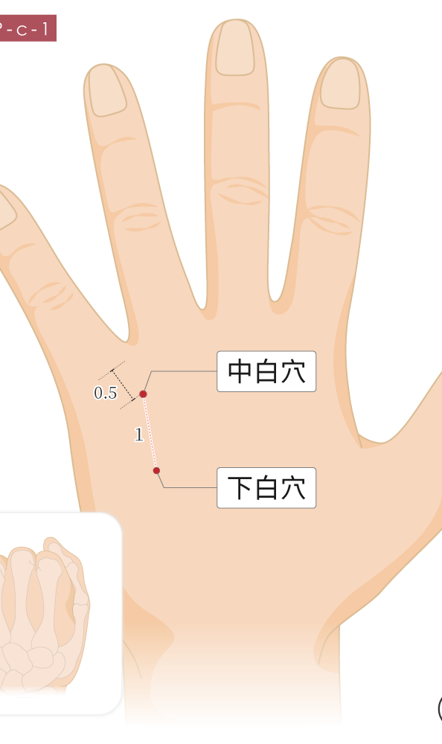
Zhong Bai 中白
According to the Wang Chuan Min lineage, Zhong bai line can be conceptualized per its Ti 體 (Form) and Yong 用 (Function)
Its form lies in Hand Shaoyang. Its Function likes in Kidney, Heart, and Spleen.
It is similar to Zhong Zhu (San jiao 3), wood point of ministerial fire, mother principle to engender child
If we needle vertically, this is treating a Disease with form 有形 (visceral disease), aiming toward communicating Xiang huo with Jun Huo (Shaoyang to Shaoyin)
If we angle the needle obliquely, we are treating a Formless disease 無形 (Qi based), following or going against the San jiao channel.

Slide 19
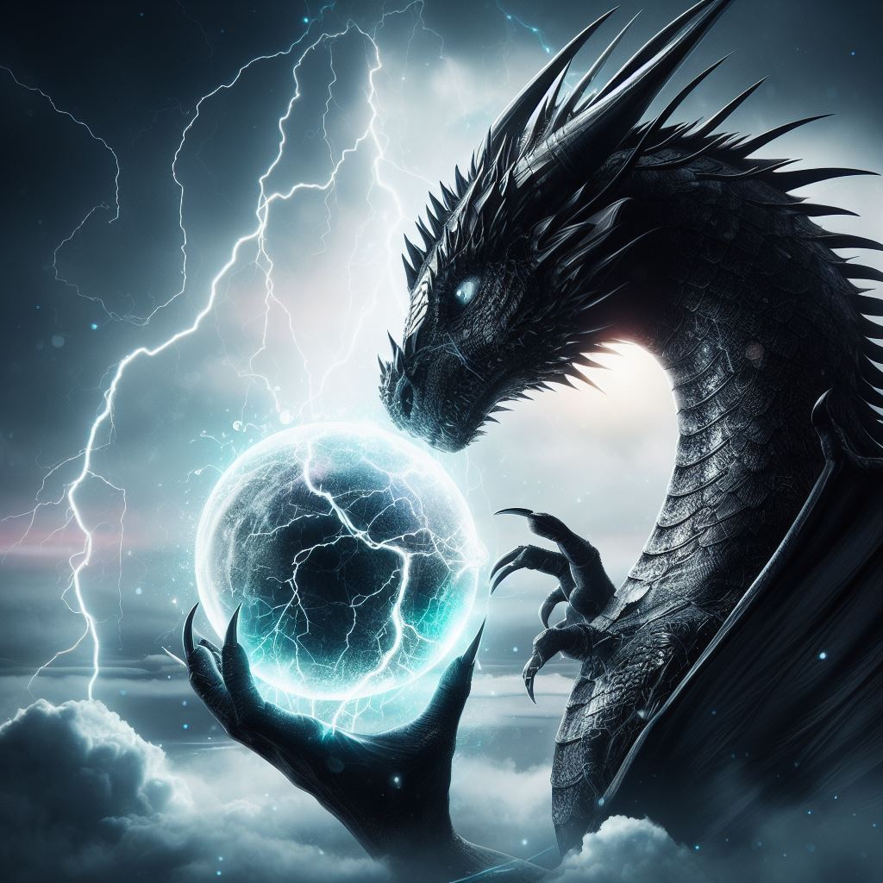
Dragon Fire 龍火 and Thunder Fire 雷火
In the Jin Yuan dynasty, there was an increased interest in the physiology of fire; on why fire began to have reckless movement 妄動/ wàng dòng.
This discussion first begins with the distinction of Ministerial Fire (Xiàng Huǒ 相火), in contrast to Sovereign Fire (Jūn Huǒ 君火). It is commonly believed that the Liver, Gallbladder, Kidneys, and Sānjiāo each internally house Ministerial Fire, though its true source lies in the Gate of Life (Mìngmén). 肝、膽、腎、三焦均內寄相火，但其源均在命門
Ministerial Fire may manifest as lesser fire or vigorous fire—it can be righteous (Zheng) or Evil (Xie). When it is evil, it is often described with the phrase “reckless movement 相火可為少火，亦可為壯火，即可為正，亦可為邪。若為邪火，多有「妄動
In the Jin Yuan, Ministerial Fire was further dissected and differentiated as the fire of the Liver and Kidneys, collectively known as the “Thunder-Dragon Fire.” If we further differentiate, Liver fire corresponds to Thunder Fire, as the Liver matches the Zhen trigram, which represents Thunder in the post-heaven Bagua. Kidney fire is considered Dragon Fire, since the Kidneys belong to the Water Zang, and the dragon is a creature amidst water, hence the saying “the dragon is submerged in the deep abyss.若再細分，則肝火為雷火，因肝於後天八卦配震卦，震為雷；腎火為龍火，因腎為水臟，龍為水中之物，所謂龍潛淵中
Whether this fire becomes pathological depends on whether it moves recklessly or departs from its proper place. Zhen signifies Thunder, and thus movement; the dragon’s nature is fierce and volatile, easily stirred and hard to tame. For this reason, reckless movement of Ministerial Fire most often refers to these two: Liver fire and Kidney fire. 至於是否屬於病態，關鍵還得看此火是否妄動而離位。震為雷，亦為動；龍性暴烈，易動難馴，

Slide 20
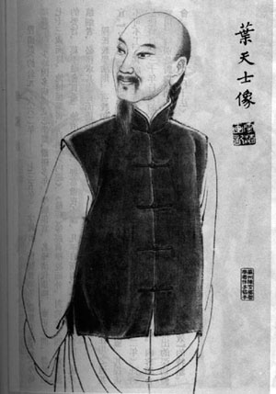
Ye Tian Shi 叶天士 on Ministerial Fire
Ye Tian Shi in his case study states
Dragon Fire is stored in the Kidneys, while Ministerial Fire (Xiang Huo) is housed in the Liver. The Yǐ and Guǐ (Wood and Water) share the same origin, and their locations lie adjacent to one another. If the essence and blood of the Liver and Kidneys are abundant, then Dragon and Xiang Fires are properly restrained, remain still and keep to their positions—each dwelling peacefully in its place.But if the Dragon-Thunder within the Kidneys loses its regulation, then Ministerial Fire boils over, and the Dragon and Xiang Fires flare up together. As Ye Tianshi said:“When the Dragon and Thunder within Yin surge, and Xiang Fire within Wood (the Liver) boils over alongside it, resulting in bleeding and coughing, it indicates that the Zang-Yin (visceral Yin) is no longer in a state of tranquility.” “龍火藏於腎，相火寄於肝，乙癸同源，位置毗鄰，若肝腎精血充足，則龍相得制，靜而守位，各安其所。腎中龍雷失守，則相火沸動，龍相交炽，葉氏謂：「陰中龍雷，夾木中相火沸動，失血咳嗽，是臟陰不為寧謐。
If the Liver zang is increasingly rigid, and Wood and Fire lodge internally, and the emotions run counter to (natural course), then Ministerial Fire will inevitably flare up. It is said: Cooling can make the Liver tranquil《存真》）若肝臟日剛，木火內寄，情志拂逆，必相火勃起，謂涼則肝寧

Slide 21
Ministerial fire ought to be cooled 相火宜凉
As Huang Yuanyu (黃元御) said: “Ministerial Fire takes Sovereign Fire as its Master” (Shang Han Xuan Jie) “相火以君火為主也（《傷寒懸解·太陽經下編》
When external stimuli affect the Heart, Sovereign Fire is easily stirred and hard to calm, and Ministerial Fire (相火) becomes excessive and harmful.外物感應於心，君火易動而難靜，相火亢而為害
As Zhang Jingyue remarked: “Once Heart Fire moves, Ministerial Fire immediately follows 張景岳云：「故心火一動，則相火翕然從之。」「Excess leads to harm; containment brings regulation.”If fire is properly regulated, it stays peacefully hidden within the Zang-Fu, warmingand facilitating transformation and generation. But if fire is unrestrained, it rises and spreads, injuring the body.亢則害，承乃制. 火若有制，謐藏臟腑，溫煦生化
Ye Tianshi (葉天士) was the first to propose the idea that “Ministerial Fire should be cooled.” In one of his case notes from Cun Zhen, he writes:“Ministerial Fire should be cooled. Whenever supplementing the Kidneys with warming methods, one must pair it with cooling the Liver to supervise and restrain it—only then will there be no one-sided bias. ”Ministerial Fire should be cooled—cooling brings control, which in turn activates the mechanism of generation without leading to excessive fiery ascent. Ye Tianshi also stated: “Ministerial Fire resides within the Jueyin; it abhors cold but prefers cooling.” 火若無制，升騰蔓延，戕害人身。葉天士首倡「相火宜涼」之說，葉案云：「相火宜涼，凡益腎取乎溫養，必佐涼肝以監制，方無偏黨」（《存真》）。相火宜涼，涼則有制，遂生生之機，無騰炎之勢。葉天士又謂：「厥陰相火內寄，惡寒喜涼。」

Slide 22
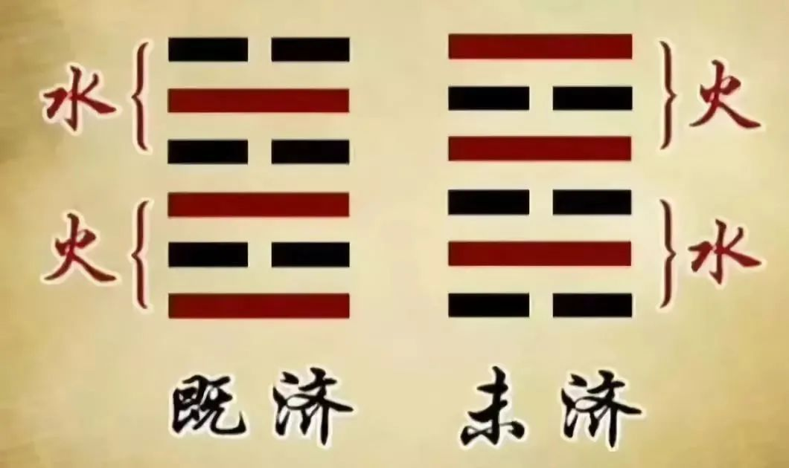
潛陽 Qian Yang/ Submerging the Yang
The goal in autoimmune treatment is for Fire and Water to cross/ aid each other 水火既濟 shuǐ huǒ jì jì (Hexagram 63). Whereas autoimmune process are often in a state of Hexagram 64, Fire and Water not yet crossing 火水未濟/Huǒ Shuǐ Wèi Jì.
Hexagram 64, you have Li (Fire above) and Kan (water below). We must ensure fire is descending. This fire ascending can be from a Yang syndrome (shaoyang yangming often) or From a Yin syndrome (Taiyin shaoyin), or a mixed Yin and Yang syndrome (Jueyin)

Slide 23
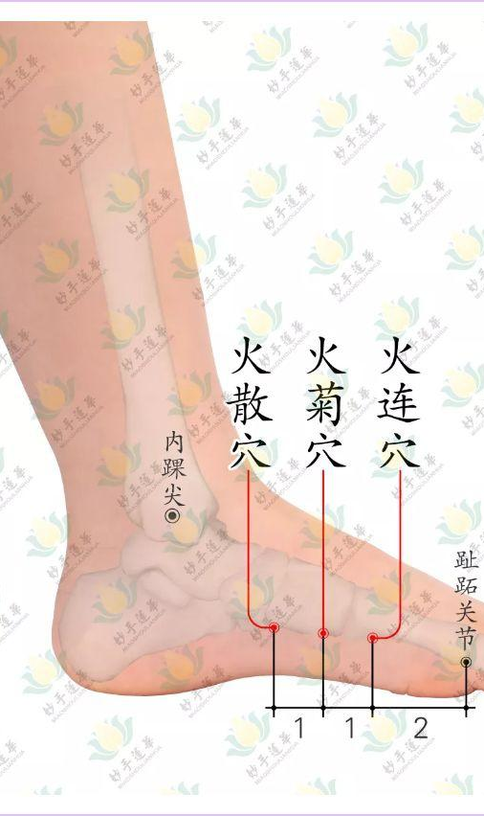
Zu san huo/ Foot three fires
66.10, 66.11, 66.12
Huo Lian 火連, Huo Ju 火聚, Huo San 火散
Form: On Foot Taiyin. Function: Heart 心之分支神經, Kidney 腎之副神經, and Six fu 六腑之副神經 for Huo san
Guides Back to its source (especially Huo san). But all of them treat counterflow Yin fire散陰火的作用, via Supplementing earth to conceal fire 補土伏火 (per Liu Yi)
Also or Damp qi transforming to Fire 濕氣化火 (Liu Yi). This damp heat can constrain fire and steam upward to the orifices and engender a brain tumor

Slide 24
Yin Fire pulse
Indications: If the condition presents with injury to the Stomach by improper diet (飲食傷胃), and injury to the Spleen from overwork or fatigue (勞倦傷脾), and fire evil rides upon it to generate intense heat (火邪乘之而生大熱).
As Per Yu Sheng Tze,
“When the right Guan pulse is wiry (弦), or floating and rapid (浮數), then Huolian (火連穴) and Huoju (火菊穴). We use Yin to Guide Yang
However, if the right Guan pulse is relaxed and weak (右關脈緩弱), then Zhongbai (中白穴), we use Yang to Guide Yin”
Huo san treats Yin fire from Shaoyin

Slide 25
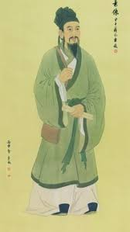
Liu Wàn Sù 劉完素 bingji of dryness
通玄處士 style name: "The Recluse of Universal Mystery”
Also known as: 劉河間 "Liu of Hejian," referencing his place of origin
One of his attributed texts is the Sù Wèn Xuán Jī Yuán Bìng Shì《素問玄機原病式》”The Suwen Framework on the Mysterious Mechanism of Disease”
This text is highly influential as it’s a commentary and expansion on the Suwen’s 19 lines of pathomechanism. Additionally, since there wasn’t a dryness pathomechanism line, LWS added his own, under the dryness category 燥類
“諸澀、枯、涸、乾、勁、皴、揭，皆屬於燥。（陽明燥金，乃肺與大腸之氣也
All roughness, withering, dryness, stiffness, chapping, and fissuring belong to the category of Dryness (Zao). (Yangming Metal Dryness is none other than the Qi of the Lung and Large Intestine qi.)
《經》言：厥陰所至，為風府，為璺啟。由風勝濕而為燥也 The Classic states: “Where Jueyin arrives, it becomes the Palace of Wind, becoming cracks and openings.” This is because Wind overcomes Dampness and thereby generates Dryness.

Slide 26
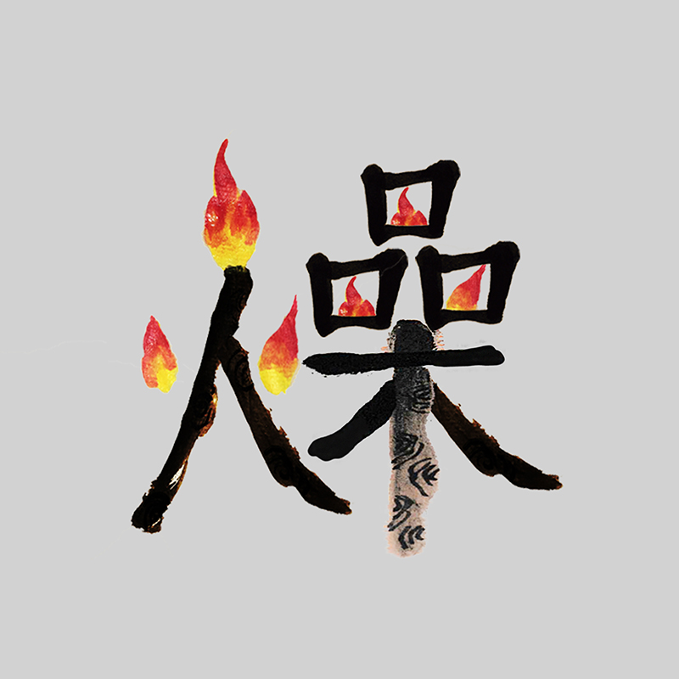
Chai hu qing zao tang 柴胡清燥湯
Chai hu to clear the dryness decoction
From the Wen Yi Lun 瘟疫論
主治: 瘟疫下後，或數下，膜原尚有餘邪，未盡傳胃，邪氣與胃氣並，熱不能頓除。After precipitation of Warm pestilence, sometimes multiple precipitations, residual pathogens may still remain in the membrane source and have not yet fully transmitted to the Stomach. When the pathogenic qi merges with the Stomach qi, the heat cannot be completely and immediately eliminated.
Ingredients: Chai hu, huang qin, tian hua fen, zhi mu, chen pi, gan cao, sheng jiang, da zao

Slide 27
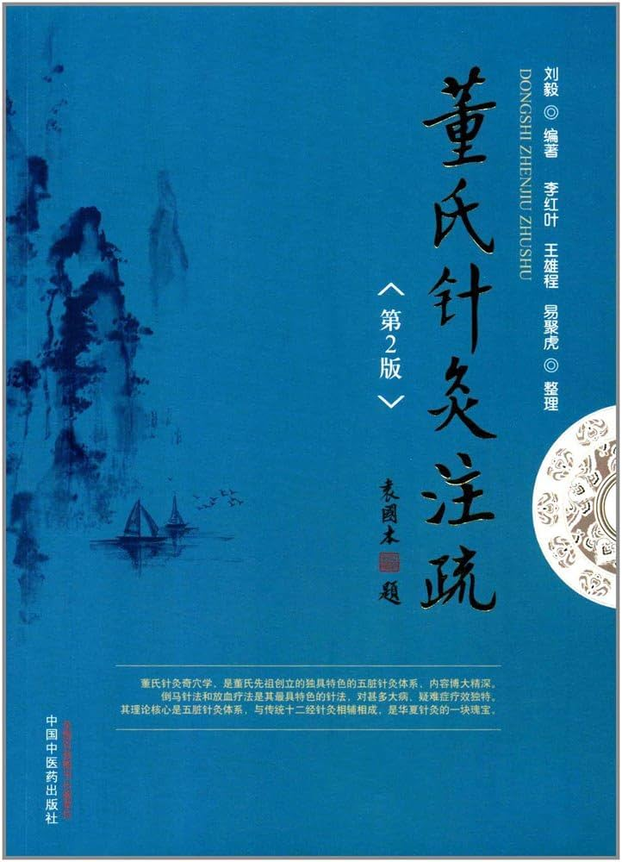
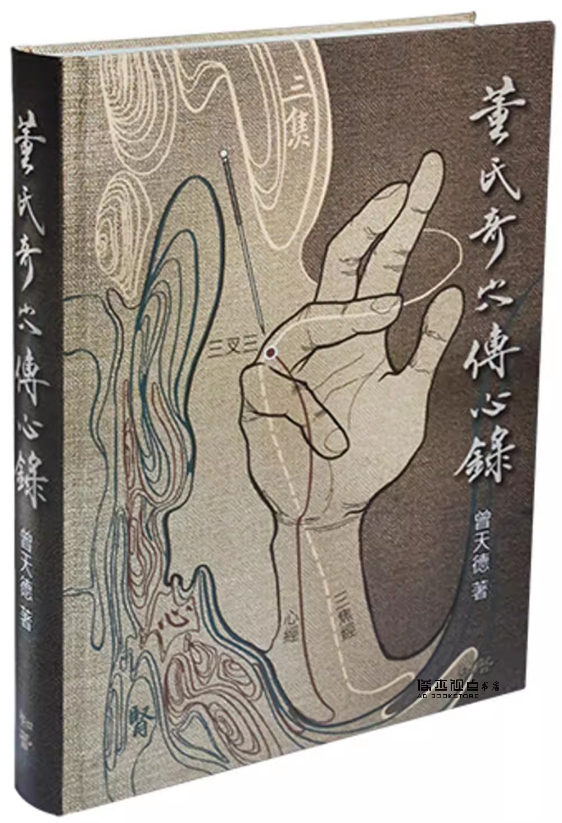
Si Ma+ San cha san
88.17-19+22.17
Liu Yi 劉毅 equated San cha san with the Shaoyang formula, Xiao chai hu tang.
San cha san is near San jiao 2 夜門 (Fluid gate).
Zeng Tian De 曾天德 stated it has three needling depths based on Heaven, Humanity, Earth. Heaven level can outthrust heat in the upper burner, at humanity level has an analgesic effect and supplements the middle burner. And at Earth level, enters the kidney and communicates the heart and kidney, outthrusting pathogens in the triple.
Si ma-Supplement the Lung, to strengthen the Zheng qi for the pathogen to be expelled. If vacuity isn’t as pronounced, use Ling Gu Da Bai (22.04-22.05)

Slide 28
Chai hu bai he tang
From: Shāng Hán Liù Shū《傷寒六書》卷三
Indications: Primarily used to treat conditions such as lingering low-grade fever and mental cloudiness during convalescence, thirst, incoherent speech, disordered spirit, as well as patterns involving food relapse, taxation relapse, and Bai He
Ingredients: Chai hu, ren shen, huang qin, gan cao, zhi mu, bai he, sheng di, chen pi
Both shaoyang disease and bai he share the symptom of Mo mo 默默/ taciturnity, as well as this alternating presentation of heat and cold. But in Bai he bing its due to the fluctuations of Grief and happiness.
Tang zong hai 唐宗海 explains Bai he 百合 disease in the following way
The Lung stores the Po (corporeal soul). If the Lung metal is unclear, then the Po is untranquil. When the Corporeal spirit qi fluctuates, it appears as if there is spirit possession (shen ling) . The Po is yin and stored in the Lung. When Lung qi is unclear, being awake is as if possessed by a spirit (Shen ling) 肺藏魄，肺金不清則魄不靜，魄氣變幻，是以如有神靈也..魄為陰，藏於肺，肺氣不清則醒如神靈。

Slide 29
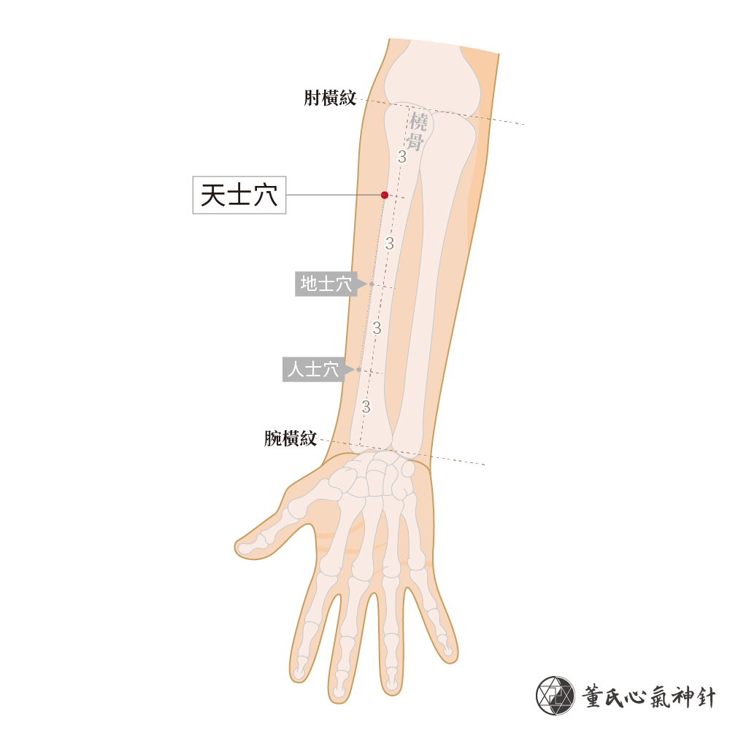
Bai he acupuncture equivalent
Palpate the Source points of the Lung and Pericardium (Tai yuan 太原 and Da Ling 大陵), if insufficient, supplement. If replete, then drain.
Tai Yuan- Earth point in Lung. Supplements Lung and Drains fire
Da Ling- Earth point of Xin bao. Drains fire and supplements Metal
Also Po Hu 魄戶 (Bladder 42)
Tung Acupuncture– 33.13-34，Ren Shi 人士+Di shi 地士 . Found on Hand Taiyin, function is on Lung and Heart 肺支神經、心分支神經

Slide 30

Chai Hu Di huang tang
From Sì Shèng Xīn Yuán《四聖心源》卷十:柴胡地黃湯.
Ingredients: Chai hu, Huang qin, Gan cao, Bai shao, Mu dan pi, Di huang
Used for heat entering the Blood chamber, presenting with fullness and distention in the chest and hypochondria, symptoms resembling chest bind (結胸), incoherent speech or delirium, and clouded consciousness.熱入血室，胸脅痞滿，狀如結胸，語言譫妄，神識不清
This is a Shaoyang condition with a tendency to heat in the blood
If available, I would recommend Fresh sliced Sheng di. Per Andy Ellis, of Spring Wind,
“The freshly sliced herb is carefully dried at a very low temperature over several days so that it does not turn black.
The aim of this careful processing is to make the dried herb as similar as possible to the fresh herb. We feel that this is the best way to emphasize the blood-cooling properties of Sheng Di Huang. For blood-heat skin disorders, feverish disorders of the blood aspect and for blood-heat bleeding disorders this extra strong blood-cooling function should be ideal”

Slide 31
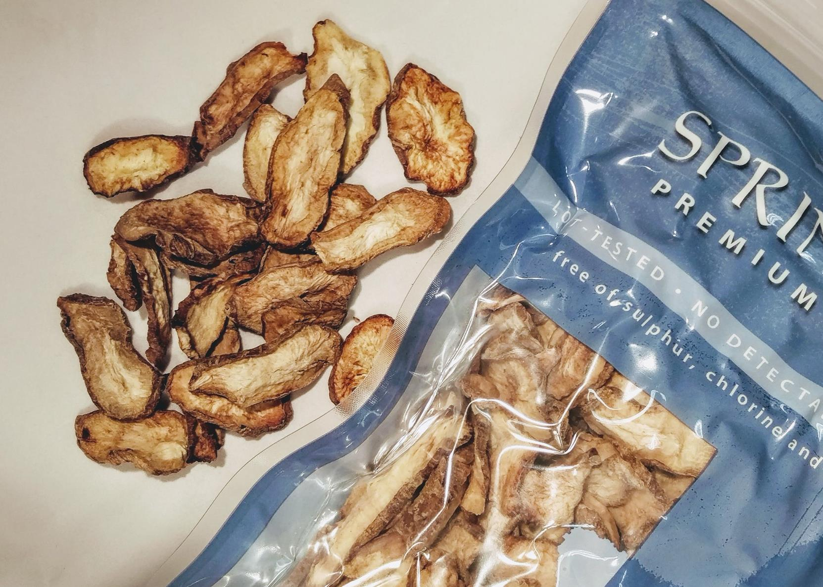
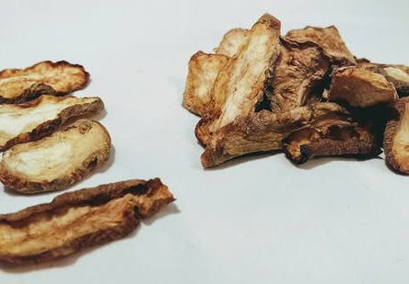
Fresh sliced Sheng di Huang 新鮮的生地黃

Slide 32
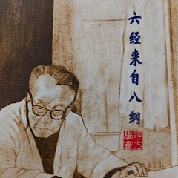
Chai hu gui zhi gan jiang tang
Also known as Chai hu gui lou tang.
Ingredients: Chai hu 15-24, Huang qin 9, Tian hua fen 12, Mu li 6-12, Gan jiang 6, Zhi gan cao 6, Gui zhi 9
For Malaria, with predominant cold, and slight heat, or only cold and no heat. This is cold Malaria syndrome. Shaoyang taiyin syndrome, Deep chronic shaoyang/ Jueyin syndrome
柴胡桂蔞湯：治瘧寒多微有熱，或但寒不熱。
Jing fang doctor, Hu Xi Shu 胡希恕, often combines it with Dang gui shao san for Lupus, with water rheum and blood vacuity combination. Think of patients on long-term prednisone and swelling
Hu Xi Shu would often add Shi gao, 45-60 grams. We can combine it also with Bai he gui zhi tang if more pronounced yang ming (Shi gao, zhi mu, gan cao, gui zhi).

Slide 33
Nanjing 5 phase pathophysiology
Difficulty 75 of the Nanjing: The Classic states, “The East is replete, the West is vacuous; drain the South, and supplement the North. 七十五難曰：經言東方實，西方虛，瀉南方，補北方
These 4 lines according to Yu Sheng Tze encapsulate the Manifestation, the Disease cause, and the Treatment method 病症，病因，治法
The East is Replete, the West is Vacuous is the Manifestation
The Drain the South, and Supplement the North is the Disease cause and Treatment method, i.e. the root.

Slide 34
Bing ji explanation
Extreme taxation diseases, their causes is from the depletion of Kidney water, such that it can no longer restrain fire. When fire becomes hyperactive, Lung metal is over-restrained and thereby becomes vacuous. Once Lung metal is vacuous, Liver wood is no longer held in check and becomes increasingly replete. Hence, the symptoms manifest as: descending qi counterflowing upward, steaming the chest; coughing and spitting blood; tidal fever that comes periodically; mental confusion; excessive dreaming; persistent night sweats; emaciation of the flesh—all these are signs of Liver repletion. 勞極病，其因腎水虛殆而不能制火，火已亢，則肺金受剋而茲虛；肺金既虛，則肝木無所畏而日實，故其證，下氣逆，上熏胸中，咳嗽咳血，潮熱時來，精神恍惚，夢多，盜汗不息，肌肉乾瘦者，皆肝實也。
When the East (Liver/Wood) is excessive, one knows the West (Lung/Metal) is vacuous. The vacuity of the West arises because the South (Heart/Fire) is in excess. And the hyperactivity of the South originates in the insufficiency of the North (Kidney/Water). Therefore, if one supplements Water and drains Fire, then Metal will no longer be vacuous, and Wood will also not become replete.東方實者，知西方虛，所以西方虛者，南方有餘也，南方亢者，本是北方不足也。故補水瀉火，則金不虛而木也不實。

Slide 35

Extending the principle
Lets say Metal is replete, then fire would be vacuous (not controlling metal). Water is hyperactive (hence fire vacuity), therefore Earth is insufficient (not controlling water). The root is the Spleen. Supplement Earth, and can also supplement fire secondarily.
If Earth is replete, then wood is vacuous. Metal will be excessive, and Fire would be insufficient. The root is Fire vacuity. This would be yang vacuity. Supplement Fire, and secondarily wood.

Slide 36
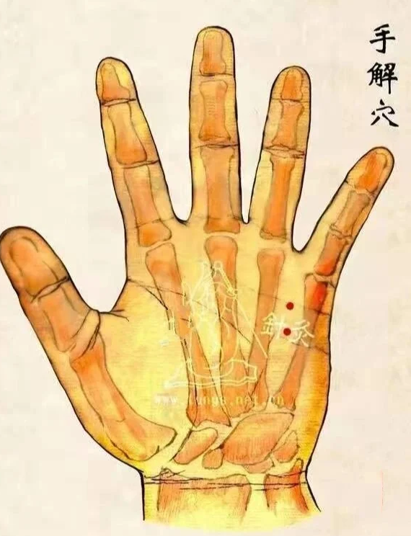
Shou Jie 手解
Form 體= Hand shaoyin Fire
Function 用= Kidney Water
This point establishes communication of Fire and Water
Can treat whole pain caused by disordered qi and blood 氣血錯亂之刺痛、全身痛
Correlated with the “Sensitive nerves of the five glands 五腺敏感神經, showcasing this area relationship to glandular reflex arcs
解毒的王穴 Monarch point to resolve Toxin

Slide 37
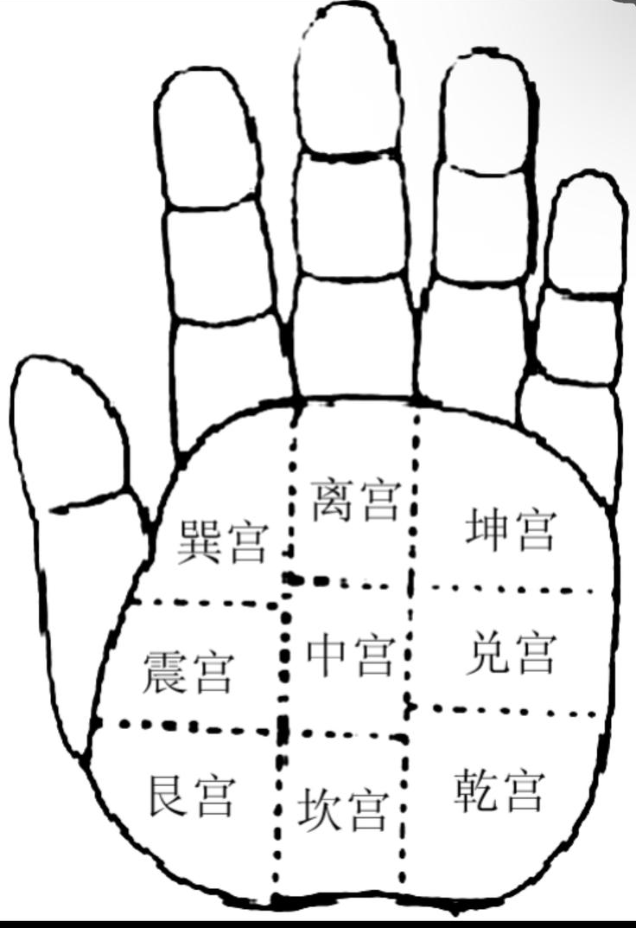
Ba Gua Palm Map
The hypothenar region is composed of
Kan palace in the Above
Dui palace in the Middle
Qian Palace in the Bottom

Slide 38
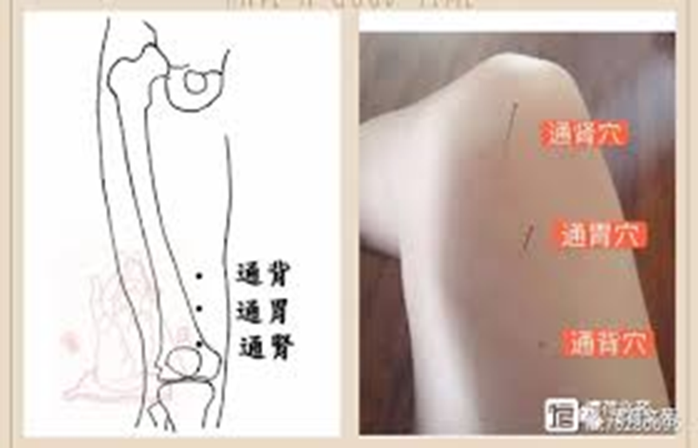
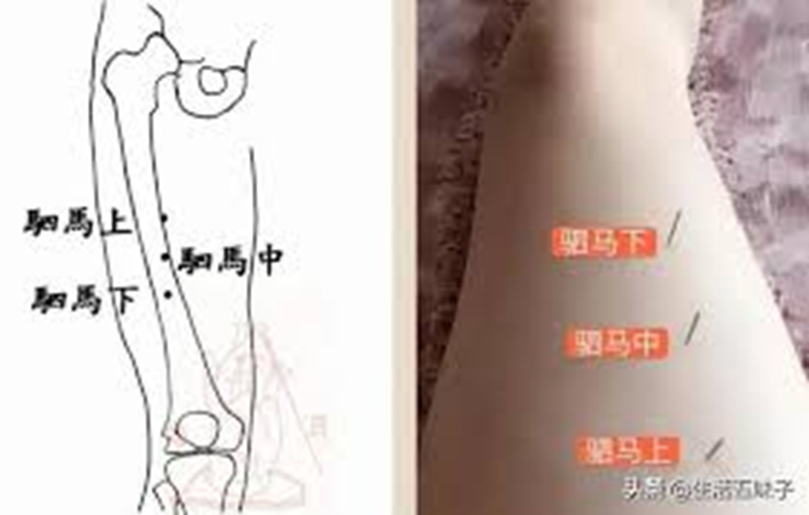
Tong shen 88.09-11+ Si ma 88.17-19
Chuan Min-Wang 王全民 strategy to Supplement the North and fortify Metal

Slide 39
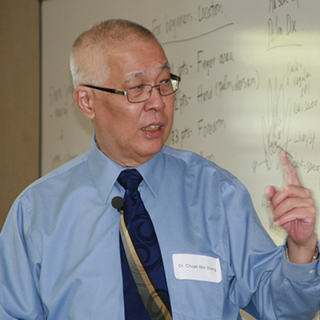
Chuan Min-Wang

Slide 40
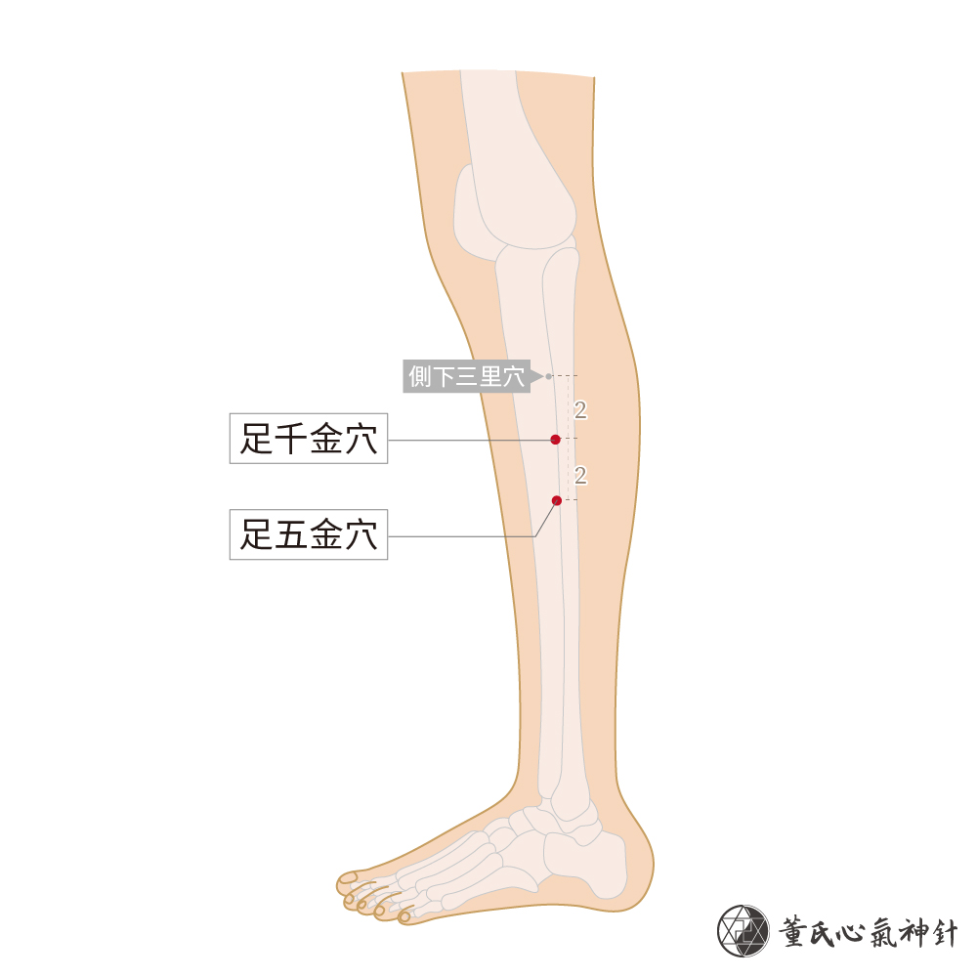
Zu qian jin 足千金+ Zu wu jin 足五金
77.24-77.25 Foot Thousand Gold and Foot Five Gold
Its form is on Foot Shaoyang. Its Function is on Lung and Kidney 肺之支神經，腎之分支神經
As Liu Yi explains these are the Image of Lung Metal and Kidney water 肺金腎水之象. These points function to Enrich kidney water and clear lung fire 滋腎水清肺火之用
Metal and water not generating 金水不生, with symptoms such as fish bone logged in the throat 魚骨刺住喉管, throat ulcers 喉嚨生瘡, laryngitis (fire moth 火蛾)

Slide 41
Ni Hai Sha theory 倪海厦
An Exposition by Dr. Ni Hai Sha
Most women know that before their period comes, they feel a sensation of fullness in their chest area. After their period, the fullness is gone. Western medicine theorizes that menstruation is due to a released egg that wasn’t fully fertilized. If the egg is fertilized, then no period should occur. This theory is incorrect. This is the reason why western science does not know the cause, prevention and treatment of diseases such as lupus, leukemia, lung and breast cancer.
A female’s period is actually derived from milk nutrients (not the milk). How can this be proven? Very easily by observation. If a female has tubal ligation performed, then no egg can reach the uterus, then no period should occur right? Yet, the period STILL occurs after tubal ligation. This means that the mechanism which controls the egg and the menstrual cycle are different. When a mother nurses her baby, there is no period. Still, females can get pregnant during nursing, but they have NO period. The fact of the matter is, the period and milk are NOT independent of each other. They are actually the same thing.
Normally, milk degradation occurs when it travels from the lungs (white milk) to the small intestine (red blood). If the milk can’t travel down from the chest area to the uterus, it reverses direction. The milk backs up, goes to the heart, and gets converted back into blood (because the heart is hot. If the milk/blood stays in the heart, lupus results. If the milk/blood goes to the nose, nose bleeding results. If the milk/blood goes to the lungs, lung cancer results. If it goes to the spinal bone marrow, leukemia results. If the milk is too much and stays in the chest area, cysts in the breasts result.
This is Ying qi counterflow

Slide 42
Pathomechanism of Systemic Lupus Erythematosus (SLE) and Leukemia
The human heart governs a man’s jing (essence). The circulatory system of men and women is precisely opposite. A woman’s breast milk is white, and a man’s semen is also white. The woman’s milk is located in the upper body (chest), while the man’s semen is in the lower body—so they are exactly reversed. The yin is above, and the man's yang is below.
Whenever something produces pure nutrition, if refined, you’ll get pure essence or nourishment. But after extracting the pure part, there will always be a lot of leftover residue. So, the residue of a woman’s breast milk is her menstrual blood, while the residue of a man’s semen is his facial hair. Facial hair is a secondary sexual characteristic in men. When the heart becomes injured, the residual byproducts from sperm production can no longer travel upward along the Ren Mai (Conception Vessel) to the corners of the mouth. So why do people get this kind of disease (SLE)? It’s because the residue from sperm—originating from the “jing palace” (a male anatomical counterpart to the uterus)—tries to ascend from the area between the bladder and small intestine. When it rises upward and reaches the heart, if the heart is too weak, the residue gets stuck and cannot rise further. When this sperm residue enters the heart, it manifests as what we call Systemic Lupus Erythematosus (SLE) in men. If the sperm residue enters the Du Mai (Governing Vessel), the resulting condition is leukemia (blood cancer).If it enters the lymphatic system, it becomes lymphoma.
This is the root of the disease—the true source. So when we see that someone no longer grows facial hair, we ask: “How has your beard been?” They say: “In the past I had to shave every day; now I only shave every three days—there’s less and less hair.”From this, we know the residue is flowing in reverse. Now, since the heart and the jing palace are very far apart, there’s quite a distance between the heart and the small intestine. So the residue of sperm must travel a long way upward to reach the heart.But for women, the distance from the breasts to the heart is much shorter. That’s why SLE occurs far more often in women.

Slide 43
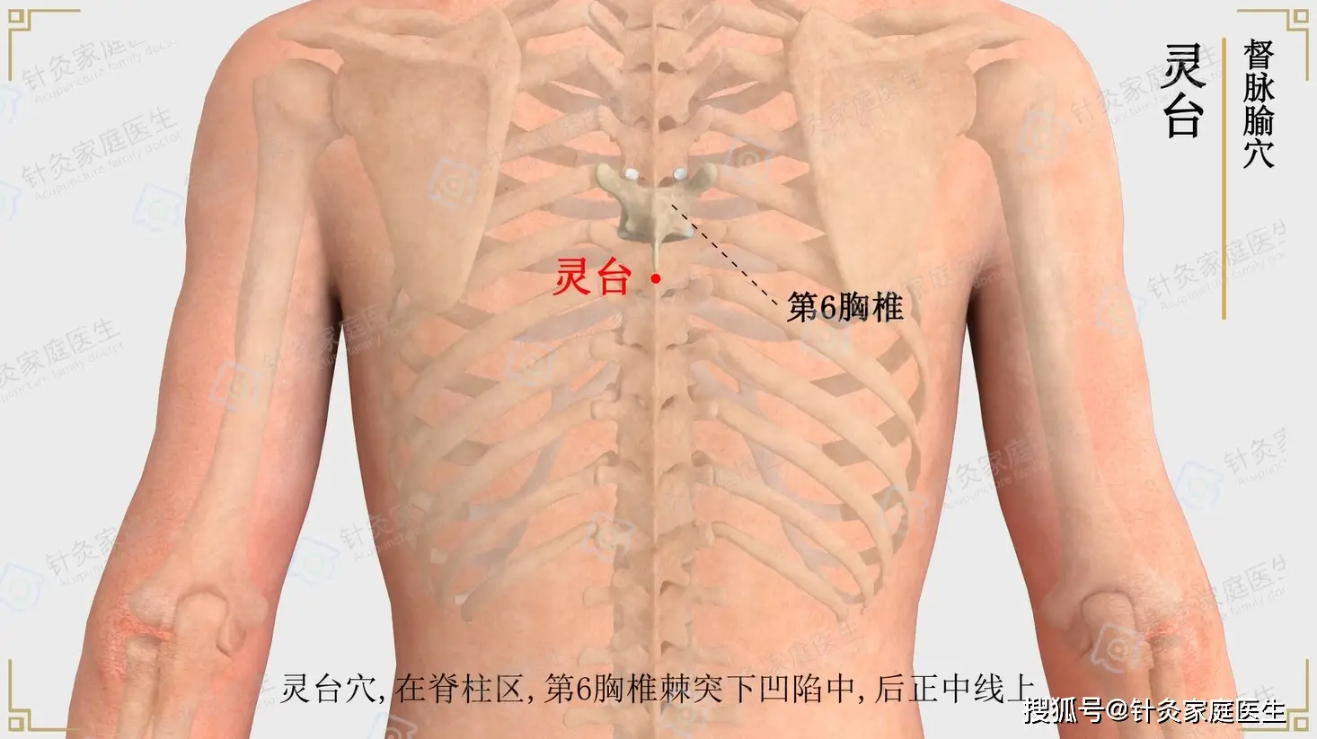
Ni Hai Sha diagnostic site
T6– Ling Tai 靈台/ Spirit terrace
This is the diagnostic site NHS uses to confirm Lupus. Tenderness below the sixth thoracic vertebra (at Ling Tai point)代表奶水或精子逆流入督脈。
Indicates SLE and also leukemia (blood cancer) and suggests that breast milk or sperm has reversed flow into the Du Mai (Governing Vessel).第六胸椎下（靈台穴）有壓痛，示血癌（白血病）
This area is related to the Heart
Ling Tai is classically indicated for Carbuncle-Sores 疔瘡 and Red-threaded carbuncle（紅絲疔）
Ding 疔= 丁 Yin fire heavenly stem

Slide 44
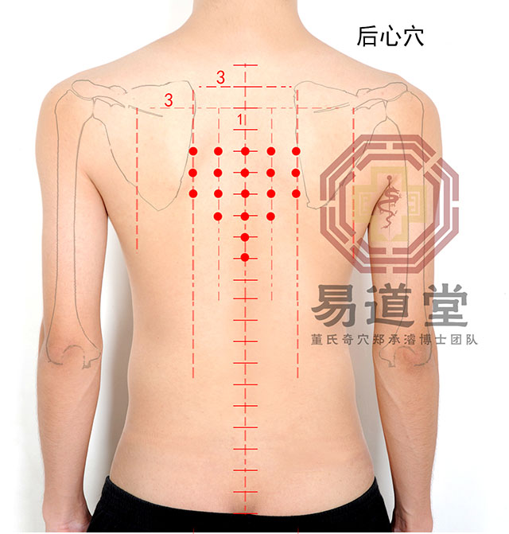
Hou xin DT 11
Heart blood level pathologies
Treats Yang Mao Sha 羊毛痧 (also called Yangmao Carbuncle羊毛疔) Yangmao Ding (Wool Carbuncle), terms often found in Wai Ke texts such as Zheng Zhi Zhun Sheng · Wai Ke 证治准绳·外科
Use a three-edged needle to prick the purple spots (in severe cases, black spots may appear) and extract the fine hair-like filaments. To treat abscesses, heart weakness, and stomach disorders, use the three-edged needle for bloodletting (limited to the limbs and facial sores).
This includes six points located below the fourth thoracic vertebra beneath Dazhui (GV14): Huoyun, Huochang, Huoming, Huoxiao, Huomen, and Tuyue; as well as four points 1.5 cun lateral to the spine: Huomiao, Huochao, Huozhong, and Huohua (eight points total on both sides), and three points 3 cun lateral to the spine: Jinji, Jinling, and Huojin (six points total on both sides). 包括大椎骨下第四個脊椎關節處之火雲、火長、火明、火校、火門、土月六穴，以及脊椎旁開一寸五分的火妙、火巢、火重、火花四穴（兩側共八穴），與旁開三寸的金吉、金陵、火金三穴（兩側共六穴）。

Slide 45
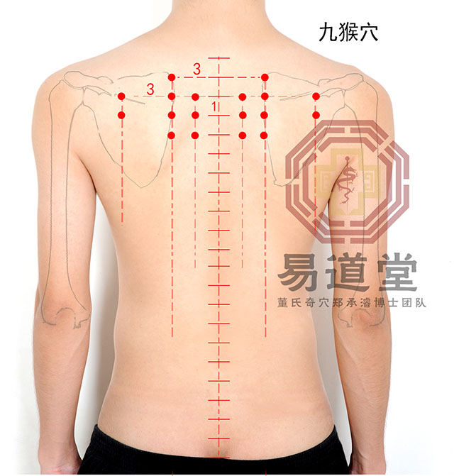
Jiǔ Hóu (九猴)
DT. 06
Treats Monkey sha 猴痧, i.e. corresponding with Scarlet Fever 猩红热, often manifesting with cutaneous itchy red eruptions
Clears the Lung, Drain Fire
Treat Cutaneous Lupus symptomatology
Includes the nine points: Huofeng, Huozhu, Huomiao, Jintang (located 2 cun above Jindou), Jinbei, Jindou, Jinji, Jinzhi, and Jinjing.包括火鳳、火主、火妙、金堂（金斗上二寸）、金北、金斗、金吉、金枝、金精九穴

Slide 46
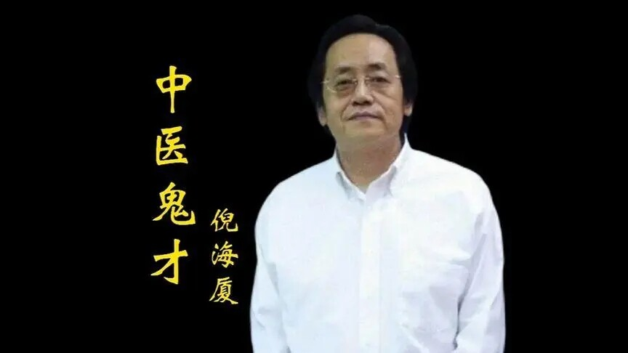
NHS Lupus formula
Modified Dang gui si ni tang+ Sheng fu zi, Gan jiang, Pao fu zi
For Jueyin Blood cold
SHL states “When hands and feet have Jueni, pulse is thin and on the verge of Expirng, Dang gui si ni tang governs
手足厥寒，脈細欲絕者，當歸四逆湯主之。
If the pulse is floating and drumskin, and there is intestinal rumbling, this belongs tp Dang Gui Si Ni Tang (Tangkuei Decoction for Frigid Extremities).
設脈浮革，因爾腸鳴者，屬當歸四逆湯主之。
Textually, DGSNT is indicated for an Expiring pulse and a Drumskin pulse

Slide 47
DGSNT ingredients
當歸四逆湯方
Dang gui 9, Gui zhi 9, Shao yao 9, Xi Xin 9, Da zao 15, Zhi gan cao 6, Mu tong 6
(Formula is based off Gui zhi tang), which harmonizes Ying and Wei, and expels Wind strike. Sheng jiang is removed as to not effuse the blood from the middle burner outward. Dang gui is added to supplement Heart and Liver blood, and effuse warm blood to the periphery.
Xi xin and Mu tong are to Warm shaoyin cold manifesting in cold in the lung vessels, and Mu tong ability to “penetrate Wood”.
Ni Hai Sha that Xi xin brings the Fire of the heart to the small intestine dispelling deep seated cold dampness in the lower burner 細辛具有升發下焦之陽的能力，能夠引心火下行入小腸，並且搜剔深層的寒濕動能
(Zhì Gān Cǎo) strengthens the Heart, specifically enhancing the force of the arterial pulse. Sháo Yào, on the other hand, strengthens the return of blood through the vessels, supports the yin aspect and helps blood flow back through the veins.W hen the two are used in equal amounts, it reflects the equal length of the arterial and venous pathways within the body, symbolizing the balance and reciprocal flow between arteries and veins, and emphasizing the importance of arterio-venous openness and circulation.

Slide 48
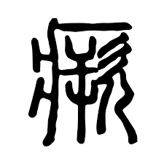
厥逆 Jue Ni
Ni Hai Sha stated “The hands and feet being cold reflects the temperature of the stomach qi. In a healthy person, the palms should be warm and the backs of the hands cool. The head should be cool, and the palms warm — this indicates that the stomach qi is rising properly. 手腳冰冷，代表的是胃氣的溫度。正常人手掌是熱的，手背是涼的。頭應該是涼的，手掌應該是熱的，表示胃氣上升正常”
Jue Ni symbolizes the qi of Yin and Yang qi not mutually following and connecting 凡厥者，陰陽氣不相順接，便為厥。厥者，手足逆冷是也

Slide 49
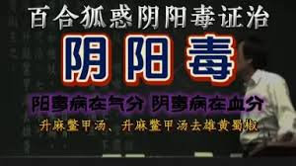
Wú Xióngzhì吴雄志 treatment
For Lupus, Wu Xiong Zhi focuses on the patho-etiology of Yin and Yang Toxin 陰陽毒 Yīn yáng dú. This is for latent evils nested in the jueyin.
WXZ looks at Lupus from the vantage point of Yang toxin
The Jin Gui Yao Lue states “As for the disease of Yang toxin, the face is red with macular spots like brocade patterns; there is throat pain, with spitting pus and blood. If treated within five days, it can be cured; after seven days, it cannot be cured. Sheng Ma Bie Jia Tang governs it “陽毒之為病，面赤班班如錦文，咽喉痛，唾膿血。五日可治，七日不可治，升麻鱉甲湯主之。"."
Yang toxin presents with reddish mottling on the face like brocade patterns.” This refers to the facial erythema seen in lupus. Sore throat” is also a common manifestation during acute lupus flare-ups, indicating a shift into the Shaoyang layer.

Slide 50
Lupus features according to WXZ
What are the characteristics of lupus?
1. “Lupus hair” (狼疮发): Hair becomes dry, fine, yellowish, and brittle (easily breaks). This is characteristic of lupus.
2. More common in women of reproductive age: Because estrogen levels are higher in this group. Estrogen is an immune activator, which increases susceptibility to autoimmune disease. This aligns with Shaoyang Ministerial Fire (少陽相火).
3. “Lupus rash” (狼疮斑): Reddish facial erythema appearing on both cheeks in brocade-like patterns. Often mistaken for allergic rashes and treated dermatologically as such.
4.“Lupus eyes” (狼疮眼): The inner canthus and lower eyelids appear red, like the eyes of a dove (jiu yan 鳩眼). This is a hallmark sign of latent pathogens (伏邪).
When you observe lupus hair, lupus rash, and lupus eyes, you must immediately assess whether the patient has lupus. These are core characteristics of the disease.

Slide 51
Sheng ma bie jia tang 升麻鳖甲汤
This is a classical formula for treating Jueyin-level disorders.
Sheng Ma: lifts and expels latent pathogens to the surface. Dang Gui: moves the blood
Bie Jia (soft-shelled turtle shell): nourishes yin. Gan Cao: has a corticosteroid-like action
Realgar (Xiong Huang): induces lymphocyte apoptosis — similar to Western immunosuppressive cytotoxic agents like azathioprine and cyclophosphamide (I often replace Xiong huang with Liu huang, less toxic, albeit, it is hotter and not appropriate for yang lesions. However, Ni Hai Sha states that Liu huang directly enters the San jiao and lights up Mingmen)
Sichuan Pepper (Shu Jiao): reduces the toxicity of realgar, such as preventing headaches
When lupus is not actively flaring, Sheng Ma Bie Jia Tang is appropriate. During a flare, when skin redness emerges, additions such as Sheng Di Huang, Mu Dan Pi, and Shou Wu are recommended. The formula must be adjusted for hot or cold constitution: Shu Jiao aligns with the principle “Winter damage by cold, spring manifests as warmth”; warming herbs such as Rou Gui and Fu Zi can be added to enhance warming action.
Once the pathogen expresses through the skin, cooling blood and invigorating blood herbs like Sheng Di, Mu Dan Pi, and Huang Qin should be added, because the latent pathogen has emerged from the blood level into the qi level, becoming a warm disease (温病). Wu Xiong Zhi for example has various SMBJT formula variants.

Slide 52
WXZ clinical strategy
WXS states Treating lupus from the perspective of latent-warm pathogen disease (伏邪温病) often yields significantly better outcomes than using only traditional “immune-suppressing” herbal strategies such as those that clear heat, cool blood, and remove rashes.
High doses of Sheng Ma may initially worsen symptoms, as the pathogen is pushed to the exterior. This may happen repeatedly until the body no longer reacts. At that point, the disease is considered resolved.
Simultaneously, one must apply the “balancing method” (调平法):
Push pathogens outward (托邪外出)
Clear external pathogens (清解外邪)
If the expelling force is too strong and clearing force too weak, acute flares may become unbearable. Conversely, if clearing is too strong and expelling is insufficient, pathogens will become latent again.

Slide 53
Four therapeutic principles
伏邪温病的四个治法
The Four Therapeutic Principles for Latent-Warm Pathogen Disorders (伏邪温病):
1. Warming (温) — for cold damage in winter
2. Supplementing (补) — to treat vacuity
3. Expelling (托) — to push out the pathogen
4. Clearing (清) — to eliminate the pathogen once expressed
These four methods must be harmonized in dosage and herb selection based on the individual case.
Yin Toxin Variant (陰毒) “Yin toxin manifests as bluish-green face and limbs, body pain as if beaten, sore throat. Sheng Ma Bie Jia Tang without Realgar and Shu Jiao governs.”
The symptoms “bluish face,” “body pain like being beaten,” and “sore throat” are often seen in multiple myeloma, which affects the entire skeletal system, causing systemic pain. This type can also be treated with a modified Sheng Ma Bie Jia Tang.

Slide 54
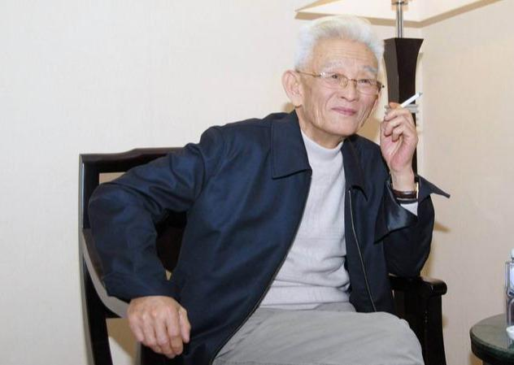
Li Ke on Autoimmune disease
Dr. Li Ke, born in 1933 in Shanxi Province, was a renowned veteran Chinese physician with over 50 years of clinical experience. Whenever encountering acute, dangerous, or critical conditions, he used potent and toxic Chinese medicinals for treatment and achieved effects akin to returning the dead to life. For stubborn and difficult diseases, their use often led to rapid turnaround, reviving long-standing severe illnesses. Among these, the most frequently used was Fuzi (附子), followed by Chuanwu (川烏). He treated over ten thousand patients with such medicines, without a single case of toxicity.
Li Ke emphasizes that the origin of immunological diseases is the Essential qi is already vacuous 本氣先虛. This allows Xie qi to continuously penetrate deeply. Li Ke states “In those with original (constitutional) qi deficiency, when the pathogen first attacks the exterior, the Zheng qi lacks the strength to expel it outward. As a result, the pathogen penetrates into the channels and lodges in the viscera, hiding within the blood and qi, ultimately developing into a condition where “a wind-cold that fails to resolve turns into consumption 癆(tuberculosis-like wasting).”本氣虛者，邪初在表，正虛無力驅邪外出而入於經絡，內舍臟腑，伏於血氣，形成「傷風不醒變成」。

Slide 55
Li Ke’s Four treatment principles
Li Ke has 4 treatment principles 理法
1. Support Upright Qi to Expel Pathogens; Assist Yang to Outthrust the evil out 、扶正達邪，助陽透邪. Support the upright to reach the evil""Assist y ang to push the evil out""Only support upright qi, let the evil exit on its own“ 扶正達邪助陽透邪但扶正其，聽邪自去
Representative Formulas
:人參敗毒散 (Rénshēn Bàidú Sǎn), 小青龍湯 (Xiǎo Qīng Lóng Tāng)
四逆湯 (Sì Nì Tāng), 麻黃附子細辛湯 (Máhuáng Fùzǐ Xìxīn Tāng)
烏頭湯 (Wūtóu Tāng) — with modifications.
He cautions us with formulas like Yin qiao san and Bai hu tang

Slide 56
固本 Consolidating the Root
2. Consolidate the Root and Cultivating the Yuan 固本培元. Take supporting upright qi as primary 以扶正為主
Representative Formulas:
附子理中湯 (Fùzǐ Lǐ Zhōng Tāng )補中益氣湯 (Bǔ Zhōng Yì Qì Tāng)
補血湯 (Bǔ Xuè Tāng)建中湯 (Jiàn Zhōng Tāng)
桂附地黃湯 (Guì Fù Dì Huáng Tāng)
This step is not about about outthrusting evils, but building the body’s Source qi.

Slide 57
Embed Attack Within Supplementation
Third principle: Embed Attack Within Supplementation 寓攻於補
Attack when qi is abundant; supplement when qi is weak; or embed attack within supplement"正氣足則攻，正氣弱則補，或寓攻於補
Clinical strategies:
When the latent pathogen is breaking through to the surface, if rashes and joint swelling/pain intensify, the following can be added: Chuanwu (Radix Aconiti), Xixin (Asarum), Fuzi (Aconite), Wuzhuyu (Evodia), Mahuang (Ephedra), Guizhi (Cinnamon twig), Gegen (Pueraria root).
If there are signs of collateral/channel disorders, add insect-type medicinals to unblock the collaterals: Wugong (centipede), Quanxie (scorpion), Dilong (earthworm), Jiangcan (stiff silkworm).若有瘀血，可加：乳香、沒藥 等活血化瘀之藥
If there is blood stasis, add blood-invigorating and stasis-dispelling herbs such as:Ruxiang (Frankincense), Moyao (Myrrh).
Representative Formula: Modified Wu Tou Tang Decoction

Slide 58
Yang Collapse (Wáng Yáng 亡陽)
4."When upright and evil [qi] contend, guard against the danger of yang collapse."正邪相爭，防亡陽之危.
When upright and evil [qi] contend, it inevitably injures the upright qi. One cannot expel the evil, nor can one support the upright — one must urgently gather the upright qi. When the lower burner has a root, the yuan qi returns to its residence.“ 正邪相爭，必傷正氣不能祛邪，不能扶正，急敛正氣下焦有根，元氣歸宅“. The struggle between upright and evil inevitably harms the upright. If one cannot attack nor supplement, gather qi urgently“. Once yuan qi returns to the lower burner, resume treatment“
In this tug-of-war: If one only sees excess evil and attacks it too harshly with cold medicinals,vOr if hidden pathogens continue to drain the upright qivthis may exhaust yuan qi and create a false pattern of heat above and cold below: Symptoms include cold icy lower legs. ,Floating false heat above, with the Face with a red appearance ,Qi rising but not descending. At this point :You can neither attack nor supplement directly 下肢冰冷或浮腫上實下虛上假熱下真寒面如紅妝氣升不降
Representative Formulas:
四逆湯 (Sì Nì Tāng) and 破格救心湯 (Pò Gé Jiù Xīn Tāng)
四逆加人參湯 (Sì Nì Jiā Rénshēn Tāng)
引火湯 (Yǐn Huǒ Tāng) 潛陽封髓湯 (Qiányáng Fēng Suǐ Tāng)

Slide 59
Cyclical method
Full resolution
5.–One has to alternate between expelling latent pathogens and supporting upright qi補充：反覆托邪與扶正之交替. This cyclical method—“stop warming and draining when deficiency signs appear, resume supporting qi” is emphasized as a key to eventually fully expel the 伏邪 (latent pathogen).

Slide 60
Lì jié bìng 歷節病
The Jin Gui States
“A sour flavor injures the sinews; when the sinews are injured, they become slack. This is called 'leakage' (xiè).A salty flavor injures the bones; when the bones are injured, they atrophy. This is called 'dryness' (kū).When dryness and leakage clash with each other, it is called 'severed leakage' (duàn xiè). When the ying qi does not circulate and the wei qi cannot move independently, and both ying and wei become feeble, the triple burner has nothing to manage, the four limbs are disconnected, the body becomes emaciated, only the feet swell greatly, yellow sweat emerges out, and the shins become cold. If there happens to be fever, then it is called li jie 味酸則傷筋，筋傷則緩，名曰泄；醎則傷骨，骨傷則痿，名曰枯；枯泄相搏，名曰斷泄。榮氣不通，衛不獨行，榮衛俱微，三焦無所御，四屬斷絕，身體羸瘦，獨足腫大，黃汗出，脛冷。假令發熱，便為歷節也
Fever signifies active immunological process

Slide 61
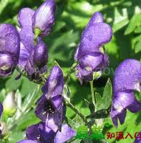
Wu Tou Tang
Li Ke primary method, based on the Jin gui disease of Lì jié bìng 歷節病 (Digit articulation disease), which can be used immunological diseases such as Lupus with arthralgia. Can be combined with Dang gui si ni tang for deep cold entering the the blood aspect 若内有久寒，深入血分，形成“沉寒痼冷”之格局
For painful migratory joint disease (li jie), with joints that cannot bend or stretch, and intense pain — Wutou Tang governs.烏頭湯方：治腳氣疼痛，不可屈伸。
Wutou Decoction also treats jiaoqi (Leg qi) pain, with inability to bend or stretch.
Ingredients: Ma huang, Shao yao, Huang qi, Zhi gan cao each 3 liang, Chuan Wu Tou 5 pieces Pound and cut them, add 2 sheng of honey, and cook down to 1 sheng. At this point, remove the Wu tou pieces 㕮咀，以蜜二升，煎取一升，即出烏豆。*A single piece of Chuanwu averages 5 grams
The above five ingredients: pound and cut four of them (excluding Chuanwu, already removed), add 3 sheng of water, boil to yield 1 sheng, strain out the dregs, mix this decoction with the honey-processed extract, decoct again, and take 7 ge (140ml) as one dose. If no effect, take all of it.右五味，㕮咀四味，以水三升，煮取一升，去滓，內蜜煎中，更煎之，服七合。不知，盡服之。

Slide 62
Wu tou intructions
Zhi gan cao should be doubled to Wu tou, so in Wu Tou Tang the dosage is 25 grams of Wu Tou, to 48 grams of Zhi gan cao. The Higher the Wu Tou, the higher the Zhi gan cao. Also any Wu tou dosage above 30 grams should be cooked for 3 hours.
According to Li Ke, the decoction method of Wutou Tang holds deep meaning: First, decoct Chuanwu with 2 sheng of honey (1 sheng ≈ 200ml Han measure) until it reduces to 1 sheng. At that point, remove the Chuanwu, keep the honey.
Honey has two purposes:As the essence of myriad flowers, honey excels at resolving all poisons — especially Chuanwu’s .The thick, viscous nature of honey, when slow-boiled, reduces toxicity.At this point, Chuanwu’s harsh, acrid, dry, and fierce nature can no longer cause harm.
Then decoct all five herbs in 3 sheng of water, reduce to 1 sheng, strain the dregs, combine with the reserved honey decoction, and boil again. This further neutralizes toxicity.
Administration method: take 7 ge (about 140ml, two-thirds of the dose)
.Instruction:“If no effect, finish the rest.”That is, if the patient does not feel numbness of lips and tongue after taking the first dose (“not aware”), they must finish the remaining third. If mild numbness is present, this is called “awareness” and no more is needed. In general, 140ml produces effects.In people with unusual constitutions, this dose may not work — then the entire decoction should be taken.

Slide 63
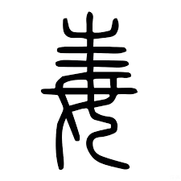
Wu tou toxicity
According to Li Ke, when using Wutou formulas, always add Double the dose of Zhi Gancao. 150g honey, 30g each of Hei Dou and Fangfeng
When using more than 30g of Fuzi, even if the original formula doesn't include them, add: 60g Zhi Gancao to effectively control toxicity.
In 1965, Dr. Li Ke performed an emergency rescue of two cases of Chuanwu poisoning in critical condition. He used:30 grams each of raw Da Huang, Fangfeng, He dou, and licorice,150 grams of honey, decocted into a soup, and administered with 30 grams of raw mung bean powder. Both patients were revived within 40 minutes. This incident also indirectly proves that when using the newly developed Wutou Tang (New Wutou Decoction), there is no danger of toxicity whatsoever.

Slide 64
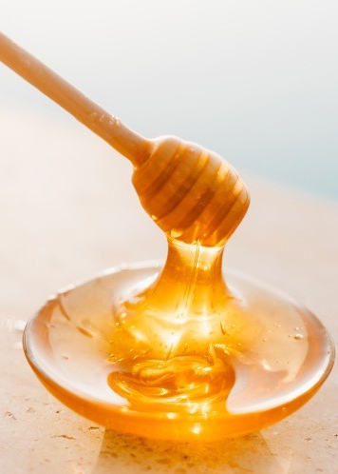
Li Ke’s Wu Tou tang
Wu Tou Tang as described, but sometimes with:
Chuanwu 20–30g or more, depending on severity
麻黃 (Mahuang) – opens surface and channels
芍藥 (Shaoyao) – harmonizes and relieves pain
黃芪 (Huangqi) – tonifies Wei qi, assists Yang
炙甘草 (Zhi Gancao) – harmonizes, detoxifies Chuanwu.
Safety Counteragents (“制毒配伍”) – always added:
These are the hallmark of Li Ke’s version:
黑豆 Hei Dou – 30g
防風 Fang Feng – 30g
炙甘草 Zhi Gancao – increased to 60g if Chuanwu or Fuzi exceeds 30g

Slide 65
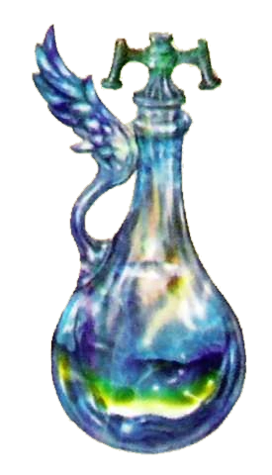
Wu tou antidote
Zhi Gancao (honey-fried licorice) supports the righteous qi and resolves all kinds of toxins, and neutralizes the toxicity of Wutou and Fuzi.
Honey nourishes the middle, moistens dryness, relieves pain, and detoxifies. It treats lung dryness with cough, intestinal dryness with constipation, epigastric burning pain, nasal congestion, mouth sores, and scalds or burns. It also counteracts the toxicity of Wutou and Fuzi.
Hei dou: Black soybeans promote blood circulation and urination, dispel wind and resolve toxicity. They treat edema, distension and fullness, wind-toxin leg disorders, jaundice with swelling, wind-damp bi syndrome with muscle spasm, postpartum convulsions with clenched jaws, abscesses and sores, and also detoxify medicinal poisons. The Compendium of Materia Medica《本草纲目》 states: “Its decoction can counteract the toxicity of arsenic, Euphorbia kansui, Aconitum (Tianxiong, Fuzi)... and a hundred other poisons.
Fangfeng (Saposhnikovia root) releases the exterior and dispels wind, overcomes dampness and relieves pain. It treats wind-cold exterior syndromes, headache, dizziness, stiff neck, wind-damp bi syndrome, sore joints, limb spasms, and tetanus. Seeking the Origin of Materia Medica 《本草求原》states: “Neutralizes poisons from Wutou, Genkwa (Yuanhua), and wild mushrooms.” Ben cao Ji Zhu《本经集注》notes: “Kills the toxicity of Fuzi.”

Slide 66
Wu tou cooking
When the dosage exceeds 30 grams for Wutou formulas: Add 2500 ml of cold water, decoct gently over low flame until reduced to 500 ml, and take in three divided doses per day. Decoction time is approximately 3 hours, which is sufficient to effectively destroy the severe toxicity of aconitine.
For Fuzi formulas used in chronic heart failure: Add 1500 ml of cold water, decoct slowly to 500 ml, and divide into 2–3 doses per day.
For critically ill patients on the verge of death due to heart failure, when using “High-Dose Breakthrough Rescue Heart Decoction” (大劑破格救心湯" (Dà jì pò gé jiù xīn tāng) ), the method is: Decoction with boiling water over high flame and rapid fire, administering as it is being decocted, without following normal procedures, in order to rescue life in the moment. At this point, the toxicity of Fuzi becomes the divine elixir that saves the patient’s life, and there is no need for concern.

Slide 67
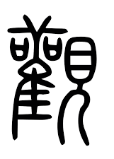
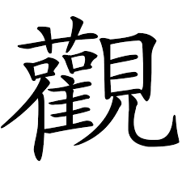
The forgotten art
Whenever a Wutou formula is prescribed, the physician must personally visit the patient’s home, demonstrate how to decoct the medicine, and observe the patient after administration. The patient must be closely monitored and questioned in detail about any sensations in the lips and tongue after taking the medicine. Only after confirming the patient is completely well, should the physician leave.
Even Zhang Zhong Jing states “If the disease is severe,[ the medicine is] taken one day and one night, for this cycle of time observe them 若病重者，壹日壹夜服，周時觀之”

Slide 68
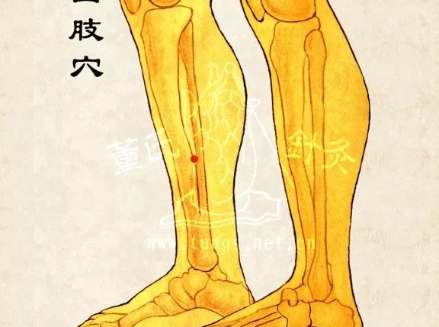
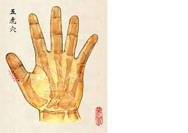

Wu hu+ Shen guan+ Si zhi
11.27+ 77.18+77.20
Expelling evils in the Taiyin, supplementing the Postnatal to foster the Prenatal (kidney yang insufficiency) releases the exterior, guides into the 4 limbs.
Zeng Tian De often combines Wu Hu with Fu Yuan (11.22) for autoimmune joint pain
Si zhi/ 4 limbs has a 4 limbs, Heart branch, and Kidney sub-branch correspondence 心之支神經、四肢神經、腎之分支神經

