Slide 1
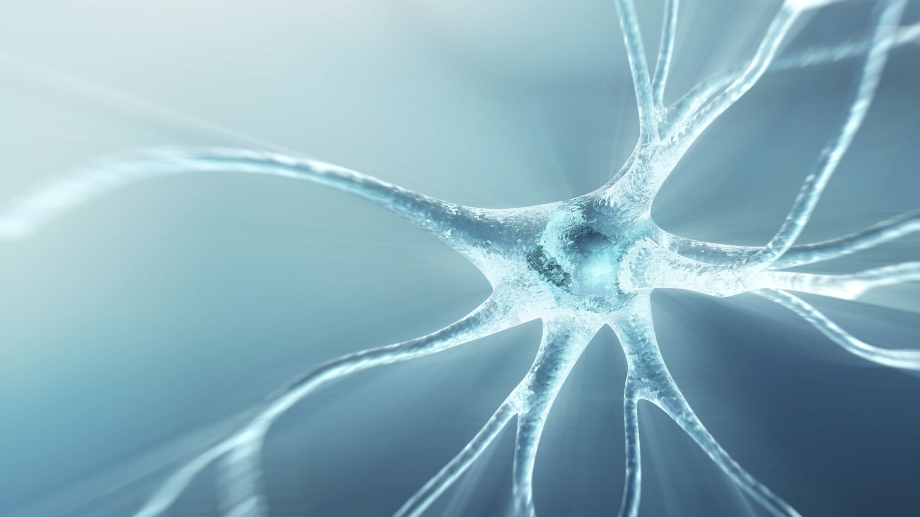
Autoimmune Series:
R.A. and Fibromyalgia
Ivan Zavala (Cloud)
L.Ac, DCCM

Slide 2
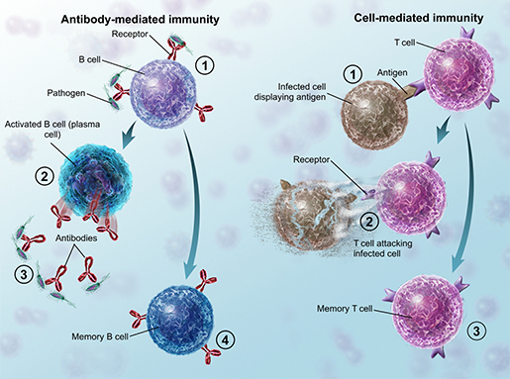
What is Autoimmune disease?
Autoimmunity 自體免疫疾病 in Chinese medicine represents an obstinate disease 痼疾. While it can have an acute nature 急性 or a chronic nature 慢性, ultimately it is a chronic stubborn disease process that ebbs and flows into manifestation and remission.
In biomedicine, there are 4 types of immune reactions: Type I (immediate/IgE-mediated), Type II (cytotoxic/IgG/IgM-mediated), Type III (immune complex-mediated), and Type IV (delayed/T-cell-mediated).
Type I mostly involves allergic diseases, whereas Type II, Type III, Type IV are the most involved in the autoimmune process. Type II and Type III are antibody-mediated and Type IV is T-cell mediated.

Slide 3
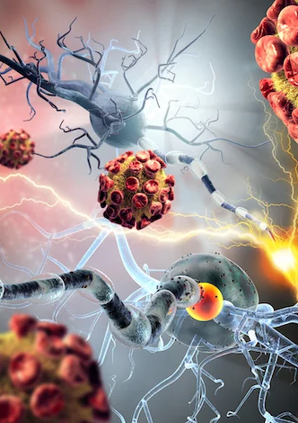
Rheumatoid arthritis and Fibromyalgia
Rheumatoid arthritis for example encompasses both Type III and Type IV immune reactions, But it is dominantly a Type IV T-cell-mediated disease, but there is still a Type III immune hypersensitivity.
Fibromyalgia, on the other hand, is not an autoimmune disease, rather it is a central nervous system disorder affecting pain perception. The exact cause is not fully understood, but research points to central sensitization—a phenomenon where the nervous system becomes hypersensitive to pain signals. This is due to abnormal sensory processing in the spinal cord and brain, particularly in the dorsal horn of the spinal cord and pain-processing areas like the thalamus, insula, and anterior cingulate cortex. Functional MRI (fMRI) studies show increased activation of pain-related brain regions, even with minimal stimulation.

Slide 4

Fu Xie 伏邪
Fu xie translates to Latent evils, hidden evils, dormant evils… This essential concept is instrumental in understanding the development of autoimmune diseases.
The Neijing states: “Winter damage by cold, inevitably in spring it will be Wen bing” “冬傷於寒，春必溫病…..
“Therefore, those who store their essence, in spring won’t suffer warm disease 故藏於精者春不病溫
Summer damage by summerheat, in autumn it will become Malarial disease 夏傷於暑，秋為痎瘧
First, this illustrates the relationship between Cold and Heat. Wenbing is a subset of Shang han. Cold causes contraction, winter/ zang organs represent the image of storage. When this contraction ensues, one’s own yang qi becomes oppressed, manifesting in heat

Slide 5

失精 Loss of essence
The susceptibility to contracting a latent pathogen is determined by both simultaneous internal and external causes. The internal cause is attributed to the loss of essence, as it leads to proclivity to latency/ dormancy without manifestation 伏而未發.
And when it does manifest, then it does transform to heat 發而化熱.
Therefore, the establishment of Latent pathogens requires the body to not have enough material resources to expel the pathogen.

Slide 6
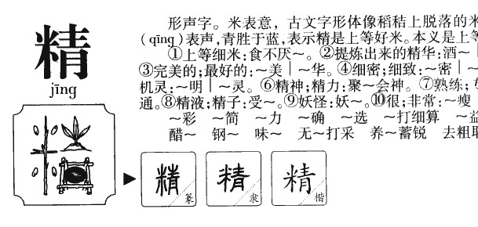

Slide 7
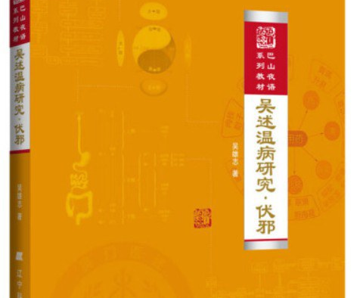
Wen bing yan jiu: Fu xie”
Many of these concepts are extracted from Wu Xiong Zhi’s “Warm disease research: Latent evils”

Slide 8

顽症 Intractable illnesses
In Chinese medicine, there is said to be 4 great intractable illnesses
(Wind 風，Taxation 勞，Drum-distention 臌，Diaphragmatic obstruction 膈), these are said to often lead to death despite accurate syndrome differentiation. Part of the reason posited is Latent pathogens.
An important understanding of Latent pathogen treatment is that symptom or disease improvement does not mean Latent pathogen expulsion, and symptoms worsening can be a sign of the latent pathogen being expelled

Slide 9



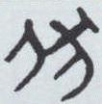

Fu xie discussion
While Fu Xie is often seen as an essential component of Warm disease studies 溫病學, its scope is far beyond that of warm diseases. The character for Fu 伏 is that of a dog 犬 prostrating underneath a human 人
Latent pathogen framework is clinically used to treat Greatly difficult diseases 大疑難病, such as chronic bacterial infections, chronic viral infections, autoimmune diseases, allergic diseases, malignant tumors, etc. Many diseases that Western medicine views as incurable or even untreatable. As long as the disease fits under the Fu xie characteristics

Slide 10
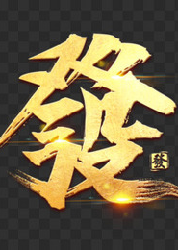
Fu xie essential characteristic
Human diseases are segmentalized into two causes---External contraction 外感 and internal damage 内傷. Within externa contraction, there two major subjects (Shang han and Wen bing).
Wen bing in particular is divided into two aspects: Newly contracted 新感 and Fu xie
Newly contracted disease refers to organism contraction with immediate Effusion/ manifestation (symptomatology). Wen bing newly contracted disease refers to acute contagious disease.
Fu xie, on the other hand, there is no immediate Effusion/ manifestation or repetitive Effusion (without resolution). This is because the Evil qi is hidden, then it activates, then it hides again in a continuous cycle of chronicity.

Slide 11
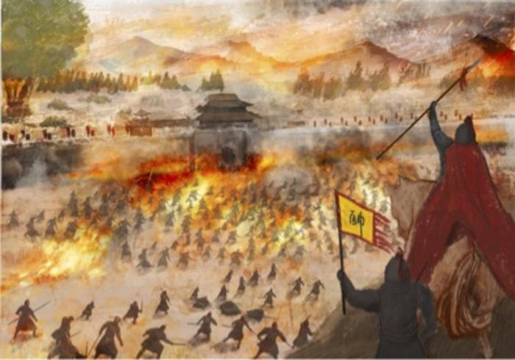
The 3 causes of latency
What leads the body to have latency?
According to Wu Xiong Zhi, the three causes are as followed:
Zheng and xie not contending 正邪不爭
The Zheng must resist evil for there to be manifestation. Think of a fever for example. In the Shang han lun, this concept of 正邪不爭 is what leads to the Coming and Going of Cold and heat 往来寒热. Symptoms is the organism’s response to pathogenic causes. Without manifestation, this means evil qi is latent.
2. Shaoyin vacuity cold--- This is yang deficiency
3. Jueyin—chronic disease enters the Luo (blood stasis)

Slide 12

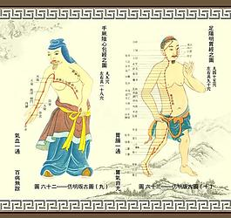
Jueyin blood stasis
The inflammation 炎症 that results from the blood stasis causes fibrosis 纖維化 and scarring 瘢痕. This fibrotic tissue leads to poor vascular blood supply, therefore immune cells and antibiotics aren’t capable of reaching the disease site. The Xie qi happens to hide inside the fibrotic scar tissue. This process is called Jueyin, chronic disease entering the Luo 厥陰久病入絡
Also this concept will be further elaborated on.

Slide 13
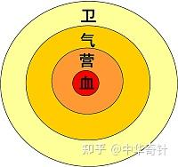
Disease transmission distinction
Wen bing theory, posits that Newly contracted disease starts from the Wei aspect >>> Qi aspect>>>Ying aspect>>>Xue aspect.
This is from exterior to interior, and it is the normal expected course of disease transmission.
Latent pathogens, follow a different abnormal pattern. The Latent evils start from the Blood/ xue>>>Ying>>>Qi>>>Wei
Also all six climactic Qi all can become Latent evils. Latent evils easily transform to fire, which means they emerge out of Shaoyang

Slide 14
The Five Latent pathogens
Latent evils consists of 1. Latent Cold, 2. Latent fire 3. Latent Wind, 4. Latent dryness, 5. Latent rheum。
Latent fire includes the pathogen of Heat. Latent rheum includes the pathogen of dampness.
The latent evils follow a 5 phase schemata.
Among these evils, warm heat and cold evils are the most common.

Slide 15

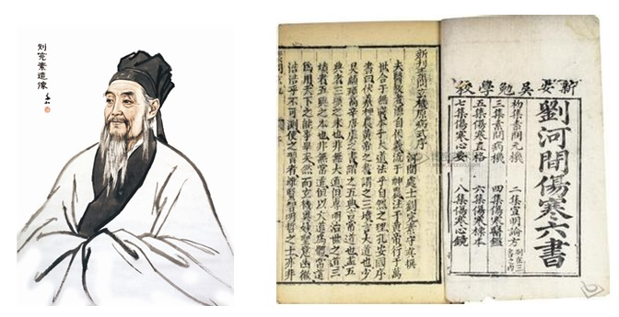
Liu Wan Su 劉完素
12 century physician, Liu Wan Su (1110-1200) is one of the most influential of the 4 great Jin Yuan masters 金元四大. He is considered the patriarch of the school of Cooling and cold “寒涼派
He posited that all the Six qi, all transform to Fire 六氣皆從化火. This has an enormous impact on how external pathogens were conceptualized, and preceded the Wen bing school

Slide 16
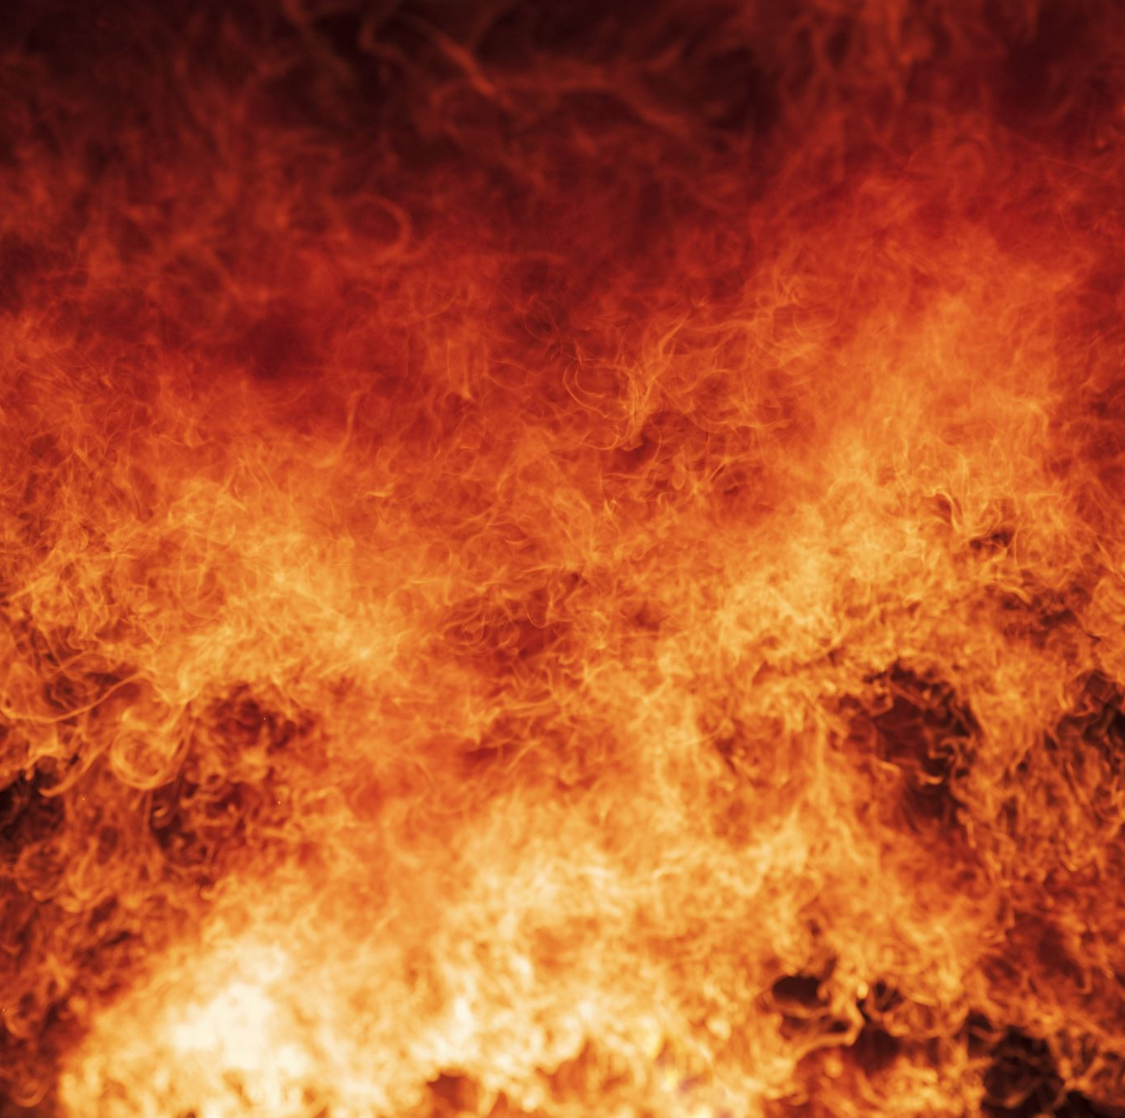
Transformation to Fire 化火
All the and, in a week, become fire, and in latent pathogen theory this is particularly the case when New contraction stirs up 新感引動 the latent evil.
For example, WXZ gives us the example of latent rheum, instead of giving Wu ling san or Xiao qing long tang, we need to give Gui ling xiao du yin instead of Wu ling san, or Xiao qing long jia shi gao tang instead of Xiao qing long tang.
One sees latent pathogen theory play out in a yang vacuous phlegm rheum patient, who contracts a new contracted cough, which then stirs latent rheum and in a week becomes pneumonia. That is the transformation to fire.

Slide 17
Lesser Yang 少陽
Shaoyang constitutes the Qi of Spring– and the Neijing of principle Damage by cold in Winter, in spring there will be Wen bing
Shaoyang in Wu yun liu qi (5 movements qi theory) governs qi of Fire– 少陽之上，火氣治之
In particular Xiang huo(ministerial fire) as the San jiao governs the movement of Ministerial fire

Slide 18
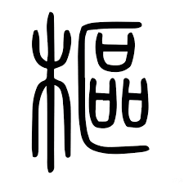

Shaoyang as pivot
Shaoyang as the pivot from where evils emerge out of the Yin.

Slide 19
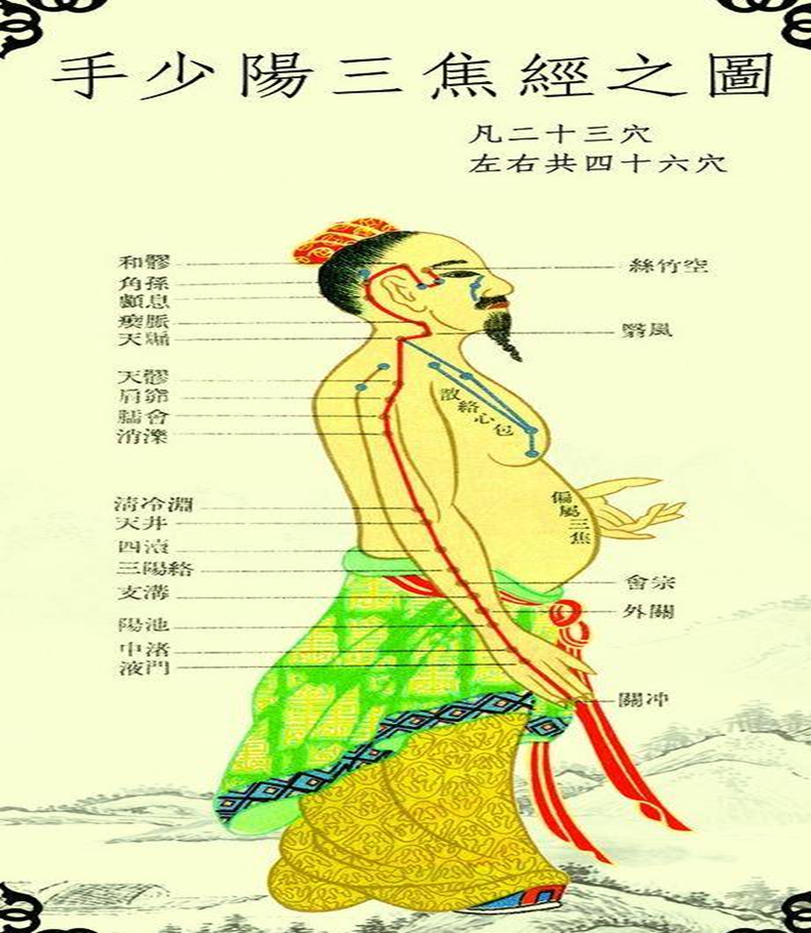
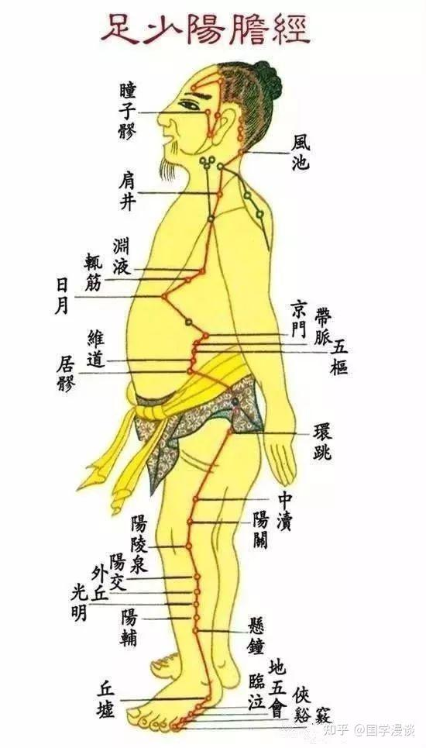
Hand and Foot Shaoyang

Slide 20
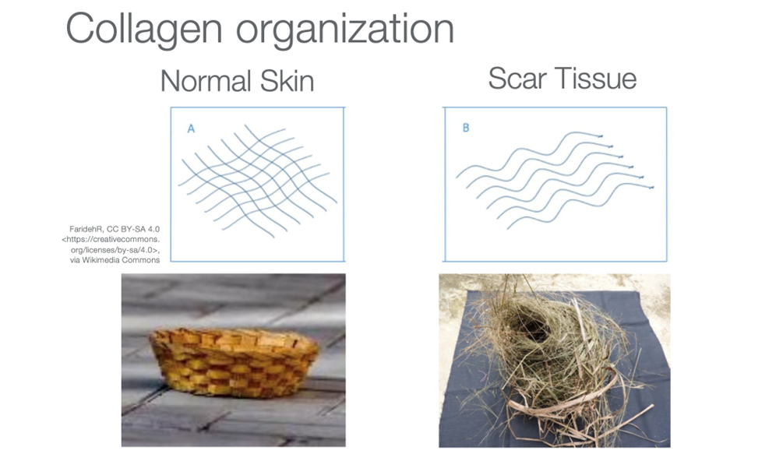
Jueyin as a Nest
Chao= Nest 巢
Latent pathogens ultimately hide in the Yin
In Taiyin because the Zheng qi is vacuous
Shaoyin because of Vacuous cold
Jueyin because of Blood stasis obstructing the Luo
Often in these Yin stages, antibiotics do not work. Blood needs Qi to command it, but Qi also needs Blood to transport it. Blood stasis obstructing the collaterals is a key pathomechanism in the formation of latent pathognes
Two Jueyin rx are Da huang Zhe Chong Wan (Huang qin tang base) and Bie Jian wan (Xiao chai tang base)
In Tung acupuncture, we can use Huan chao 還巢 11.06 (to draw out evils out of shaoyang)

Slide 21
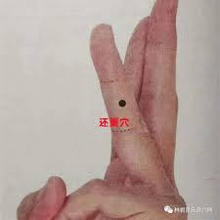
Huan chao
In Tung acupuncture, we can use Huan chao 還巢 11.06 (to draw out evils out of shaoyang)
Combine with Fu yuan 11.22 when pathogens are in the shaoyang bone level, which treats Sinew swelling, bone swelling, periosteum inflammation 筋肿痛、骨骼肿大、骨膜炎

Slide 22
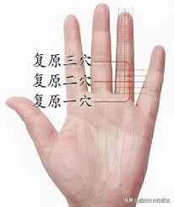
Fu Yuan/ Recover

Slide 23
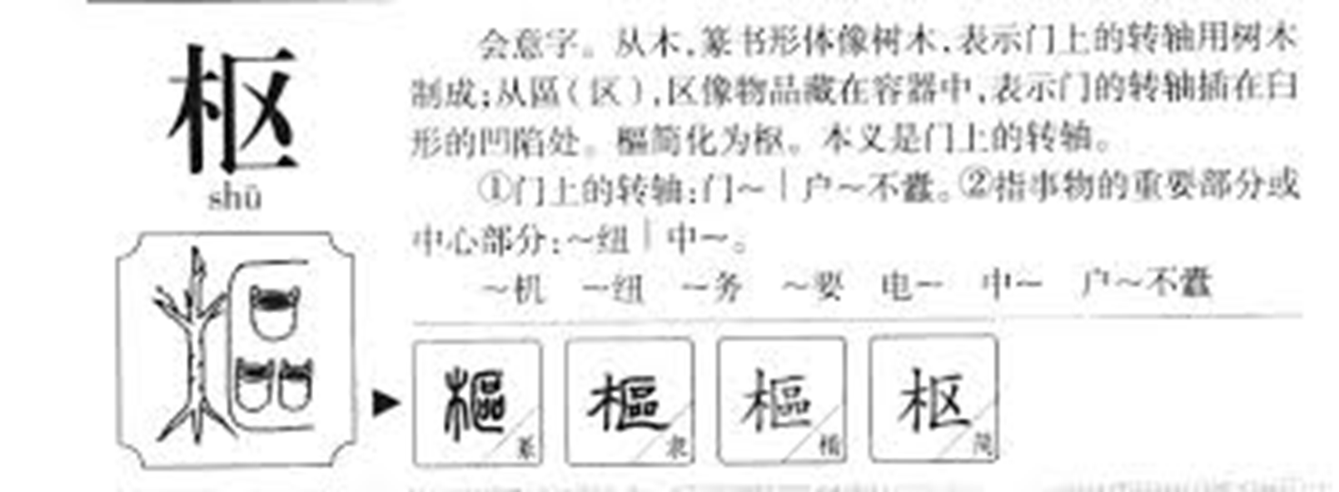
樞 Shu-Pivot/ Hinge

Slide 24
San jiao history
To really understand Shaoyang in a panoramic perspective, we need to understand its historical outline. As Professor Huang Long Xiang mentions there are FOUR San jiao theoretical doctrines.
Neijing view (New Synthesis of theoretical doctrine derived from previous circulating theories)
Nanjing view (Supplemetary)
Shan Fan Fang 《删繁方》
Zhu Bing Yuan Hou Lun (The most complete integrated model)
HLX argues because researchers have mostly focused on the Neijing model of Sanjiao, with supplementary study of the Nanjing view, it has led to erroneous conclusions.

Slide 25
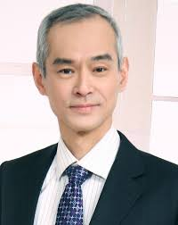
Huang Long Xiang
黃龍祥
While Professor HLX academic accolades are too numerous to name, his relevance for this lecture is the historical information provided in his
San jiao article
探三焦之名实索三焦学说之骊珠
“Exploring the name and reality of the San Jiao, and to seek the ‘legendary black pearl’ of the San Jiao theory.“
Found in:
现代中医临床
第 32 卷第 1 期 2025 年 1 月
Modern Chinese Clinical Medicine Vol. 32 No. 1 Jan. 2025

Slide 26
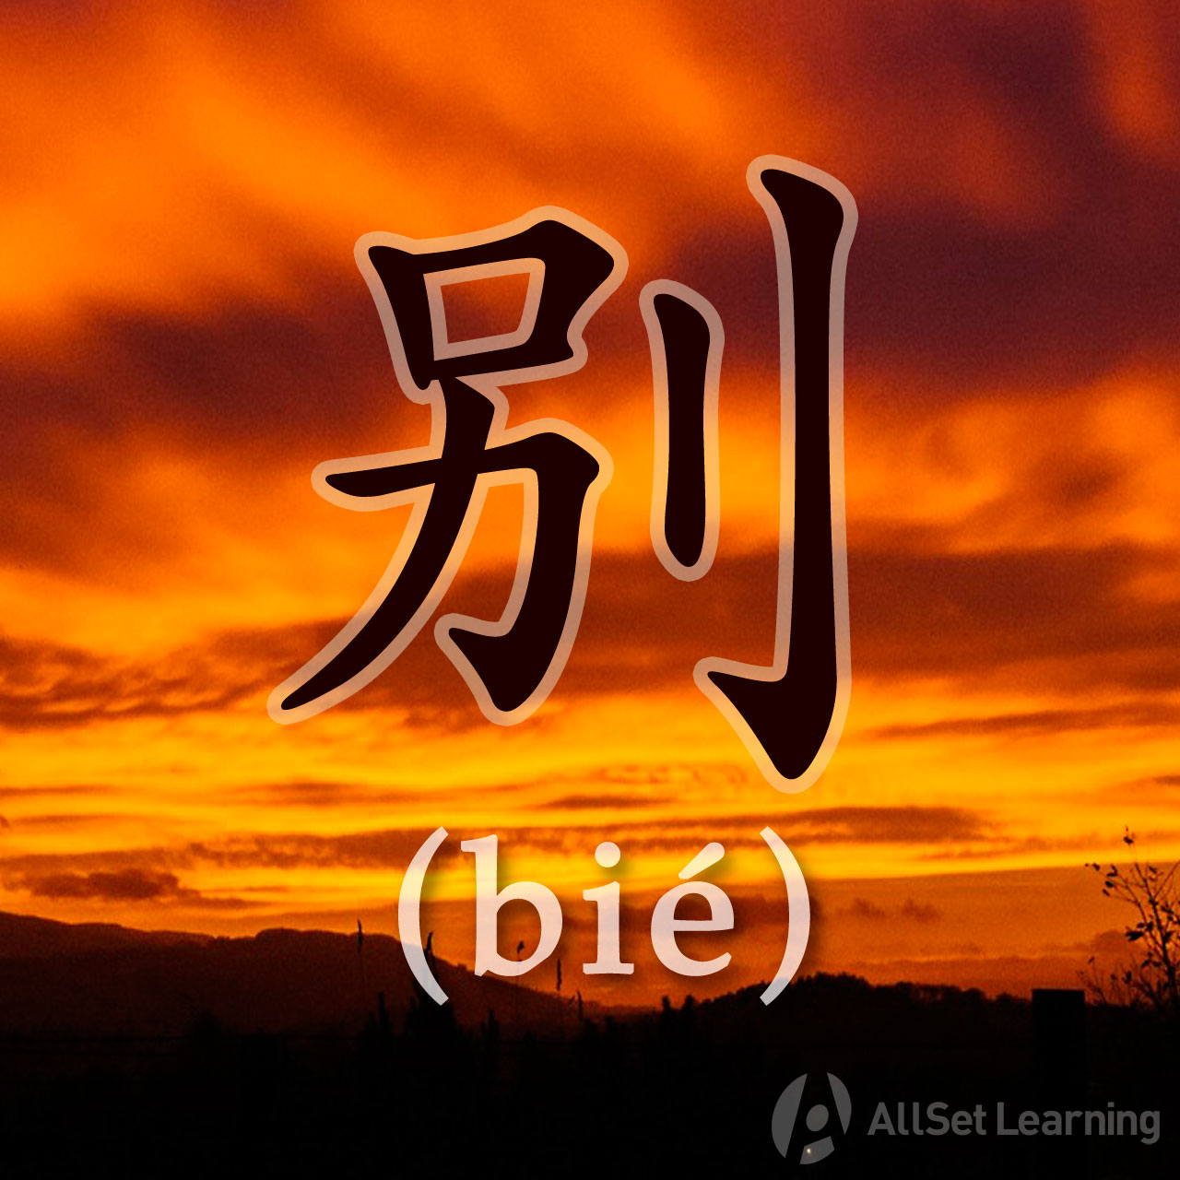
Neijing view
HLX states the Neijing perspective on San jiao is a revision of older theoretical doctines on the San jiao, but integrated to fit a new model based on the Neijing author’s new derivative grand synthesis of physiology. A grand physiological model where San jiao becomes the weaving framework connecting various theories on circulation.
Some of these older San jiao doctrines are preserved in the Neijing, often these doctrines appear in Bie lun 別論 chapters (Diverging discourse) of the Jing mai

Slide 27
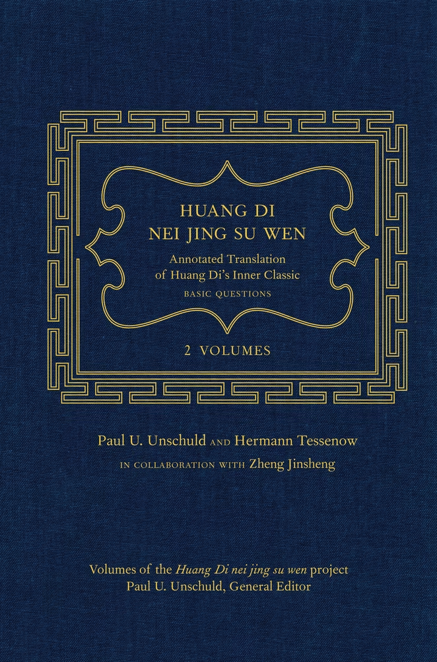
Older Neijing Doctrine
When food qi enters the stomach, its essence disperses to the stomach and its qi pours to the sinews. When food qi enters the stomach, the turbid qi returns to the heart, pouring its essence to the vessels. When the vessel qi flows to the Jing-channels. The channels Qi returns to the Lungs, the lung faces the Hundred vessels, transporting its essence to the Skin and body hair. The hair vessels unite with the essence, moving Qi to the organs.
食氣入胃,散精於肝,淫氣於筋。 食氣入胃,濁氣歸心,淫精於脈。 脈氣流經,經氣歸於肺,肺朝百脈,輸精於皮毛。 毛脈合精,行氣於府( 本文作者 註:「府」 指內府,與「 外經」 相對)。
When the Organs Jing shen is luminescent, it flows to the 4 zang (heart, liver, spleen, kidney), qi returns to balance. When their balance becomes equalized, the Qi mouth becomes the cun (kou) to determine life or death. 府精神明,留 (流)於四臟(本文作者註:心肝脾腎),氣歸於權衡。 權衡以平,氣口成寸,以決死生。
When drink enters to the stomach, the overfilled essence qi, ascending and transporting to the spleen. The spleen’s Qi spreads the essence upward to the lungs, regulates the water pathways, and transporting downward to the bladder.
Water essence disseminates in the 4 directions, moving simultaneously along the 5 channels, harmonizing with the Yin-Yang of the five Zang organs and the four seasons. Estimate this to be a constant pattern.” 飲入於胃,遊溢精氣,上輸於脾臟。 脾氣散精,上 歸於肺;通調水道,下輸膀胱。 水精四布,五經並行, 合於四時五臟陰陽,揆度以為常也。 (《素問‧經脈別論篇》)

Slide 28
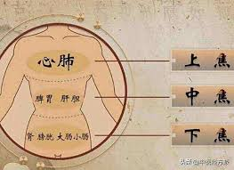
San jiao as three
Additionally, the Neijing also makes the distinction of the San jiao as a construct of three. Summed in the axiomatic phrase of:
上焦如霧 Upper Burner like a Mist
中焦如漚 Middle Burner like a Froth
下焦如凟 Lower Burner like a Ditch
This is described in the Ling shu chapter on Ying and Wei birth and meeting 營衛生會.
This chapter describes the generation of Ying and Wei as stemming from the San jiao’s physiological and anatomical system.

Slide 29
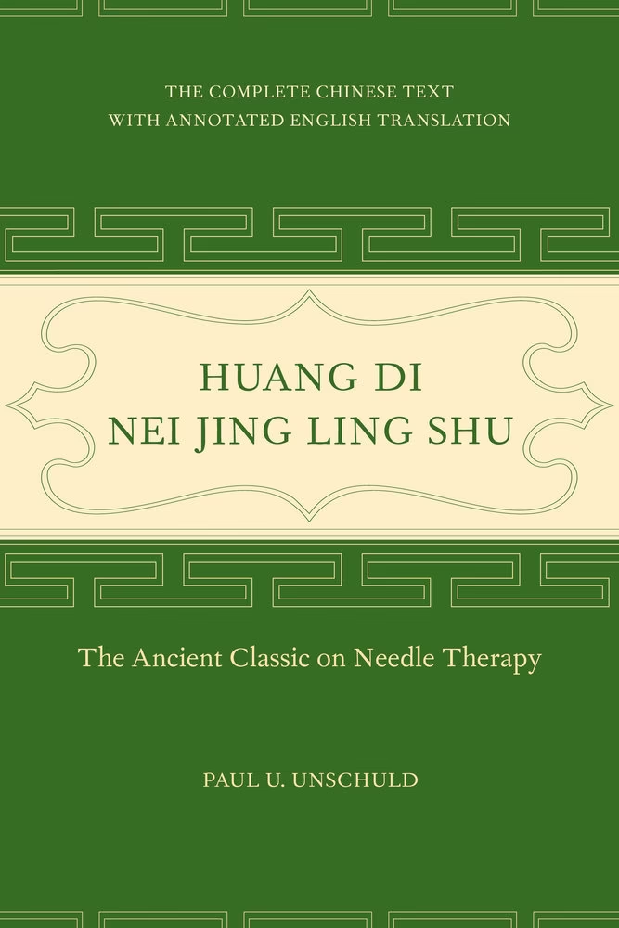
San jiao synthesis
Huang di says” I wish to heat about where Ying and Wei circulate, and where their pathways go to. Qi bo answers: Ying comes from the Middle Burner, Wei comes the Lower/ Upper Jiao. 黃帝曰:「願聞營衛之所行,皆何道從來?」岐伯 答曰:「營出於中焦,衛出於下(上)焦。」
Huang di says: I wish to hear where San jiao emerges…
The rest of the chapter describes the San jiao integrated with Ying wei theory
黃帝曰:「願聞三焦之所出。 」岐伯答曰:「上焦出於胃上口,並咽 以上貫膈而布胸中,走腋,循太陰之分而行,還至陽明,上至舌,下足陽明,常與營俱行於陽二十五度,行 於陰亦二十五度,一週也,故五十度而復大會於手太 陰矣。 」
中焦亦並胃中(口),出上焦之後,此受氣者,泌 糟粕,蒸津液,化其精微,上註於肺脈,乃化而為血, 以奉生身,莫貴於此,故獨得行於經隧道,命曰營氣。
下焦者,別迴腸,注於膀胱而滲入焉。 故水穀者 常並居於胃中,成糟粕而俱下於大腸,而成下焦,滲而俱下,濟泌別汁,循下焦而滲入膀胱焉

Slide 30
Neijing conclusion
The Neijing perspective on the San jiao proposes several revolutionary tenets, such as Ying and Wei and their distinct separation in the Middle Burner. Lingshu 5 flavor chapter describes to us how when Grain enters the stomach, its subtle essence, first pours into Two jiaos of the stomach, and it pours in the 5 zang, diverging out of two pathways, the path of Ying and Wei 《靈樞·五味》篇「谷始入於胃,其精微者,先出於胃之兩焦,以概五臟,別出兩行,營衛之道
Additionally, the three Jiaos replaced several functions of individuals organs. For example, the lower burner replaced older Six fu model . 下焦」概念及相關內容則移植於舊有的六腑「三焦
Replacing older theories of Qi circulation of Tidal movement to Qi and blood circular movement in the Jing mai, what is titled as Ring without End 將舊文的「氣血運行潮汐說」改為「氣血運行經脈循環說」,即所謂「營衛之行也,上下相貫,如環之無端」是也
The San jiao thus became an integrative link for the new doctrine of Ying, its 50 cycles, and the totality of Qi and blood circulation in the 12 Jing mai.

Slide 31
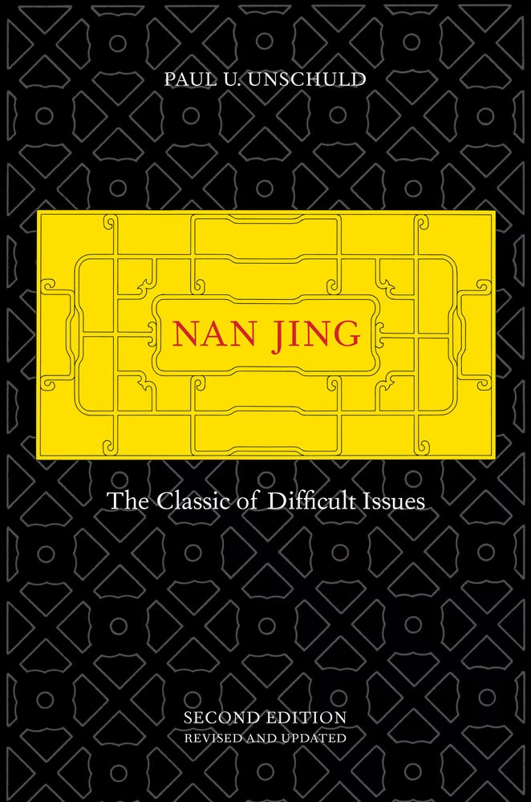
Nanjing View
HLX argues that the Nanjing also innovated and synthesized several perspectives on the Neijing and other extant texts. Among the 81 chapters of the Nanjing, 5 discuss the San jiao.
Chapter 31 represents the theoretical influence of the Nejing, the San jiao as the Pathway of water and grain, the beginning and end of Qi 水谷之道路,氣之所终始也”
This chapter also gives each of the Jiao, a therapeutic treatment site
Upper Jiao, treat with Dan zhong (between the breasts)
上焦者，在心下，下膈，在胃上口，主內而不出。其治在膻中，玉堂下一寸六分，直兩乳間陷者是。
Middle Jiao, Treat Beside the Navel
中焦者，在胃中脘，不上不下，主腐熟水穀。其治有齊傍。
The Lower Burner treat 1 cun below the Navel
下焦者，當膀胱上口，主分別清濁，主出而不內，以傳導也。其治在齊下一寸

Slide 32
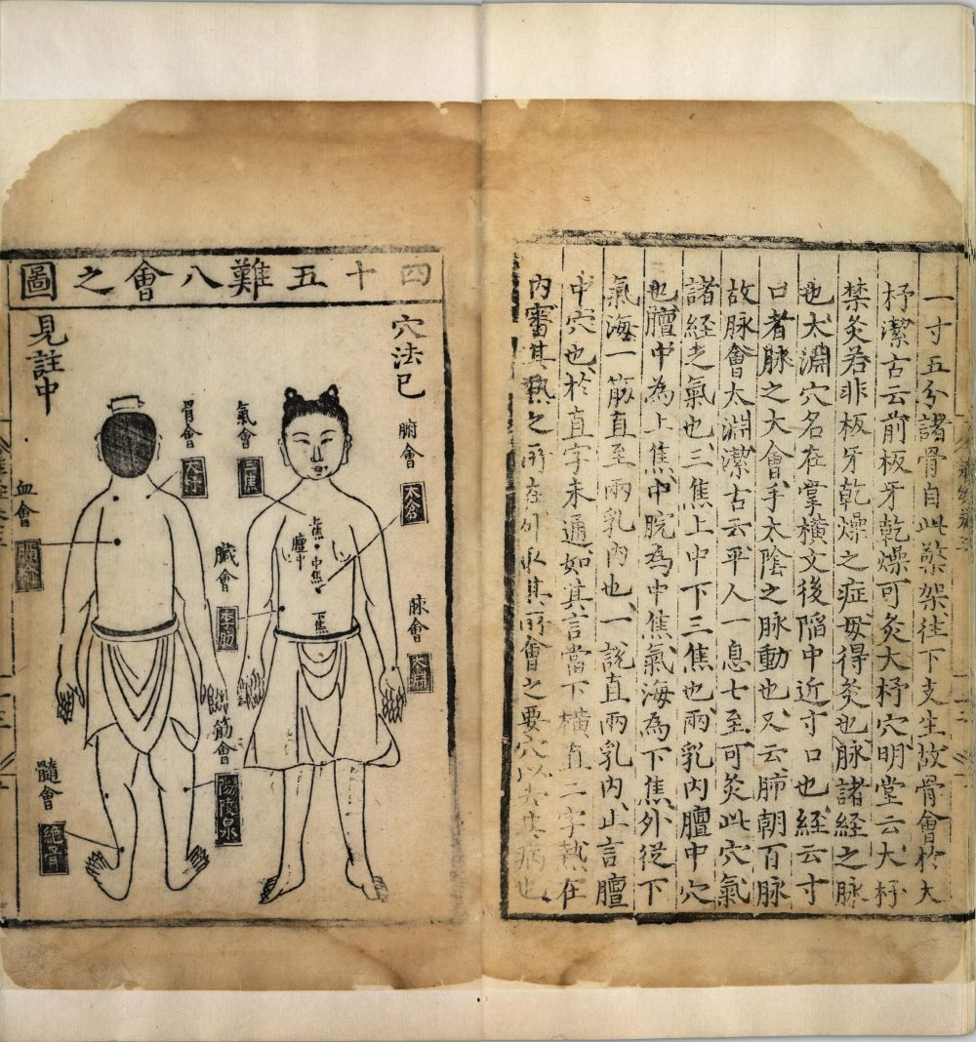
Nanjing distinction
Nanjing makes the San jiao as the Bie/ differentiator of Yuan qi 三焦也。有原氣之別焉 or envoy of Yuan qi 三焦者，原氣之別使也
This Yuan Qi becomes synonymous with the Yuan-source impetus located at the Stirring qi between the kidneys 動力之源在腎間動氣
This Stirring Qi is described as Qi chong/ Qi thoroughfare 氣衝
This Qi thoroughfare is said to be where the Chong Mai originates… 故名曰三焦，其府在氣街。一本曰衝。
衝脈者，起於氣衝，並足陽明之經，夾齊上行，至胸中而散也

Slide 33
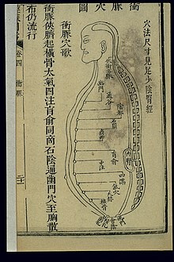
Chong mai 衝脈
The Lingshu also hints at the idea of Chong mai being the sea of the twelve Jing. Together with the great Luo of Shaoyin, it originates below the kidneys and emerges at the Qi thoroughfare."(Lingshu- Dong shu chatpter) 沖脈者,十二經之海也,與少陰之大絡,起於腎下,出於氣街。 」 (《靈樞‧動輸》
Since the Chong mai originates in the Lower burner, and the Nanjing links the driving force of San jiao to be in the lower, this radically changes the San jiao construct. As the Neijing focused on the Middle burner of San jiao to integrate Qi and blood generation and movement.
Chapter 66 of the Nanjing reiterates that this stirring qi between the kidneys is the Life and destiny of a person. And the root of the 12 channels. This is the chapter also that describes the source points 焦所行之俞為原者，何也？然：臍下腎間動氣者，人之生命也，十二經之根本也，故名曰原。三焦者，原氣之別使也，主通行三氣，經歷於五藏六府。原者，三焦之尊號也，故所止輒為原。五藏六府之有病者，取其原也
The Neijing describes the Chong mai as the sea of the five Zang and six Fu; all the organs depend on it

Slide 34
Ming Tang Jing 明堂經
The Ming Tang Jing (The Luminous Hall Classic) elaborates and refines Nanjing san jiao theory by assigning Front mu and shu points of the San jiao, and other point to treat San jiao disorders. 《難經》之後的針灸腧穴經典《黃帝明堂經》三焦相關輸穴內容更體現了《難經》三焦學說的觀點,並使之進一步完善。 例如增加了三焦輸、募,以及主治三焦症的其他輸穴,
Professor HLX states” A particularly significant detail lies in the Mu point of the San Jiao, Shimen (“Stone Gate”), whose alternating names reflect a common origin from the Nanjing's San Jiao theory:
Shimen, the Mu point of the San Jiao, also known as: Liji (‘Benefit Mechanism’), also named Jinglu (‘Essence Dew’), also named Dantian (‘Elixir Field’),and Mingmen (‘Gate of Life’). It is located two cun below the navel.“
Additionally, the Mingtang Jing records the Shu point of the San Jiao as being:"1.5 cun lateral to below the 13th vertebra.
Thus, Both the Mu and Shu points of San Jiao are positioned below the navel, further emphasizing the Lower Jiao’s leading role
特別是三焦之募「石門」的別名透露出與《難經》三焦學說一脈相承的特徵:「石門,三焦募也,一名利機,一名精露,一名丹田,一名命門,在臍下二寸。 」又所載三焦輸「在第十三椎下兩旁各一寸五分」,三焦之募、輸皆定於臍下,突出了下焦的主導作用

Slide 35
Shan Fang Fang 删繁方
This text biggest contribution is outlining the symptoms and treatment principles for the Upper, Middle, and Lower Jiao, while simplistically integrating Neijing and Nanjing theories of San jiao.
Upper Jiao
Middle Jiao- Vomiting and diarrhea
Lower Jiao– Vomiting with bowel obstruction
San Jiao is also called the Three Passes (San Guan):The Upper Jiao is called 'Three-Tube Reflux',The Middle Jiao is called 'Sudden Turmoil',The Lower Jiao is called 'Running Vomit’. These three parts combine as one — named but formless — governing the five Zang and six Fu, connecting with the spirit paths, circulating throughout the body, audible yet invisible, harmonizing and regulating essence and Qi, directing the water pathways, and mediating Qi between the intestines and stomach — something that cannot be overlooked.
論曰:「夫三焦者,一名三關也,上焦名三管反射,中焦名霍亂,下焦名走哺,合而為一有名無形,主五臟六腑,往還神道,周身貫體,可聞不可見,和利精氣,決通水道,息氣腸胃之間,不可不知也。 (轉引自《備急千金要方‧三焦脈論》卷二十)

Slide 36
Upper Jiao symptomatology
"The Upper Jiao is like mist. Its Qi originates from the upper tube of the stomach, ascends through the throat, passing through the diaphragm, spreading through the chest, moving to the armpits, follows the Foot Taiyin, then redirects to the Hand Yangming, ascends to the tongue, and descends again to the Foot Yangming. It constantly moves with Ying and Wei Qi.
It governs the Hand Shaoyang and the illnesses of the heart and lungs…Its disorders include: contraction and pain in the elbow,vomiting food before digestion, interruption in Qi movement,fullness and oppression in the diaphragm.Cold causes instability of spirit, diarrhea, and voice loss. Repletion leads to Qi obstruction in the heart; vacuirt draws Qi to the lungs.
論曰:「夫上焦如霧,其氣起於胃上管,並咽以上貫膈,布胸中,走腋循足太陰之分而行,還注於手陽明,上至舌下注足陽明,常與榮衛…主手少陽,心肺之病……其病則肘攣痛,食先吐而後下,其氣不續,膈間厭悶,所以飲食先吐而後下也,寒則精神不守,洩下便利,語聲不出,若實則上絕於心,若虛則引氣於肺也

Slide 37
Middle Jiao symptomatology
The Middle Jiao is like foam. Its Qi starts from the middle tube of the stomach, following the Upper Jiao.It receives Qi and is in charge of transforming the flavors of food and drink, retaining dregs, steaming body fluids, and refining essence. This essence is sent upward to the lung channel, transformed into blood, and used to nourish life — this is most precious. Therefore, it alone moves through the channel passages and is called Ying Qi.
It is governed by the Foot Yangming.The Yangming's alternate name is Fenglong, located eight cun above the outer ankle.It branches to the Taiyin, interconnecting the channels above and below, reaching the Great granary.It governs digestion and transformation. If excessive: generates heat, blocks passages, disrupts upward and downward flow.If vacuous: creates cold, abdominal pain, diarrhea, dysentery, sudden turmoil.It governs spleen and stomach disorders.If deficient, tonify the stomach; if excessive, drain the spleen — regulate the center, harmonize the source, leaving nothing untreated.
中焦如漚,其氣起於胃中管,在上焦之後,此受氣者主化水穀之味,秘糟粕蒸津液,化為精微,上註於肺脈乃化而為血,奉以生身,莫貴於此,故獨得行於經隧道,名曰營氣。 主足陽明。 陽明之別號,曰豐隆,在外踝,去踝八寸,別走太陰絡諸經之脈,上下絡太倉。 主腐熟五穀,不吐不下,實則生熱,熱則閉塞不通,上下隔瑤,虛則生寒,寒則腹痛、洞洩、便痢、霍亂,主脾胃之病…若虛則補於胃,實則瀉於脾,調其中,和其源,萬不遺一也

Slide 38
Lower Jiao symptomatology
The Lower Jiao is like a ditch. Its Qi arises from the lower tube of the stomach, branches to the small intestine, enters the bladder, and seeps into it Therefore, water and grains always reside in the stomach, become dregs, and descend together to the large intestine. It is governed by the Foot Taiyang, which irrigates body fluids and converges with the bladder. It governs excretion but not intake, separates the clear and turbid, and relates to the liver and kidney. If replete: urination and defecation become obstructed, Qi reverses, vomiting is uncontrollable — hence the name Running Vomit. If vacuous: urination and defecation are uncontrolled, body fluids and Qi are exhausted. Heat should be treated by draining the liver; cold by tonifying the kidney."(*Cited from: Beiji Qianjin Yaofang, Vol. 20, “Vacuoty and Repletion of San Jiao”)
下焦如瀆,其氣起胃下管,別迴腸,注於膀胱而滲入焉,故水穀者常幷居於胃中,成糟粕,而倶下於大腸。 主足太陽,灌滲津液,合膀胱。 主出不主入,別於清濁,主肝腎之病候也,若實則大小便不通利,氣逆不續,嘔吐不禁,故曰走哺,若虛則大小便不止,津液氣瑤……熱則瀉於肝、寒則補於腎也

Slide 39
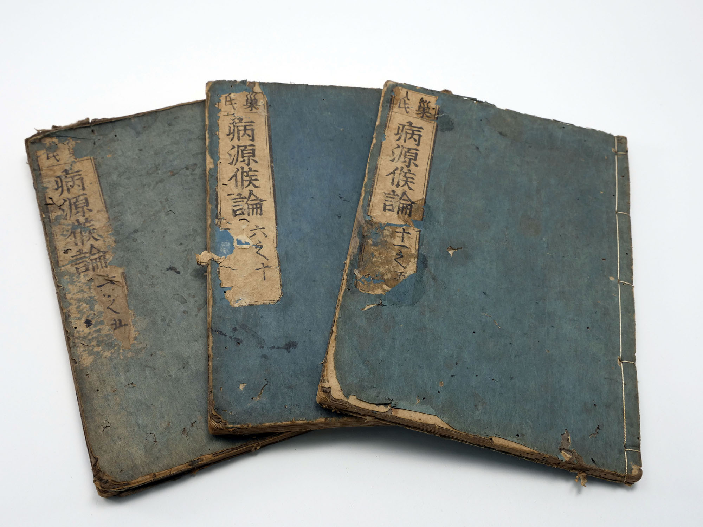
Zhu Bing Yuan Hou Lun 諸病源候論
“Treatise on the Origins and Symptoms of Medical Disorders”
A text written by the Court Physician Chao Yuan Fang 巢元方 in the Sui Dynasty (581-618). It is the oldest nosological encyclopedia in CM, describing disease etiology and symptomatology. It gives descriptions of 1739 diseases under 71 categories. It also details approximately 200 different daoyin exercises for treating various diseases.
HLX argues that the ZBYHL contains the most comprehensive San jiao theoretical framework that has largely been ignored.

Slide 40
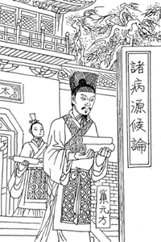
ZBYHL view
All theories of the San jiao are fully integrated here, including:
Its Terminology and definition 術語及定義
The beginning and end of the Qi of San jiao 三焦之氣終始
Disease indications and principles 病候及治則
Pulse Method 脈法 (originating in the Maijing)
If the cun pulse is slow, it indicates cold in the Upper Jiao. If the guan pulse is slow, there is cold in the Middle Jiao. If the chi pulse is slow, it indicates cold in the Lower Jia If the chi pulse is floating, it indicates Yang excess in the Lower Jiao.
Maijing states the Cun pulse governs disorders of the Upper Jiao.
The guan pulse governs the Middle Jiao.
The chi pulse governs the Lower Jiao.

Slide 41
Fu Xie disease characteristics
Remember newly contracted pathogens symptoms should appear immediately. Latent pathogens will have no symptoms after contraction. Additionally, WXZ makes the point that there are two types of latent pathogens.
Seasonal latency– Disease manifests next season
Yearly latency– Disease manifests years later (gives example of child infected with Hepatitis B virus during childhood and developing symptoms until adolescence in spring)

Slide 42
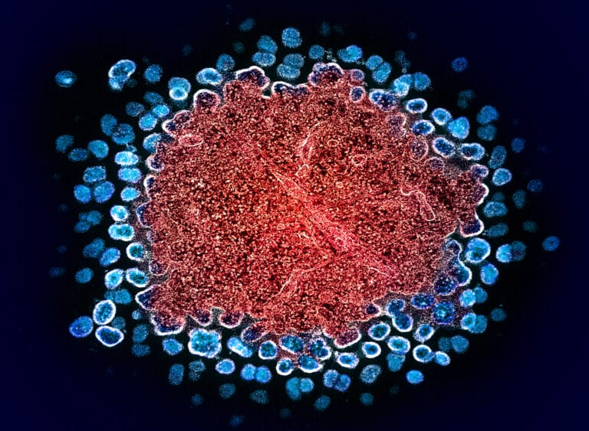
Chronic disease 痼疾
How do we determine Chronic disease 痼疾 has a Fu xie pathogen?
If the Chronic disease repeatedly flares, this is Fu xie
If the Chronic disease is slow and lingering with continuous progression , this is Nei shang/ internal damage. This does not have acute flare ups, but progresses over time.
In summary, if the chronic disease has periods of remission, progression, and acute flares, this is Latent pathogens. If the illness is persistently chronic, and gradually worsens over time this is internal damage.

Slide 43
Xu lao 虛勞/ Vacuity taxation
There are two types of Xu lao
Vacuity induced Xu lao, arising from malnutrition for example. The primary strategy is to Supplement
Latent pathogen induced Xu lao, in other words, repletion causing vacuity. The strategy needs to be a combined Attacking and supplementation. Treatment needs to first address the repletion as the guiding principle. Many patients with tumors manifest with symptoms of Xu lao. Often tumors have a Latent pathogen component.

Slide 44
Limitations of pattern diagnosis
WXZ states Orthodox Chinese Medicine relies on differentiating patterns.
A pattern (Zheng 證) refers to an organism’s own response 反應 to disease. And different constitutions responses will be different, even if it’s the same disease. It represents the phenomenological expression at a given moment, a snapshot of the present.
Now, what triggers the onset of the disease is referred to as Bing yin 病因/ disease cause. Often referring to the pathogenic factor itself.
Disease 病 reflects the continuous evolving process with a defined progression and transformation.
Pattern diagnosis unfortunately does not reflect or address the dynamic progression of the disease. WXZ gives the example of Diabetes, which starts with stomach heat, then to stomach heat with yin xu, then to Qi and Yi xu, then to dual Yin and Yang xu, often with blood stasis and liver qi depression. At an moment, the patient can present with one or two of these, but in the past had another pattern, and is developing into another pattern.

Slide 45
Return to disease differentiation 辯病
WXZ asks us if the disease’s clinical outcome is really a reflection of the Pattern/ syndrome or the disease’s influence.
And he states at times it is due to the Pattern, with different constitutions expressing different responses to the same illness, like we see in the common cold. For example, Gui zhi tang constitution vs a Ma huang tang or a Ma huang fu zi xi xin tang.
But in complex and difficult disease, he states the decisive factor is not the pattern, but the disease itself.
He gives the example of pulmonary consumption 肺癆/ tuberculosis. Often it manifests with Lung yin xu and Lung qi xu with yin xu and internal heat, or yin yang xu, and often the pattern correct formula is Bai he gu jin tang. But it doesn’t work. Instead the empirical formula Lao Ke tang 癆咳湯 works better because it attacks the root pathology, i.e. the disease. Same with Ascites and Wen yi/ epidemic pestilence which wiped out entire cities rendering vast lands desolate and dead bodies all over, was this due to patterns?
In these type of illnesses, we must develop a disease-oriented approach, targeting the root pathology directly and then adjust the treatment based on pattern 隨證加減

Slide 46
Interruption method 截斷法
In the face of serious and complex diseases, the interruption method is to target directly the disease and then modify the treatment according to the syndrome/ pattern. Especially when progression of the disease is determined by the illness itself. Targeting the syndrome alone is insufficient, if the disease is being worsened by the evolution of the disease.
But we need to also target the pattern, since the disease has a continuity, passage and transmutation behavior, which is subjected to the pattern’s influence. But if we do not know the disease’s continuity and its subsequent developmental process, we will not be able to interrupt it. Thus, we must deeply study disease.

Slide 47
Latent pathogen stages
Wu Xiong gives an example how Latent pathogens can be differentiated into two stages: Internal latency 内伏 and External emergence 外發
Internal latency process means from Wei to Qi to Ying to Xue
External emergence is from Xue to Ying to Qi to Wei
Internal latency corresponds to the Three Yang transmitting to the Three yin, from Shaoyang transmitting to Taiyin, then the Xie qi becoming latent, transmitting to Shaoyin, and finally nesting in Jueyin where it leads to death.
An example is in Hepatitis, where Shaoyang has concurrent qi vacuity, i.e. progressing to Taiyin. This is the Chai hu gui zhi gan jiang tang pattern. It will then transmit to Shaoyin (Where estrogen deactivation becomes impaired leading to genital atrophy and subsequent impotence). Ultimately, leading to Jueyin (internal wind, stirring blood). This is an example of a Fixed/ regular behavior of this disease.

Slide 48
Latent pathogen complexity
Latent pathogen theory deepens our inherent understand of the disease process. Breaking us free from the rigid dichotomy of separation from Exterior and interior, vacuity and repletion, cold and heat. In complex disease, these are entangled. There might be appearance of Heat/ inflammation, but also vacuity such as diarrhea and low appetite. The heat might be due to a newly contracted pathogen, i.e. immune response, entangled with the chronicity of an underlying qi vacuity.
We see this in the prescription Zhi zi gan jiang tang. If we only focus on treating the heat flare, the pathogen will not be expelled and become further embedded.
Thus, a single disease may manifest as both an acute onset and a chronic condition simultaneously. Latent pathogen theory unites internal and external causes, the interdependence of vacuity and repletion, and the fluidity of states of cold and heat. Often latent pathogen strategies will have simultaneous methods at once (drawing out, attacking, supplementing, clearing)

Slide 49
Latent pathogen proclivity
There are four main factors to Latent pathogen tendency
Constitution 體質
Chronic diseases 痼疾
Exterior contraction 外感
The seven emotions 七情
The constitution refers to Prenatal Endowment 先天稟賦, but also Postnatal acquirement 後天獲得, but Prenatal endowment occupies the leading factor. Prenatal endowment leads to genetic/hereditary disorders and can also lead to susceptibility to specific diseases. Essentially, we can divide this into Genetic diseases 遺傳性病 and hereditary susceptibility 遺傳易感. One is present since birth, and the other is tendency/ likelihood to develop diseases due to hereditary causes, or developing a distinct disease outcome after contracting a disease

Slide 50
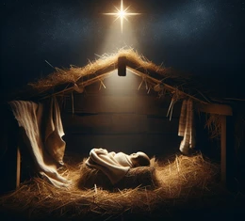
Ti zhi 體質
The constitution refers to Prenatal Endowment 先天稟賦, but also Postnatal acquirement 後天獲得, but Prenatal endowment occupies the leading factor. Prenatal endowment leads to genetic/hereditary disorders and can also lead to susceptibility to specific diseases. Essentially, we can divide this into Genetic diseases 遺傳性病 and hereditary susceptibility 遺傳易感. One is present since birth, and the other is tendency/ likelihood to develop diseases due to hereditary causes, or developing a distinct disease outcome after contracting a disease
Postnatal factors refers to Long-term fatigue, malnutrition, vicious moods, major life misfortunes, intensive labor, taxation worry, taxation sex, taxation labor all can influence a person’s constitution.
Constitution is a primordial/ innate internal cause, whereas Postnatal factor are external causes

Slide 51
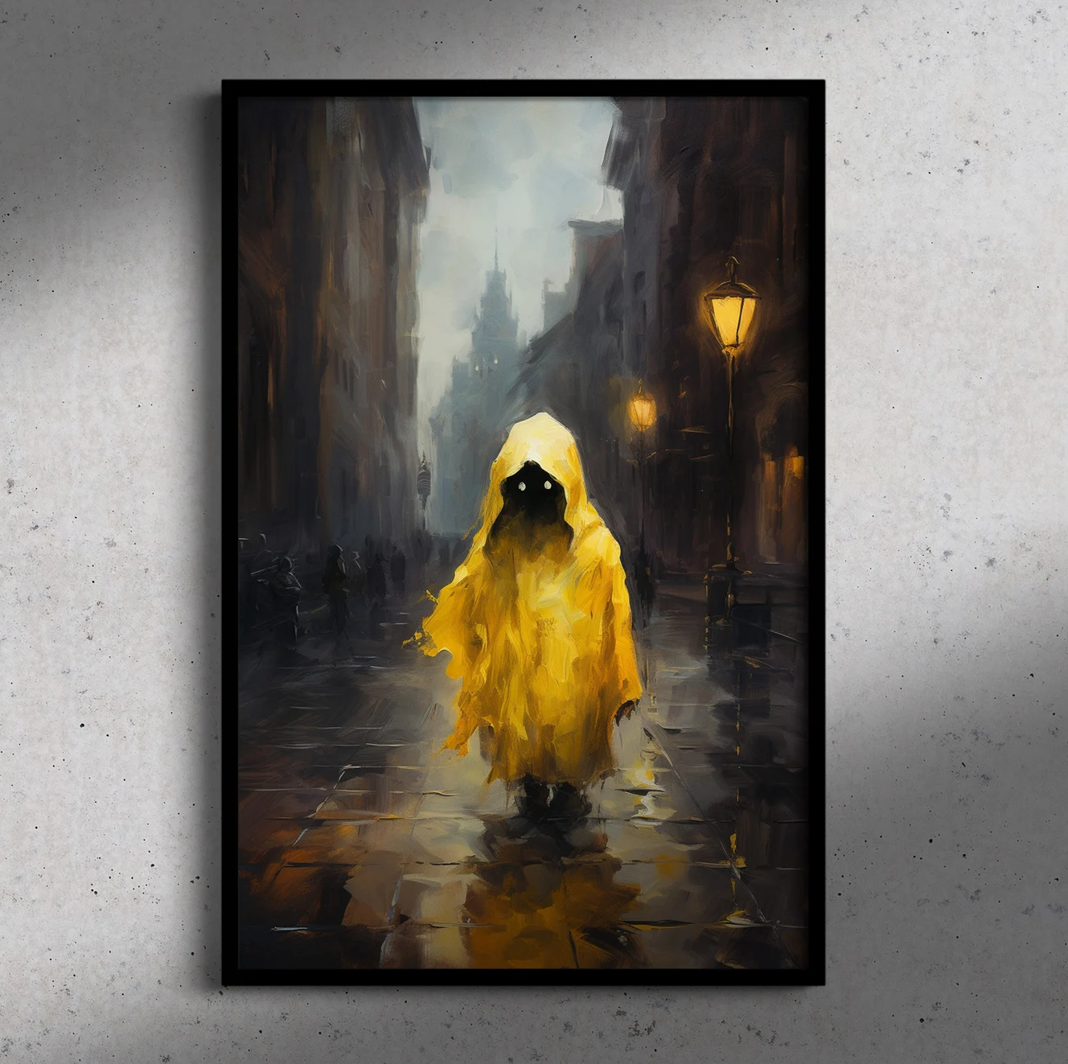
Chronic Diseases
Chronic diseases are spoken of in the Shanghan Zabing lun. For example, in the SHL, there is the term Jia 家 (household/ interior) meaning, basically someone that lives with a condition
Damp patients 濕家, Wind patients 風家, Panting patients 喘家, Strangury Patients, 淋家, Sore patients, 瘡家, Bleeding patients 衂家, Death of blood patients 亡血家，Sweating patients 汗家, Vomiting patients 嘔家, Vacuous patients 虛家.
When these patients contract an Exterior illness, it interfaces with their pre-existing chronic disease state.
WXZ states chronic diseases can be divided into two scenarios: One is acute flare up, the other is remission or lingering phase, during which latent pathogens are formed

Slide 52
External contraction and recurrence
External contraction can stir latent pathogen to emerge, as it stirs Wei qi. Symptoms of Effusion 發 relate to Zheng and Xie mutually clashing.
If there is Zheng qi vacuity, the immune response will not be sufficient leading to the Xie qi to lurk. Only when the Zheng qi is sufficient does the body again mount a response, or the evil emerges spontaneously often by external stimuli from another exterior pathogen.
WXZ states there are six types of 復 recurrence:
1. 勞復 Taxation recurrence
2. 正復 Upright (vacuity) recurrence
3. 食復 Diet recurrence
4. 自復 Spontaneous recurrence
5. 病復 Disease recurrence (other diseases)
6. 時復 Seasonal recurrence

Slide 53
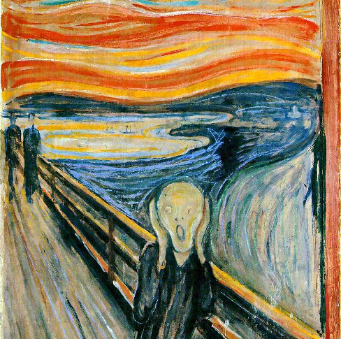
7 emotions 七情
WXZ tells us that extraverted individuals who vent their emotions tend to not develop liver fire as the immediately respond to the external stimuli. However introverted individuals tend to develop repressed fire. These individuals tend to have strong fire and instead develop mania
The introverted individuals tend to be gloomy, i.e. Qi depression pattern. Or they are shaoyin yang vacuous and they do not respond immediately. They go home and weep instead, as they are in a shaoyin state of mental fatigue and lack of spirit. These individuals tend to have a transformation to latent fire.
Also individuals with already latent evils, emotional stirring can draw and stir latent evils. WXZ makes the point that emotions are NOT LATENT EVILS, but emotions can transform to fire and stir latent evils because they affect the Liver yang.

Slide 54
Liver yang
When the Liver yang violently opens 肝陽暴張 it causes latent pathogens to effuse.
The liver governs courses and discharge 肝主疏泄
The liver governs birth and emerges 肝主生發
In a true Jueyin liver pattern, this evil qi can emerge and sudden attack of the blood vessels of the Heart and brain. Ultimately, causing death, stroke, or even convulsions. In latent pathogen context, think of Lyme disease causing epilepsy. Think of neuro syphilis causing madness and neurological sequela like Tabes dorsalis.
Lastly, the Liver governs the Tendons and Membranes 筋膜. This membrane connects to the Source Qi, leading to Yuan qi afflictions. The pathogen lurking at the level of the Membranes, but in the visceral blood aspect, i.e. organ membrane.

Slide 55
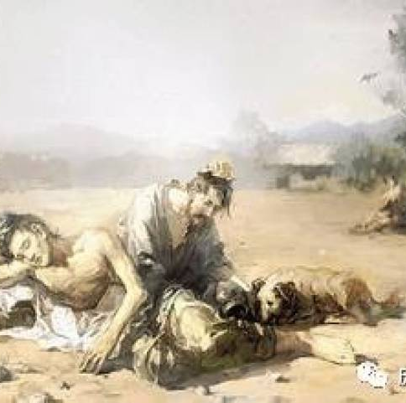
Exterior and pain
Newly contracted pathogens draw out latent pathogens… As newly external pathogens create an immunological response (Febrile event= FA RE 發熱). This newly activated Wei qi event stirs up old diseases to emerge.
Additionally, according to the Jing Fang lineage of Hu Xi Shu, pain syndromes are unresolved exterior. And in the Hu Xi Shu lineage the exterior pertains to a Yang or Yin syndrome.
Yang exterior= Taiyang
Yin exterior= Shaoyin

Slide 56
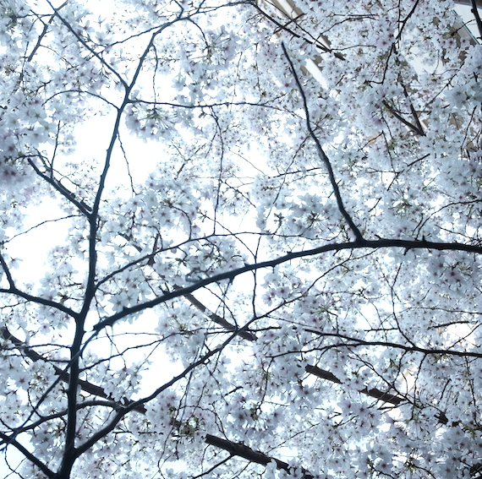
Pain
Both R.A. and Fibro have the characteristic of pain, therefore both are a type of Bi syndrome 痹證
R.A. is often seen as a Bone-Bi
Fibro is often seen as Muscle bi or a Sinew bi (connective tissue)

Slide 57
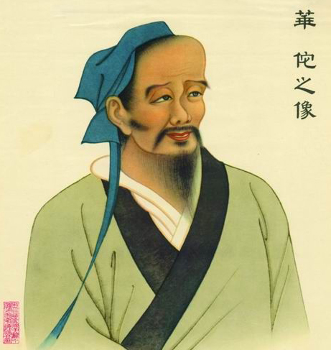
Bi syndrome pulses
This comes from Hua Tuo’s 華佗 Zhong Zang Jing 中藏經/ Central visceral classic, in the 5 bi treatise 五痹論
1. Qi impediment---Deep slow, and choppy at the right cun
2. Blood impediment– Knotted and unsmooth in the left cun or severed/ expiring
3. Flesh impediment- Right guan, weak on both lift and pressing, coming and going is choppy
4. Sinew impediment- Left guan is wiry, urgent and rapid, and forceful in both floating and deep levels
5. Bone impediment- depending on the mechanism. Both chi will present Deep or simultaneously as followed:
Cold-- Slow
Heat -- Rapid
Wind - Floating,
Damp– Soggy
Vacuous-- Slippery

Slide 58
Shen and Pain
From Lingshu chapter 71, Zhou bi 周痹/ circulation impediment
Huang di asks: How does pain emerge, what is its cause, and the reason for its name (Zhou bi) 黃帝曰：善。此痛安生？何因而有名？
Qi bo replies: The qi of cold wind and damp, it guests in the spaces in the external divisions of the flesh. Exerting force resulting in foam. When foam gets cold, it will gather. When it gathers then is squeezes the flesh and breaks it apart. As it breaks it apart, it generates pain. When there’s pain the Spirit goes to it. When the Spirit goes to it then there’s heart. When there’s heat it resolves the pain When the pain is resolve, then the (evil qi) recedes. When it recedes, then the Bi manifests (somewhere else), the emergence/ outbreak follows this outline. 歧伯對曰：風寒濕氣，客於外分肉之間，迫切而為沫，沫得寒則聚，聚則排分肉而分裂也，分裂則痛，痛則神歸之，神歸之則熱，熱則痛解，痛解則厥，厥則他痺發，發則如是
Huang di: Good, I have grasped its meaning. This internalization is not in the viscera, its externalization is not yet emerging in the skin. It alone settles in the space of the division of the flesh. The True qi cannot circulate, hence why its called Circulation impediment 帝曰：善。余已得其意矣。此內不在藏，而外未發於皮，獨居分肉之間，真氣不能周，故名曰周痺。

Slide 59
Bao ci 報刺
Ling shu chapter 7, Guan zhen, needle technique:
Reactive needling (commentators say 報 is to repeat 復刺· or 重刺)
Reactive needling is to Pierce the pain (site) without a fixed place. When it moves up and down, (the needle) is inserted straight in, without drawing out the needle (immediately). Using the left hand to follow the disease site and pressing it, then removing the needle, and repeating the needling.
報刺者，刺痛無常處也。上下行者，直內無拔鍼，以左手隨病所按之，乃出鍼，復刺之也

Slide 60
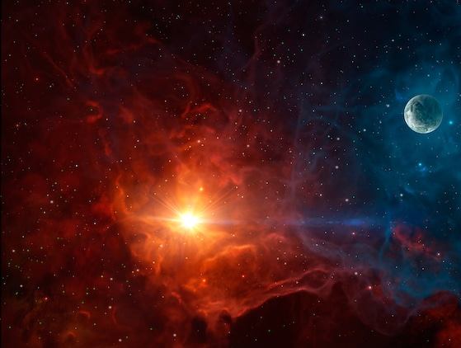
Spaces between
Space between Shaoyang and Yangming to regulate autoimmune response. This space covers the Empty Space 虛空 (Xu Kong) where Qi circulates.
While all the Jing mai are located in the Spaces of the Flesh divisions 分肉之間. In autoimmune responses, the inflammatory cascade often involve the spatial layers of the Shaoyang and yangming matrix.
Dr. Wei-Chieh Young states that Shu Stream points which in the Nanjing are said to treat Body swelling and joint pain 俞主體重節痛 are akin to Damp

Slide 61

Shu stream
Shi Stream points in the Nanjing are said to treat Body swelling and joint pain 俞主體重節痛. This is akin to Dampness, hence in the Yin channels they correspond to Earth.
In the Lingshu, they are said to treat Diseases with an intermittent or seasonal worsening 病時間時甚者，取之輸. Dr. Wei-Chieh Young links this to Shaoyang diseases, which has an intermittent nature. And in the Yang channels, they correspond to Wind.

Slide 62
Jian Zhong
44.06 (Center Shoulder)
Wang Chuan Min locates it closer to the Hand shaoyang
https://www.youtube.com/watch?v=cYZrk43Idfg
This placement allows Jian zhong to treat Wind impediment 行痹
Function: Heart
Form: Hand shaoyang or Hand yangming

Slide 63
Si ma
Location: https://www.youtube.com/watch?v=H4JkGVu6eqM
Sima treats Qi to attune the Blood, when the Qi is invigorated the blood moves and the hundred diseases vanish
Si ma Function is in the Lungs, which governs Qi but also Lung function is in moving blood. Primary Tung disciple, Chen Du Ren (陳渡人針灸醫案) states that Si ma strongly invigorates heart blood. This is because according to Wawng Chuan Min, originally Si ma was closer to the heart line.
Si ma FORM lies between Foot shaoyang and Foot yangming (Qi of Wind and Dryness), i..e Wind dryness
Si ma FUNCTION lies in Lung commanding channel and Liver branch channel. Lung is Shaoyin within Yang, Liver is Shaoyang within Yin. Si ma takes Liver blood as its form, and Lung qi as its Function.
Liu Yi states that “Blood is Yin, only when Lung qi activates Liver blood can circulation occur… Using Lung qi as the highest end point, qi without blood cannot attach, ergo Qi is Blood’s envoy and Blood is Qi’s function.

Slide 64
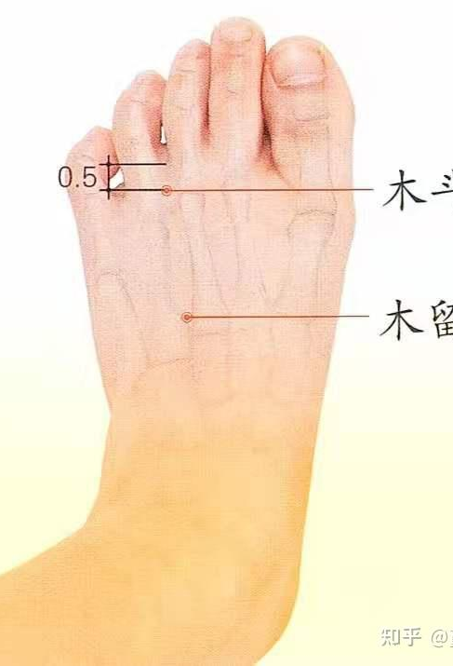
Mu Dou Mu liu
66.06-66.07
Function: Liver and Spleen
Form: Foot Yangming (originally a branch of Foot Yangming diverted to the middle toe), some also put between Foot and Foot shaoyang
Strategy of use Yang to guide Yin, uses to treat yin diseases
Treats: Leukocytosis, splenomegaly, indigestion fatigue, numbness, liver and gallbladder disease, poliomyelitis in children
Combination with Pi Zhong 11.18 for splenomegaly… Think Epstein barr, an often trigger for Fibromyalgia
Function lies in harmonizing Liver and Spleen. Liver stores blood, Spleen controls Blood (hence its usage for numbness)
Liu Yi calls them: Regulating nerve points 神經調節穴
Wang Chuan Min states: For Dark complexion, bilateral floating guans 面黯，雙關脈浮
Mu Dou Mu liu can treat Drug Toxins via its functions of Transformation and Dredging

Slide 65
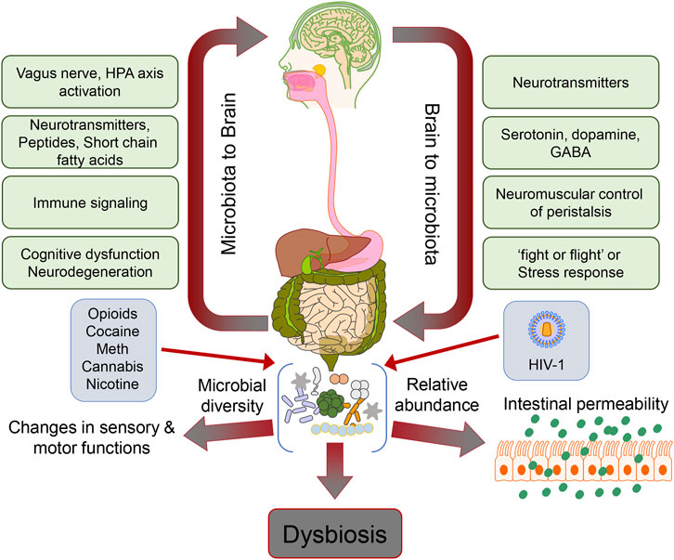
Gut-Brain Axis
Liver spleen disharmony as a Gut brain axis disharmony
People nowadays tend to have alterations in their intestinal mucosa leading to increased intestinal permeability, which negatively affects the gut microbiota and causes significant disturbances in the immune system (leading to autoimmunity) and the endocrine system (involving neurotransmitters such as serotonin, dopamine, glutamine, norepinephrine, and nitric oxide). This causes cascade of imbalances can result in psychological disorders, as well as various metabolic and endocrine diseases. This is akin to SIBO (small intestine bacterial overgrowth)
This Gut brain axis disorder is linked to Yin Fire, when the Clear Yang of the Spleen cannot rise

Slide 66
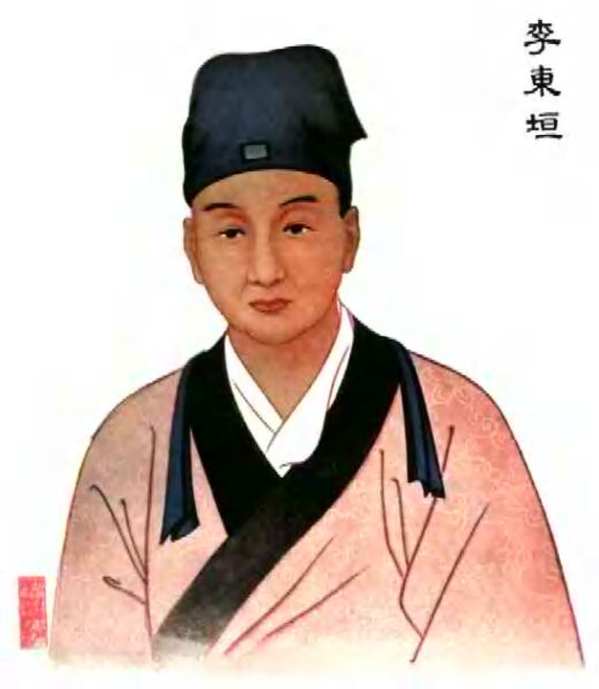
Yin fire 陰火
According to Pi Wei Lun theory, when Yin is excessive in the lower body, there is a tendency for Yang to rebel upward, particularly the Ministerial fire of the Shaoyang and Thunder-dragon fire. This yin fire arises due to damp obstruction of the lower burner. This is called a state of Double Yin 重陰
But the key is in the failure of the ascending function of the Spleen-earth qi mechanism
Often the failure of the ascending function of the Spleen arises from Disharmony between Liver and Spleen

Slide 67
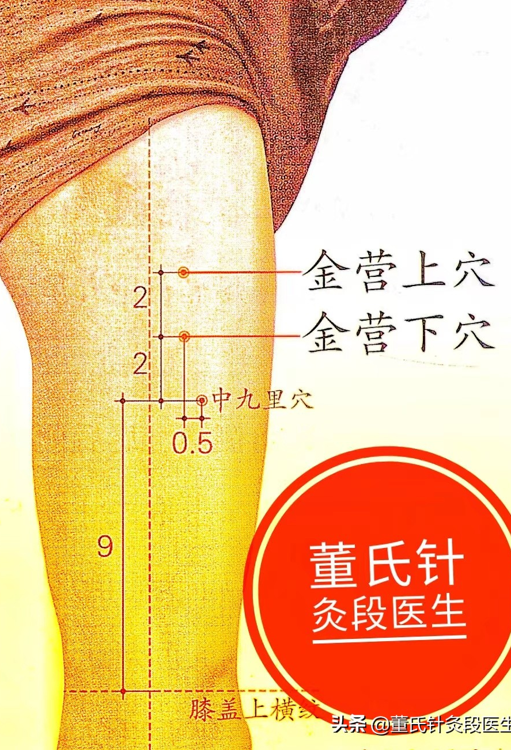
Jin Ying 金營
88.33-88.34 (Jin ying shang, Jin Ying xia)---Metal barracks/ Metal camp
Lung Shen jing, Heart Branch
Form lies in Foot Shaoyang, Function lies in Heart and Lung (Ying and Wei)
Indications: Whole body analgesic point, emergency point for acute disease, drug and food toxin, acute gastro-colitis
Lung governs Wei qi and exterior, Heart governs Ying qi and Interior. Lung governs the Skin, Heart governs the Vessels. This is Ying wei disharmony of Shaoyang. Acute wind fire toxin

Slide 68
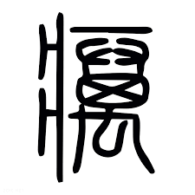
Pestilential wind 癘風
Suwen 42, the Treatise on Wind 風論 states: “When the Wei qi has that which congeals it and fails to circulate, therefore the flesh has numbness. In cases of li (pestilence), the Ying qi becomes hot and rotten, its qi becomes unclear, thereby causing destruction of the nasal column, discoloration of the complexion, and ulceration of the skin. When wind-cold lodges in the vessels and does not depart, it is termed li feng (pestilent wind), or sometimes called han re (cold-heat disorder).”
衛氣有所凝而不行，故其肉有不仁也。癘者有榮氣熱胕，其氣不清，故使其鼻柱壞而色敗，皮膚瘍潰。風寒客於脈而不去，名曰癘風，或名曰寒熱

Slide 69
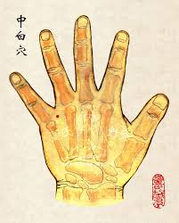
Zhong Bai 中白
22.06, also known as Ghost Gate 鬼門
Spleen, Heart, Kidney shenjing
Zhong bai and San cha san are similar, but San cha san is horizontal puncture (X axis) and Zhong bai is vertical puncture (Y axis)
For External contraction from Yang vacuity constitution
Form likes in Hand shaoyang. Function lies in Spleen, Heart, Kidney. Originally Tung emphasized Kidney in his 1968 edition, but added Spleen and Heart in 1973 edition
Raises the Stomach qi, Liu Yi compares it to Bu zhong yi I tang (Yin fire.. Fire evil overwhelming, producing great fever, with right guan weakness)
Yu Sheng Tze states “Zhong bai Raises Clear Yang, ministerial fire engenders peen earth, building the spleen to eliminate dampness, transforming phlegm and eliminating stasis”

Slide 70
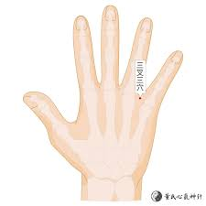
San Cha San
22,17
Also called Pi cha san (Pi=Spleen)
San cha san, with Huo san, Tong Shen, Shui Xiang are known as the 4 points to Decreae sugar/ glucose 降糖四穴
According to Second Generation disciple, Yu Sheng Tze, San cha san for External contraction causing Shaoyang disease. This affects both the Lung and extends to involve the Spleen (often due to mistaken medicine causing Exterior contraction to internally collapse 外感内陷
Can also treat Liver disease that affects the Lung (External contraction complicated by inner ear inflammation)

Slide 71
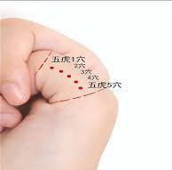
Wu Hu
5 points in all
Function lies in the Spleen, Form lies in the Lung (Dampness and Exterior bi syndrome)… Spleen governs the 4 limbs, Lung governs the Exterior
Hu wen zhi adds Kidney as part of its Zheng jing (Spleen Kidney), Kidney governs bones
Treats whole body bone swelling, especially joint disorders such as Rheumatoid Arthritis.
Hu Wen Zhi indications: Systemic bone swellings, pneumonia, bronchitis, cervical lymphatic tuberculosis, tonsillitis, swelling and pain on the inner side of the sole of the foot, hepatomegaly (enlarged liver), liver cirrhosis.
For treating systemic bone swellings or drug-induced bone swellings, combining with Linggu (Spirit Bone) point, Dabai (Great White) point, and Fuyuan (Restoration) point produces even better effects.

Slide 72
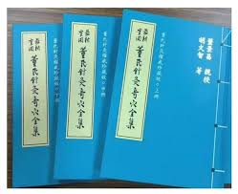
最新實用董氏針灸奇穴穴全集
Many expanded Tung indications and expanded Tung points come from
"The Latest Practical Complete Collection of Dong's Extraordinary Acupuncture Points“
From Hu Wen Zhi 胡文智

Slide 73
Wu Hu differentiation
Wu hu Yi and Wu hu Er, located higher up, for Hand Finger pain and finger numbness, such as acute wind effusion
Wu Hu er and Wu hu san treat Toe pain. Often used for Gout, especially when combined with Huo ju and Huo lian
Wu Hu er and Wu hu si treat Damp heat type sciatic pain and numbness
Wu hu si and Wu hu wu, treat ankle sprain, heel pain

Slide 74
Immunosuppressant formula
Gui zhi shao zhi mu tang--- R.A. representative formula from the Jin Gui Yao Lue
This formula Warms Yang, Courses Wind, and Effuses the Exterior
This is for Latent evil hidden in the Shaoyin. Initially when using this formula, the joint pain may initially worsen due to the wind dispersing nature of the herbs, causing pain to travel between joints. Skin numbness and tingling may occur, but once all affects joints have expressed their symptoms, the overall pain will resolve.
According to WXZ, this formula exemplifies the principles of Dragon method, warming the Shaoyin thunder fire. But moderates Dragon fire of shaoyang through Shao yao gan cao. If only warming yang herbs are used it will intensify pain and cause unbearable joint pain

Slide 75
GZSYZMT pathomechanism
According to Wu Xiong Zhi, the Ma huang, gui zhi, sheng jiang, fang feng promote sweating and fluid circulation, key for External dampness
Gui zhi treats Taiyang fever and pain relief. Ma hang contains ephedrine, pseudoephedrine, and norephedrine, which mimics adrenal function and has immunosuppressive effects
Fang feng is a biphasic immune modulator, it boosts immunity but also suppresses overactive humoral responses (as seen in allergies)
Bai Zhu and Fu zi expel water qi in the skin, which creates an ant-crawling sensation in the skin as water is expelled. Bai zhu relates to Taiyin and Fu zi to shaoyin. Spleen governs water and Kidneys steams and transform fluids, strengthening spleen and stomach and enabling pathogens to emerge out of Shaoyang.
Shaoyao gan cao tang treats the shaoyang component, hs immunosuppressive effects. Shaoyao is immunosuppressive and Gan cao has glucocorticoids-like effects
Zhi mu treats Yangming joint swelling, the Shennong bencao jing says Zhi mu treats thirst, heat in the center, and dispels evil qi and limb edema.
For excess Wind water and heat, we use Yue bi tang (Ma huang, shi gao method), for exterior Damp heat, we use Ma xing yi gan tang

Slide 76
GZSYZMT ingredients
Gui zhi 12
Bai shao 9
Zhi mu 12
Ma huang 6
Gan cao 6
Fu zi (dose dependent)
Fang feng 12
Bai zhu 15
Sheng jiang 15

Slide 77
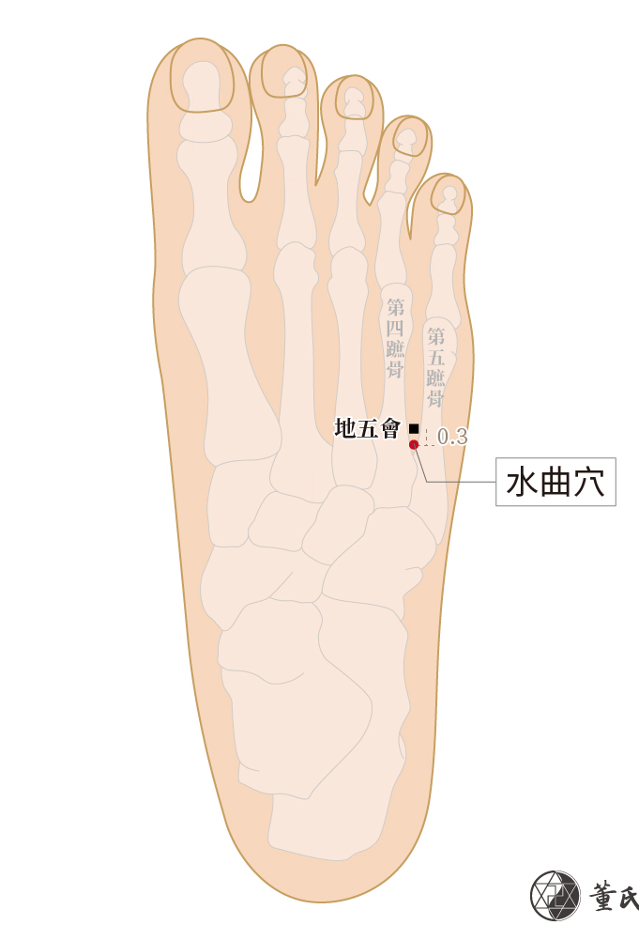
Shui qu 水曲
66.09
Also called Ma Ling 馬靈 “Horse spirit/ Horse magic”
Indications: Waist pain, 4 limb edema, abdominal distention, cervical neuralgia, uterus diseases.. (revised indications)-- whole bone pain, neuralgia, flesh atrophy, numbness
Tung prohibition of needling during: Asthma, Lung disease, Excessive phlegm, Weak body types”
Combine with Shui Yu 44.17 to treat all types of excessive accumulation of water in the upper body
Liu Yi summarizes it as treating Headaches from Water rheum surging upward, Joint pain from Water damp, Flesh pain from Zhuo Bi 著痹 (Fixity impediment), muscular atrophy, peripheral nerve pain, obesity in the thighs and waist, etc.
Form Lies in Shaoyang. Function lies in Lung and Kidney branch shen jing

Slide 78
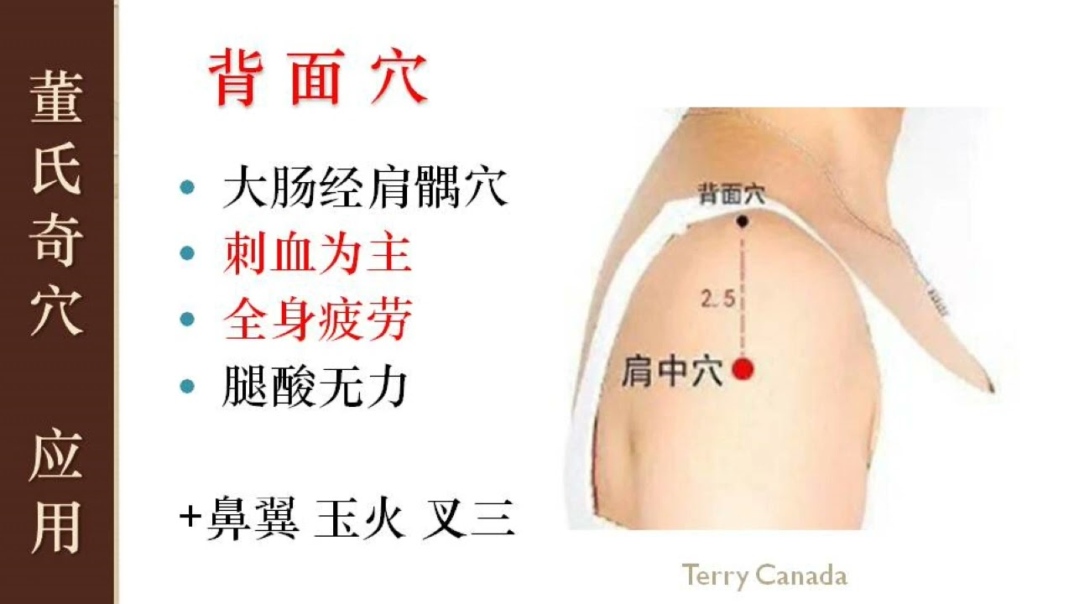
Yangming body pain
Bleed Bei mian 44.07 背面穴
Tung’s shenjing--- Dan Tian 丹田
Treats: Whole body fatigue. Bilateral leg soreness, votming, liver cholera, spleen cholera, Yangming cholera（Huo Luan 霍亂)
Prick the Ying spring for Febrile disorders, in autoimmune flares, we can use Ying Spring to treat febrile disorders, as Ying govern Body heat 滎主身熱

Slide 79
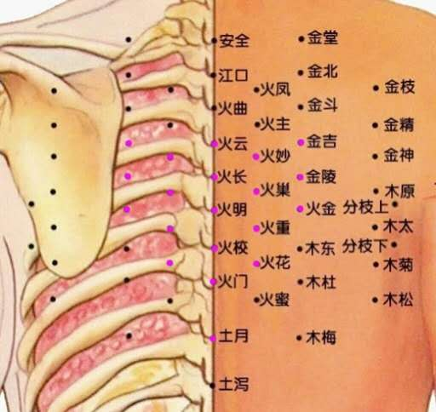
Heart body pain
“All pain belongs to the heart”
Prick Hou Xin/ Back of the heart--- For heart blood level diseases
For latent Shaoyin cold--- Ma huang fu zi xi xin xin tang
For latent Taiyang cold– Gui zhi jia fu zi tang

Slide 80
Shaoyang Shaoyin rx
Modified Xiao chai hu tang with shaoyin element
Chai hu 25, Huang qin 9, Xi xin 3, Sheng jiang 3, Da zao 9, Yu jin, Zhi gan cao 9
San huang tang for Latent wind
(Ma huang, Huang qi, Huang qin, Xi xin, and Du huo)

Slide 81
Huang qin tang
Huang qin 9g, Bai shao 6, Zhi gan cao 6, Da zao 12g
SHL: Taiyang and shaoyang combined disease, with spontaneous diarrhea
Treats Shaoyang diseases in the Fu, especially combined with diarrhea, like cholegenic diarrhea. A characteristic sign is diarrhea accompanied with detest for greasy (substances).
If vomiting add Sheng jiang and Ban xia>>> Huang qin jia ban xia sheng jiang tang
Liu Bao Yi in Wen Re Feng Yuan (Source of Warm disease treatment) uses Huang qin tang with Dan cho chi and Xuan shen for latent pathogens.
Dan dou chi can release the exterior and one must release the exterior in latent pathogen treatment

Slide 82
Da yuan Yin
Bing lang 6g, Hou po 3g, Cao guo 5 fen, Zhi mu 3g, Shao yao 3g, Huang qin 3g, Gan cao 5 fen.
Eliminate turbidity, transform turbidity. Treats warm epidemic or malaria. Latent pathogen in the Mo Yuan (Membrane source). External shivering and high fever, occurring irregularly, one to three times per day. Oppression in the chest, nausea and vomiting, headache and vexation, wiry and rapid pulse. Tongue margins deep red, tongue coating greasy
For intense heat pathogens use Huang qin tang. Fo
Thick white coating and very poor appetite, strong aversion to food. Thick tongue white coating like a layer of powder. Lack of taste perception. Our taste buds are distributed in the crevices of the lingual papillae. If the lingual papillae has excessive hyperplasia, forms thick white coating, can then hide taste buds and prevents them from making contact with food.
Taste receptors are not stimulated by the sour, sweet, bitter, components of food, leading to lack of appetite.

Slide 83
Da Yuan Yin essential points
Heavy emphasis, thick white tongue coating like amassed powder. Front of the tongue coating is white and thick. When tongue is curled up, can see deep red sublingual, illustrating internally has red, in the blood layer, which is latent evil
Can add Zhi mu, Da huang, or Shi gao depending on the manifestation or where the evil is emerging
Heavily use Yi yi ren for increased effect
Mo Yuan belong to shaoyang, operating through Jueyin qi. Anatomically relating to internal structures such as the fatty omentum 脂網膜
This formula is also applicable for latent damp heat in Taiyin. Taiyin governs Qi, if Taiyin is vacuous, add Huang qi and Tai zi shen

Slide 84
Hao QIN Qing Dan tang
Qing hao nao (volatile oil extract) 9g , Dan Zhu ru 9g, Xian Ban xia 4.5g, Chi fu ling 9g, Qing zi qin 9g, Sheng zhi ke 4.5, Chen Guang Pi 4.5g, Bi yu san 9g (Hua shi, Qing dai, Gan cao)
Indications: Shaoyang damp heat turbid phllegm pattern, cold heat like malaria, light cold, severe heat, bitter taste, chest oppression, vomiting sour digestive fluids, sometimes vomiting yellow saliva and sticky, and in extreme situations causes dry vomiting and hiccups, chest and hypochondrium distended pain, scanty yellow urination, red tongue and white greasy coating, occasionally showing mixed color patches, rapid pulse.
HQQDT treats Latent pathogen warm disease shifting out Wen bing. Has distinct intermingled dampness. Hao qin qing dan tang primarily treats fever.

Slide 85
Jueyin Rx
One of the key formulas WXZ proposes for deep seated pathogens is Ma huang sheng ma tang
SHL says
“Cold damage, 6 or 7 days, after great precipitation, the cun pulse is deep and slow, the hands and feet have reversal cold, the lower pulse sections don’t arrive, the throat is uncomfortable, spitting blood and pus, with incessant diarrhea”
Key characteristic of pulse: Faint and weak, and the patient complains of throat pain resembling injury, but not actual throat impediment. Or there is throat pain and diarrhea.
Faint pulse indications Shaoyin. Weak pulse indicates Taiyin. Once transformed to heat, latent qi often presents as throat pain and diarrhea, hallmark of Fu xie

Slide 86
MHSMT ingredients
Ma huang, Sheng ma, Dang gui, Zhi mu, Huang qin, Tian men dong, Yu zhu, Shao yao, Gui zhi, Fu ling, Zhi gan cao, Shi Gao, Bai zhu, Gan jiang.
Can go 10 grams across, but higher shi gao if pathogen is provoking febrile response. Go higher on Sheng ma to outthrust the pathogen.
If patient is weak, consider lower dosages by half or 1/3.
This formula encompasses Fundamental Fu xie strategy of
Supplementation 補
Clearing 瀉
Supporting 托

Slide 87
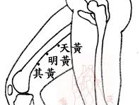
上三黃 Shang san huang
Upper three yellows (Tian huang, Ming Huang, Qi Huang) 88.12-88.14
Per Second Generation disciple, Liu Yi, “Master Tung emphasized Yin channels located in a line. Its effects depends on both the vertical positioning and depth of the needling. Yang channels are spread out over an area, more like the size of a postage stamp, needle accuracy does not need to be fixed”
Shang san huang is on Foot Jueyin, but according to Master Tung covers three Zang. According to Chen Du Ren, Shang san huang encompasses Trapezoidal needling technique 梯子針法. This technique resembles a ladder or trapezoid, and the effectiveness is influenced by the depth of insertion

Slide 88

Shang san huang continued
The anatomical layers of the Three yellows corresponds as followed:
The superficial layer corresponds to the Auxiliary aspect of the Kidney
The Middle layer corresponds to the Liver
The deep layer corresponds to the Heart
While other disciples like Hu Wen Zhi have given a different schematic, this is based off Master Tung’s original work.

Slide 89

Li Gou 蠡溝
Foot Jueyin Luo point/ Liver 5
It diverges to connect to Foot Shaoyang (KEY aspect)
While this point has many indications relating to the lower burner, particularly the genitalia, such as itching of the scrotum, leukorrhea, genital swelling, genital twitching, lower abdomen swelling, shan-mounting, persistent erection, urinary difficulty, burning sensation in the throat as if a mass of flesh is trying to come out, stiff bac that one cannot bend back or fotward, etc.
It can be used as a guiding point to hone into the blood level aspect of the Jueyin.
He Pu Ren states that since Li Gou “is a Foot jueyin Luo point, it can drain damp heat of Liver and Gallbladder from the lower yin/ genitalia”. This damp heat can manifest in swelling, and often mental tension.

