Slide 1
Multiple Sclerosis and Myasthenia Gravis
Neurological Autoimmunity
Ivan Zavala L.Ac, DCCM

Slide 2
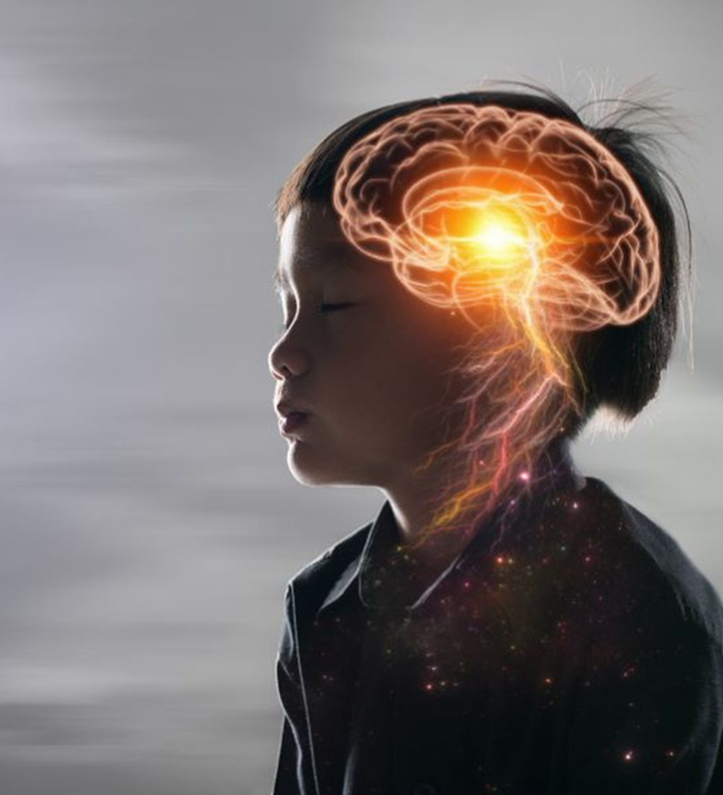
Multiple sclerosis pathophysiology
A chronic autoimmune demyelinating disease of the central nervous system (CNS), primarily affecting the brain, spinal cord, and optic nerves. Its hallmark is the destruction of myelin sheaths surrounding neurons, leading to impaired nerve conduction and neurological deficits.
Primarily an Immunopathogenesis of Type IV hypersensitivity (T-cell mediated). In some subtypes and cases, involvement of Type II/III mechanisms (antibody and immune complex mediated)
Lesion Development:
Immune cells infiltrate CNS through a disrupted blood-brain barrier.
Attack on oligodendrocytes and myelin Inflammation,
Demyelination, axonal damage and Gliosis (scar formation)
Neurodegeneration in chronic stages

Slide 3
Myoasthenia Gravis pathophysiology
A chronic autoimmune neuromuscular disorder characterized by fluctuating skeletal muscle weakness, worsened by activity and improved with rest (Yin syndrome sign)
Immunopathogenesis, MG is a classic Type II hypersensitivity disorder, mediated by autoantibodies against components of the neuromuscular junction.
Mechanisms of Muscle Weakness
First there is a Blocking of ACh binding: Antibodies prevent acetylcholine from activating the receptor.
Receptor internalization: Antibody binding leads to receptor cross-linking and removal.
3. Complement-mediated lysis. Especially with AChR antibodies, leads to destruction of postsynaptic membrane.
4. Synaptic transmission failure. End result is less effective neuromuscular transmission, i.e. muscle weakness
Postsynaptic membrane of the neuromuscular junction: Presynaptic release of ACh is normal, but post-synaptic response is impaired

Slide 4
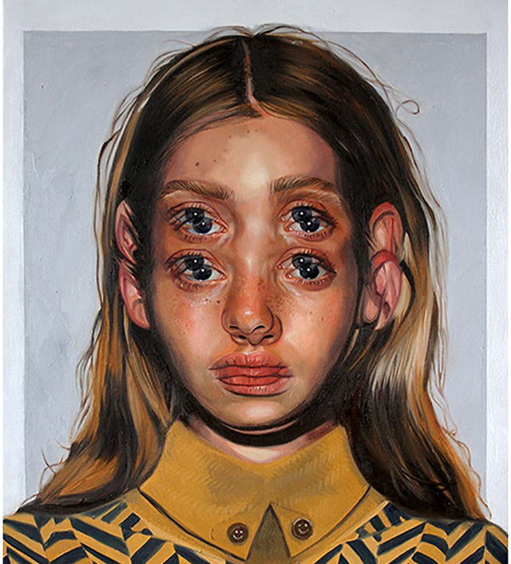
MS and MG disease names
MS is called Duōfāxìng yìnghuà zhèng 多發性硬化症 or “Multiple sclerosis disorder“. Often associate with Marrow dryness (suǐ kū 髓枯)
Myasthenia Gravis is Zhòngzhèng jī wúlì 重症肌無力. Literally. "Severe muscle weakness”

Slide 5
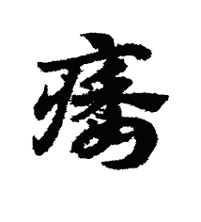
Wěi Zhèng 痿證 (Atrophy/ wilting syndrome)
While Bi-impediments are often marked by inhibited function due to restriction in the tissue matrix, i.e. an impediment. Often characterized by pain, while Wei-atrophyos characterized by weakness and limpness preventing the lifting of the arms and legs. And eventually due to immobility, the atrophy/ wilting sets in. We can summarize it in three markers
肢體筋脈弛緩，，The limbs and sinews are slack,
.軟弱無力 Overall weakness and without strength
3. 不能隨意運動 Inability to move following one’s wishes

Slide 6
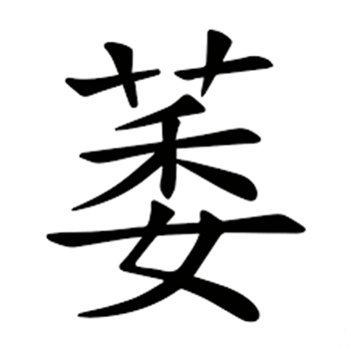
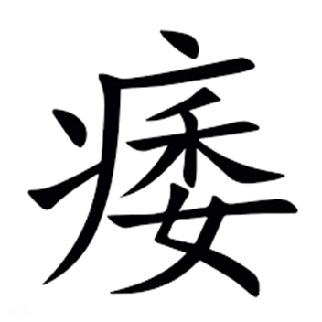
Wei etymology
The Shuowen Jiezi 說文解字 (Explaining Language and Analyzing Characters) categorizes Atrophy under the disease radical《疒部》and defines it as Bi 痿：痹也。从疒委聲. Linguistically, it’s a semantic-phonetic, 形聲; xíngshēng, where one part of the character represents the Sound and the other the Meaning.
Now even though 萎 is seen as the phonetic, it actually means wither. Represents the image of Grasses and trees dried up and dying 草木枯死

Slide 7
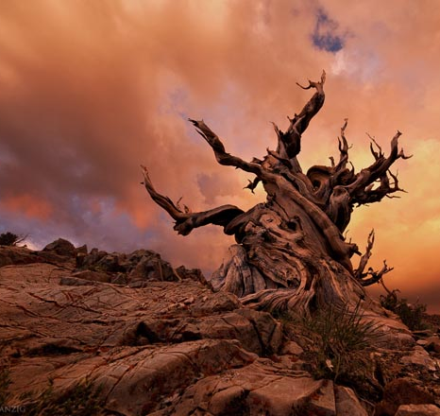
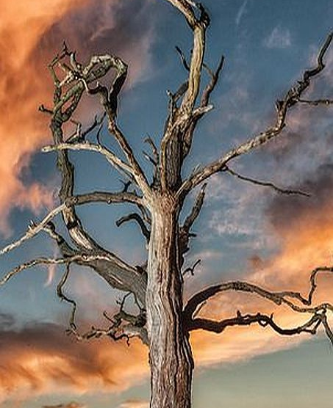
Process of Metal/ Fall

Slide 8
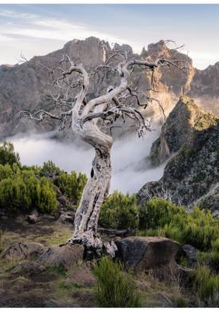

Death has Yin and Yang, Metal relating to Fall and Heaven

Slide 9
Suwen 44 sequence
Chapter 44, Wěi Lùn《痿論》 is the canonical chapter describing the treatment of Atrophy. Interestingly enough, this chapter comes after the chapter on Bì Lùn《痺論》 . The order of 《痺論》 ("Bì Lùn") followed by 《痿論》 ("Wěi Lùn") in the Suwen is not accidental, but deeply intentional. In fact, this sequencing reflects both a clinical logic and a pathomechanistic progression within classical Chinese medicine.
It signifies a progression from Bì obstruction to Atrophy.. Many cases of Wei 痿 begin as Bi 痺
An Obstruction of qi and blood by external pathogens (wind, cold, damp, heat), leading to an internal deficiency of Qi, yin, fluids, jing, marrow which causes Wěi. Clinically, for example, chronic damp-heat bi syndrome can burn yin and damage the sinews, eventually leading to Wei).
This chapter progression also illustrates a Yang to Yin spectrum: 痺 represents excess/pathogenic obstruction (a more "yang" dynamic).痿 represents deficiency/degeneration (a more "yin" dynamic). The Neijing often moves from exterior/excess to interior/deficiency, or from reversible to deeper degeneration.

Slide 10
Suwen 44
Suwen 44 describes 5 types of Wei (Crippling Wilt 痿躄 pertaining to the Lung, Vessel wilting 脈痿 pertaining to the Heart, Flesh wilting 肉痿 pertaining to the Spleen, Sinew wilting 筋痿 pertaining to the Liver, and Bone wilting 骨痿 pertaining to the Kidney). Each of them has their own signs, but essentially all of them manifest from some type Great heat 大熱. The archetypal zang affected is the Lung, as its related to Qi.
When the Lung is hot, the lobes are scorched, the skin and body hair become vacuous and weak . if [external evils] urgently press and affix upon it, then Cripplig wilt engenders 故肺熱葉焦，則皮毛虛弱，急薄著則生痿躄也；
The Yellow Emperor asked :“How does one develop these?” Qi Bo replied: The Lung is the leader of the viscera, and is the canopy of the Heart. If one has that which is lost or perishes, and that which is sought and cannot be attained, the Lung will emit a sound (sighing or grief-crying);I f it emits sound, the Lung becomes hot and its leaf scorches. Therefore, it is said: "The five viscera, due to Lung heat and scorched lobes, emerges to becoming Crippling wilt, this is the meaning .” 帝曰：何以得之。歧伯曰：肺者藏之長也，為心之蓋也；有所失亡，所求不得，則發肺鳴，鳴則肺熱葉焦，故曰：五藏因肺熱葉焦，發為痿躄，此之謂也。

Slide 11

Fire desiccating Metal

Slide 12
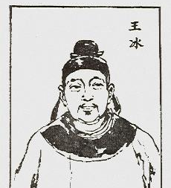
Suwen 74--19 lines Pathomechanism 病機十九條
All Atrophy, panting, and vomiting belongs to the upper 諸痿喘嘔，皆屬於上
The atrophy attribution according to the Tang dynasty Suwen commentator, Wáng Bīng (王冰) , is associated with the Upper Burner 上焦. Both panting and vomiting are associated with Ni-counterflow 逆. Panting with Lung qi counterflow and vomiting with Stomach qi counterflow.
Wang Bing comments in his Expanded and Supplemented Commentary on the Huangdi Neijing Suwen/ Chóng Guǎng Bǔ Zhù Huáng Dì Nèi Jīng重廣補注黃帝內經素問
“What is designed as ‘upper’ is the Upper jiao qi qi of the Heart and Lung. Blazing heat and diffuse burning is qi of the Heart; the receiving and transformation of heat is the qi of the Lung. When heat depresses and transforms upward, ergo the disease pertains to the upper jiao.
王冰注：「上謂上焦心肺氣也，炎熱薄爍，心之氣也，承熱分化，肺之氣也，熱鬱化上，故病屬上焦。

Slide 13
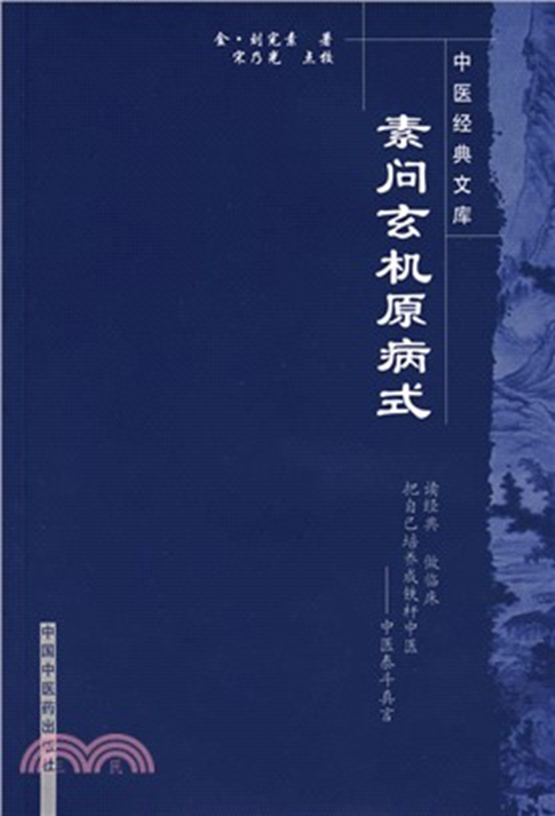
Lung Metal
Liu Wan Su relates this Pathomechanism with the Pathomechanism of Lung-metal All disorders of qi involving Fullness, constraint, and atrophy all belong to Lung Metal.（諸氣膹鬱病痿，皆屬肺金。
This can also be interpreted as 膹=憤 (Anger). 膹鬱 as a compound refers to Accumulation and Fullness 聚滿，and Constrain bindings 鬱結
膹 means fulness 膹滿 . "鬱 means 奔迫 (rushing and pressing urgency).""痿 means the hands and feet are flaccid and weak, without strength to move. In general, the Lung governs qi, and qi belongs to yang. Yang governs lightness, clarity, and upward movement — thus, the Lung resides in the upper part of the body. When diseased, its qi becomes full, distended, and surging, unable to ascend, eventually leading to flaccidity and weakness of the limbs, which can no longer gather or hold [movement].This arises because Lung metal (and Liver wood) becomes dry; and when dryness becomes pathological, blood and fluids decline, and are unable to nourish the hundred bones. Thus the Classic says: "The fingers, receiving blood, can grasp; the palm, receiving blood, can hold; the feet, receiving blood, can step. "Therefore, when autumn metal flourishes, misty qi gathers and becomes constrained, and grasses and trees wither and fall —this is the image of disease."萎" (withered) is akin to "痿" (atrophied).
膹謂膹滿也，鬱謂奔迫也，痿謂手足痿弱無力以運動也，大抵肺主氣，氣為陽，陽主輕清而升，故肺居上部，病則其氣膹滿奔迫不能上升，至於手足痿弱不能收持，由肺金木燥，燥之為病，血液衰少不能營養百骸故也，經曰手指得血而能攝，掌得血而能握，足得血而能步，故秋金旺則霧氣蒙鬱而草木萎落病之象也，萎猶痿也。

Slide 14
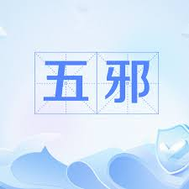
5 evils
The Lung-Metal is always afflicted.
The 50th Difficulty says: “In diseases, there are Xu Xie (vacuity evils), Shi Xie (repletion evils), Zei Xie (thieving evils), Wei Xie (minor evils), and Proper evils (Zheng Xie). How can they be distinguished?”五十難曰：病有虛邪，有實邪，有賊邪，有微邪，有正邪，何以別之?
Answer:
That which comes from behind is called deficient evil 從後來者為虛邪
That which comes from the front is called excess evil 從前來者為實邪
That which comes from what it does not overcome is called thieving evil 從所不勝來者為賊邪
That which comes from what it does overcome is called Mild evil 從所勝來者為微邪
That which arises from within is called proper evils 自病者為正邪

Slide 15
Nanjing 49
The 49th Difficulty states: “There are diseases of the Orthodox channels arising from themselves (自病), and there are those caused by the five evils (五邪). How can they be distinguished?”然四十九難曰：有正經自病，有五邪所傷，何以別之？
Answer: The Classic say “Worry, sorrow, and overthinking injure the Heart. Exposure to cold and drinking cold injure the Lung; Rage and counterflow of qi that ascends and does not descend injure the Liver; Improper diet and overexertion injure the Spleen; Prolonged sitting on damp ground, or forcefully entering water, injures the Kidney, these are considered self-arising diseases of the Orthodox channels ：經言憂愁思慮則傷心；形寒飲冷則傷肺；恚怒氣逆，上而不下則傷肝；飲食勞倦則傷脾；久坐濕地，強力入水則傷腎。是正經之自病也。 (正經之自病).
What are the “five evils”? 何謂五邪？
Answer: Wind strike (中風), summer heat injury (傷暑), food damage and fatigue (飲食勞倦), cold damage (傷寒), and damp invasion (中濕) — these are called the five evils.
Since Neijing states that Wei comes from the Lung, and it is the fire from desire that scorches the lung lobes. Nanjing 49 relates worry to the Heart. Therefore, this is Fire overwhelming Metal 火乘金
A thieving evil 賊邪 (Vigorous fire disperses Qi 壯火散氣)

Slide 16
TCM common etiologies
1. 感受溫毒 Contraction of Warm Toxin
2.濕熱侵淫 External Damp heat encroaching
3. 飲食毒物所傷 Injury from Food and drink toxin
4. 久病房勞 Chronic Illness and bedroom taxation
5. 跌撲瘀阻 Trauma and blood stasis obstruction
The first two are Exterior causes 外因, and the last three are a subset of Interior cause 内因 and Neither exterior and interior 不內外因. Note that the Suwen emphasizes Interior causes.
The exterior pathogens tend to cause a depletion of Lung and stomach fluids leading to its development 耗傷肺胃津液而成。
Whereas Internal damage often Impair the Zang fu, leading to vacuity of Stomach and spleen and Liver kidney debilitation 內傷多損及臟腑，導致脾胃虛弱、肝腎虧損。

Slide 17
Yangming
Tx: Neijing tells us in the Treatment of Atrophy, alone choose Yangming 治痿者獨取陽明
Yangming is Yang, composed of Yang Earth and Yang Metal (陽土, 陽金) .
For atrophy, it is primarily a Yin disease 痿證為陰病), therefore we must From Yang Guide Yin 從陽引陰 (
When we choose the position of Yang Earth, we drain fire and we supplement metal (Child土位—瀉火 (子) 補金 (母) and protecting against wood invasion via reverse control 反克. Earth is the child of fire and mother of earth. Think of Qu chi/ LI 11 (Earth of Yang Metal) to represent this principle.
When we choose the Position of Yangming Metal, 金位, we drain Earth 瀉土( 子) and Supplement Water 補水. This the selection of Ling Gu Da Bai.
Also go to Lao Gong/ Pericardium 8 and drain it

Slide 18
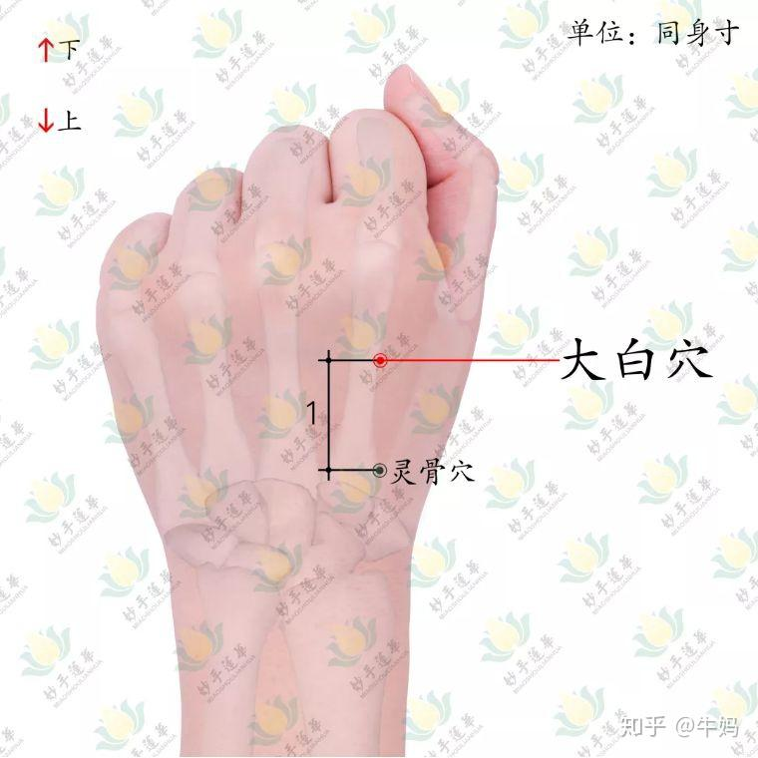
Ling gu 靈骨 da bai 大白 22.04-22.05
This point Form is on Yang metal (Large intestine/ Hand Yangming)
Its Function is on Lung 肺支神經 (Hu Wen Zhi put Hearts kidney shenjing for Ling gu 心及腎神經 )
These have has a major effect on Hemiplegia 半身不遂, which is a symptom category important to look from a Neurology lens. Also for powerless lower limbs 下肢無力
Second its indicated for Strange diseases 怪病. Directionally, Ling gu enters (Zheng qi oriented), and Da bai exits (Xie qi oriented)

Slide 19
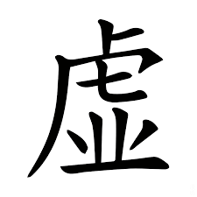
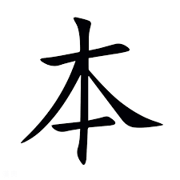
Vacuity and repletion
Most of these Wei syndromes we Take Vacuity as the Root, or a Vacuity repletion complex 以虛為本，或虛實錯雜。

Slide 20
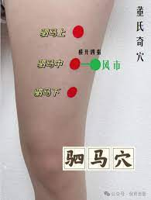
Si Ma 駟馬 88.17-88.19
Between Foot Yangming (Stomach) and Foot Shaoyang (GB), and its Function is on Lung commanding nerve 縂神經, and Liver-subbranch 分支神經.
Yang to Guide Yin strategy. Prioritizing Yang earth to Engender Metal, or Metal to control Shaoyang wood.
Similar to Ling Gu and Da Bai, in its indication for Hemiplegia. Si Ma works on Treating the blood by first treating the Qi 治血先治氣. Once Lung qi is strengthened, blood can perfuse through the 12 channels.
Si ma also works on Treat the muscle by treating the muscle 治肉治肉. Atrophy disorders often are categorized as Rou wei/ Muscle atrophy 肉痿
Needling between Si Ma (Lung line) and Tong Tian (Heart line) has a stronger effect on invigorating heart blood. Wang Chuan Min states that originally Si ma location was closer to Tong Tian.

Slide 21
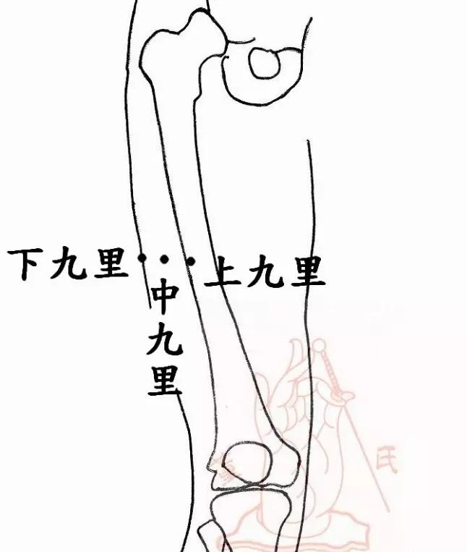
San Jiu Li 三九里
Jiu Li form is on Foot Shaoyang. Its Shenjing changes depending if its Zhong Jiu Li, Shang Jiu Li, Xia Jiu Li.
Zhong Jiu Li functions is on the Lung and the Neuromuscular elasticity of the Legs 腿之彈力神經. Shang Jiu Li on Heart and Kidney. And Xia Jiu Li on Spine and Legs
All of them encapsulate the idea of Metal not controlling wood 金不克木, which is often seen in Interior wind 内風 syndromes seen in neurological diseases. Right cun weaker in comparison to a hyperactive left guan for example is a pulse manifestation to Assist metal to control wood.

Slide 22
WXZ on Myoasthenia Gravis
WXZ proposes that when a latent pathogen emerges, it enters Shaoyang causing sore throat and swelling. If the Shaoyang is unresolved, it transmits to Yangming leading to a persistent high fever.
It is at this stage the autoimmune disease process can be halted by clearing the Shaoyang, WXZ suggests Xiao chai hu tang plus Niu bang zi. Niu Bang xi also known as Da Li Zi 大力子 “Great strength seed”, not only clears heat in the throat, but also muscle weakness within the Shaoyang
In the Qian Jin Yao Fang 千金藥方, WXS makes the equivalence of Ròu jí 肉極 with Wei-atrophy. Rou ji is an extreme exhaustion of the muscle/ flesh, often an advance stage of Heat based Wei-atrophy.
The proposed formula to treat is Yue Bi Jia Zhu Tang：
It treats Internal extreme. depletion, heat causing bodily fluid desiccation, because the interstices open, sweat greatly drips, pestilential wind [invades], [thus causing] lower jiao and leg weakness
《千金方》越婢加朮湯：治內極，熱則身體津脫，腠理開，汗大泄，厲風氣，下焦腳弱

Slide 23
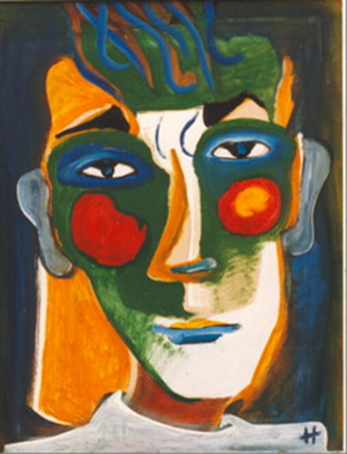
Myoasthenia Gravis strategies
Yue Bi Jia Zhu tang can be modified with Fu zi, which signifies the underlying basis of developing thus febrile muscle wasting is yang vacuity
Bai zhu and Cang zhu govern Taiyin. Myoasthenia Gravis a Taiyin disease from a Liujing perspective, we need to open the lung, descend the qi, and expel dampness and hot qi in the 分肉之間 wasting the muscle envelope, i.e. Sinew membrane of the Muscle 肌肉之筋膜
Yue bi jia zhu tang
Ma huang 18
Shi gao 24
Sheng jiang 6
Gan cao 6
Da zao 9
Bai zhu 9

Slide 24
Heat and Cold types
While Atrophy often is treated from the perspective of heat. For example, Wei-Chieh Young often recommends Di Huang Yin zi for chronic neurological diseases, such as Multiple sclerosis, Parkinson, and Amyotrophic Lateral Sclerosis. Often heat based atrophy, is followed by or preceded by yang vacuity. Heat consumes Qi so can lead to Qi and Yang vacuity, if Yang vacuity follows it. If it precedes it, Yang vacuity leads to lack of transformation, which create Qi constraint and therefore heat.
The SHL tells us an importance principle:
Reversal cold (Jue), dryness in the throat, vexation and restlessness, and internal binding in the Yangming with zoa delirious speech and chaotic vexation, then administer Gancao Ganjiang Tang (Licorice and Dried Ginger Decoction).厥逆，咽中乾，煩燥，陽明內結，讝語煩亂，更飲甘草乾薑湯
At midnight, when the yang qi returns, both feet should become warm. If the shins are still slightly tight and contracted, then again administer Shaoyao Gancao Tang (Peony and Licorice Decoction).夜半陽氣還，兩足當熱，脛尚微拘急，重與芍藥甘草湯
Then the shins will extend. If, upon giving Chengqi Tang (one of the “Purgative Decoctions”), there is a mild soft stool, then the delirious speech will cease — thus one knows that the illness can be cured. 爾乃脛伸，以承氣湯微溏，則止其讝語，故知病可愈.
If sweating and additionally fire needles has been used repeatedly, then Si Ni Tang is indicated. 若重發汗，復加燒鍼者，四逆湯主之
Resurrect Yang First, then Boost the Yin, and finally regulate the Yang qi.

Slide 25
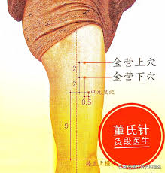
Jin Yin Shang Xia 金營上穴｜金营下穴
88.33-88.34
Form: Foot Shaoyang
Function: Heart and Lung
Emergency pain point, point to clear toxin. Shaoyang stirring blood heat and restlessness. Akin to Zhi zi (Shaoyang heart fire syndrome)
Qi depression and blood stasis. Gallbladder and Heart extraordinary connection, Zang Fu Bie Tong theory. Gallbladder’s Yang wood engenders Heart’s Yin fire, via the pivoting mechanism.

Slide 26
Autoimmune Pulse Diagnosis
WXZ argues the main pulse reflecting Latent qi is a Faint and weak pulse 微弱脈, He tells us explicitly that a pulse without strength, and an unclear sensation of the finger, is a Fundamental pulse of Latent qi 脈不有無力，指感不得很清晰，這是伏氣的一個基本的脈.
The Faint pulse is related to Yang xu, Shaoyin yang deficiency. The faint refers a decline in the heart’s contractile and output function, and a reduction in the heart’s ejection faction. Yang is faint.
Weak is related to Qi vacuity, a weak pulse is one without force. Both faint and weak reflect an insufficiency of yang qi, aligning with the idea of Winter damage by cold
Shaoyin yang deficiency is fundamental for Latent pathogens to develop, often along with a weak pulse which reflects Taiyin qi vacuity.
A Shaoyin condition will be Faint and Thin per the Shang han lun, due to Yang and yin deficiency. Not all faint and weak pulses are Latent pathogens.
For example, in lung cancer, the cun often will be deeper than the chi

Slide 27
Latent qi signs
1. Sore Throat is a Key sign of Latent qi. Often reflecting pathogens in the Shaoyin, or transforming to heat and transitioning into Shaoyang.
The Shang han lun has various lines where there is sore throat in Shaoyin disease, such as in the formulas:
Gan cao tang
Jie geng tang
3. Ban xia San ji tang
But in general, sore throat signifies this latent pathogen proclivity for Wu Xiong Zhi
2. Diarrhea– being the second typical sign for Latent qi. For example, diarrhea with a rapid pulse characterized by sore throat, palpitations, anxiety, and a hurried pulse reflects the onset of viral myocarditis, an expression of Warm disease. Ge gen qin lian tang governs.
3. Eyes red like dove eyes– Inner canthus or lower lid showers peculiar redness, this suggests heat in Jueyin, latent pathogens and a tendency to autoimmune diseases or certain hematological malignancies
4. Hair easily sheds– a signed of depleted Kidney qi
5. Skin rashes 皮疹
6. Musculoskeletal changes
7. Internal organ damage

Slide 28
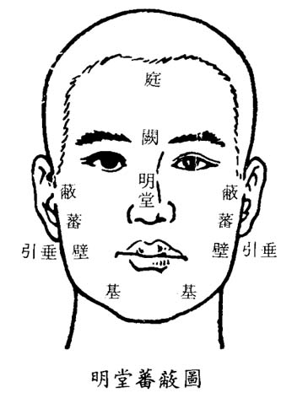
Autoimmune facial diagnosis
From a Liujing perspective, we will focus on Shaoyang, Shaoyin and Jueyin
Wu Xiong Zhi’s Liu jing facial diagnosis:
Taiyang is diagnosed on Yin Tang
Shaoyang, below on the sides of the nose
Yangming on the top of the nose
Taiyin on the sides of the nose tip, next to Bi Yi
Shaoyin the eyes
Jueyin between nose and eyes

Slide 29
Blood Bi/ Xue Bi
Multiple sclerosis since an archetypal symptom of it is Numbness, in the Shang Han Za Bing Lun this is characterized as belong to the disease of Blood Bi 血痹
The Jingui states:
“Question: In the case of blood impediment (血痺), how is it attained?”問曰：血痺病從何得之
The Master replied: "People of noble rank and luxurious living tend to have weak bones and abundant flesh and skin. When they become overexerted, fatigued, and sweat profusely, then lie down without moving at the proper times, and are further touched by a slight breeze, they thereby contract the illness. As for the pulse: it will be faint and rough at the cun position, and slightly tight at the guan position. It is appropriate to use needling to draw out yang qi, so as to make the pulse harmonious; when the tightness resolves, the illness will be cured.”師曰：夫尊榮人骨弱肌膚盛，重困疲勞汗出，臥不時動搖，加被微風，遂得之。但以脈自微濇在寸口，關上小緊，宜鍼引陽氣，令脈和，緊去則愈

Slide 30
Huang qi gui zhi wu wu tang 黃耆桂枝五物湯
In blood impediment, both yin and yang are weak. The cun and guan positions are faint, the chi is slightly tight. The external sign is bodily numbness, in the semblance of wind impediment. Huangqi Guizhi Wuwu Tang (Astragalus and Cinnamon Twig Five-Substance Decoction) governs. 血痺陰陽俱微，寸口關上微，尺中小緊，外證身體不仁，如風痹狀，黃耆桂枝五物湯主之
Sheng Huang qi 30-60
Gui zhi 9
Da zao 12-20
Sheng jiang 18
Bai shao 9
This is Gui zhi tang minus Zhi gan cao, doubling Sheng jiang, and adding Huang qi.
Huang qi is said to release the exterior of rheum on the surface, regenerating skin, treating numbness and oily sweat.
HXS categorizes it as a Taiyang Taiyin syndrome with blood vacuity
Hu Xi Shi would often add Shi gao, when there is dry mouth, heat effusion, and rapid pulses. Even sometimes pain with a lot of irritability can be seen as Heat stasis, a shi gao pattern

Slide 31
絡病 Luo disease
Ye Tian Shi 葉天士 concept of Chronic disease enters the Luo 久病入絡
Add vines: Vines due to their image are said to affect the Luo mai 絡脈, and have a special effect on peripheral disease, particularly for pain syndromes that affect the blood layer and wei level, as well as peripheral skin manifestation with an immuno-vasculopathy component such as: Raynaud, venous stasis dermatitis, eosinophilic dermatitis, purpuras, thromboangiitis obliterans , dermatomyositis, etc.
Wu Xiong Zhi favors Ji Xue Teng
Add insect and animal medicinals: Quan Xie, Wu gong, Bai jiang can, Shui zhi, Tu bie chong, Wu Shao She, Bie Jia, Chan Tui

Slide 32
Tung concept of Polio 小儿麻痹
When Master Tung would treat Infantile Polio 小儿麻痹, he would use what he calls the 5 flowers 五花. This is also for any leg weakness.
The 5 flowers are: Jian Zhong 44.06, Yun Bai 44.11, Li Bai 44.12, Xia Qu 44.15, Shang Qu 44.16
He would alternate usages between Jian Zhong, Yun Bai, and Shang Qu. And then Jian Zhong, Li Bai, and Xia Qu
Hu Wen Zhi often adds Shen Jian 神肩穴 44.19

Slide 33
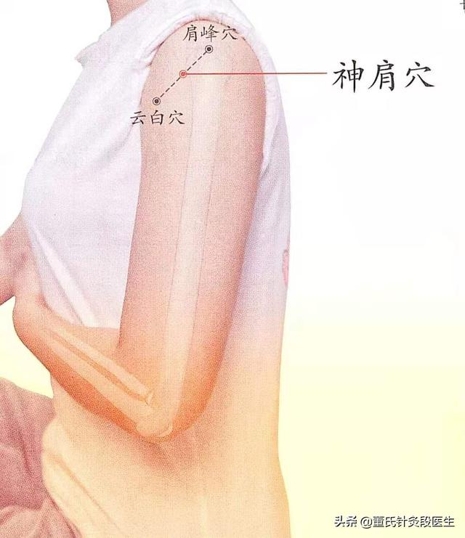
Shen Jian
One of the 72 resolving points for Hu Wen Zhi 董氏七十二絕針之一. Between Jian Feng and Yun Bai

Slide 34
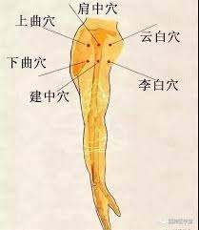
Six shoulders 六肩
The Hu Wen Zhi lineage of Tung often combines them all into what is termed the Six shoulders.
Master Tung would only use 2-3 at a time, not six.

Slide 35
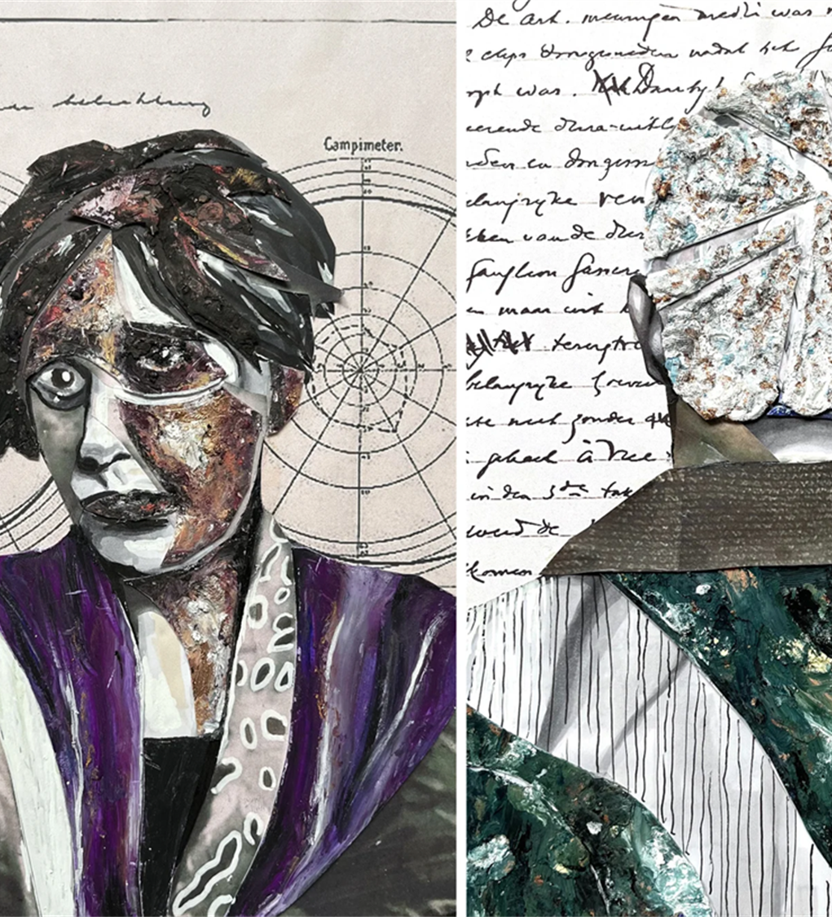
CM concept of Nerves 神經
Nerves can be conceptualized from two vantage points. From a Wu zang perspective or from a Liu Jing perspective.
From a Liu Jing perspective, nerves are often related to Shaoyang or Jueyin, i.e. the wood phase. Shaoyang in excess and Jueyin in deficiency. Shaoyang from the perspective of Qi and Jueyin from the perspective of blood. Both relate to pathologies of Wind. Dr. Arnaud Versluys would state the Jueyin is the Nervous system, for example he gives the example of Eye twitching in a Yang syndrome is Xiao chai hu tang, and in a yin syndrome, Wu mei wan
From the perspective of Wu zang, there are modern physicians who directly state the Kidney governs the nerves 腎主神經, this is from a structural standpoint of Kidney governing the Spine, where nervous system emanate from.
Others will reference more the Liver governs the Jin mo 肝主筋膜. Jin mo referring to the Sinew membranes, often relating to nerve-vascular membrane sheathes and nexuses.

Slide 36
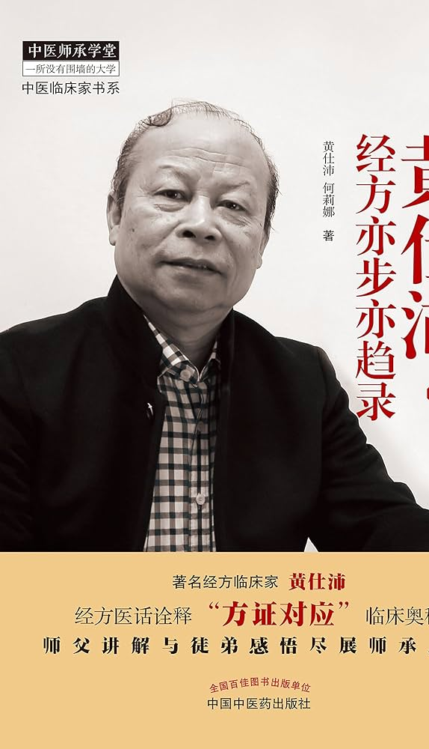
Huang Shi Pei 黃仕沛 “on Ma huang”
Huáng Shì Pèi, an expert on using Ma huang for neurological conditions. He quotes Huang Huang 黃煌 who states “those unable to use Mahuang, cannot be regarded as a good doctor 不会用麻黃，不算是一個好中醫”
Ma huang can Stir up sunken yang 振奮沉陽, this is the function of Ma huang in a neurological context.
Huang Shi Pei says Ma huang has six major functions:
Resolve the exterior, effuse sweat 解表發汗
Stop Pain 止痛
Calm Panting 平喘
Benefit urination, disperse swelling 利尿消腫
Stir up sunken yang 振奮沉陽
Break concretions, conglomerations, gatherings and accumulations 破癥瘕聚積

Slide 37
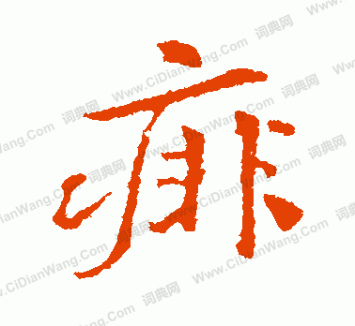
中風痱 Zhòng fēng fèi
A type of subset of Wind strike. Wiseman translates it as Wind disablement. Defined as Wilting-Wei with loss of the use of the limbs without pain or loss of mental faculties.
This can relate to a number of neurological conditions that begin suddenly with progressive disablement.
Ma huang can Raise the dead and return them to life 起死回生, consider its usage in the Jin Gui formula 雜寮方, Huan Tun Tang 還魂 湯 (return the corporeal spirit decoction). To rescue sudden death 救卒死 from guesting a rebellious, death (qi) 客忤死.
Ma huang 3 liang, Xing ren 72 pieces, Zhi gan cao 1 liang, and Qian Jin Yao Fang adds Gui xin 2 liang
One can go up to 45 grams of Ma huang, even six liang (16x6), slowly titrate the dose

Slide 38
Xu Ming Tang 續命湯 Life-Restoring Decoction)
Gu Jin Lu Yan (Tested Formulas Ancient and Modern):“《古今錄驗》records 續命湯 Xuming Tang
Indications: Treats wind-stroke disablement, in which the body cannot control itself, the mouth cannot speak, clouded and dim, not knowing the location of pain, or is so tense and contracted they are unable to turn to the side." 治中風痱，身體不能自收，口不能言，冒昧不知痛處，或拘急不得轉側“
Ingredients; Ma huang, Gui zhi, dang gui, ren shen, shi gao, gan jiang, gan cao 3 liang. Chuan Xiong 1 liang, Xing ren 40 pieces.
This formula put simply Stirs up sunken yang and warms, scatters, disseminates and penetrates 溫散宣通
There are several versions of Xu ming tang, but they usually include a mix of
1. Acrid warm herbs (Ma huang, gui zhi, rou gui, xi xin, du huo, gan jiang, sheng jiang, fu zi, fang feng),
2. Cold-cool herbs (shi gao, ling yang jiao, sheng ma, sheng di huang, tian men dong, di gu pi, huang qin, ge gen, jing jie, fang ji)
3 Blood nourishing and moving herbs: Dang gui, chuan Xiong, shao yao
4, Qi supplementing herbs: Ren shen, Gan cao, fu ling, bai zhu

Slide 39
Xu Ming Tang indications per HSP
According to Huang Shi Pei,
1. The body unable to support or hold itself refers toa decrease in limb’s muscular strength and reduced muscle tone.
2. Dimness and unaware of the location of pain indicates sensory impairment
3. Unable to speak refers to slurred or impaired speech and dysfunction in swallowing
4. Rigidity and inability to turn the body is increased hypertonic muscle and possibly neurogenic pain
5. Also treats inability to lie down, rebellious qi coughing and shortness of breath, facial puffiness, referring to damage to the respiratory muscles
This formula does not treat with Yin xu with internal stirring of liver wind syndromes

Slide 40
Yangming medicinals
Yangming medicinals that treat diseases of the muscles include:
Shi gao, i.e. Bai hu jia ren shen tang, Bai hu jia gui zhi tang
Ge gen- Ge gen tang, Gui zhi jia ge gen tang, zhu ye shi gao tang
Tian hua fen--- Gua lou gui zhi tang
Yi Yi Yi ren- Ma xing Yi gan tang
Taiyin medicines are often combined with Yangming
Ma huang (Taiyin lung herb) combined with shi gao: Ma xing shi gan tang, Xu Ming tang
Ma huang with Yi Yi ren– Ma xing Yi gan tang
Ma huang with ge gen: Ge gen tang

Slide 41
Feng Yin tang
Archetypal Yangming neurological formula
Da Huang, Gan Jiang, and Long Gu — 4 liang each; Gui Zhi — 3 liang; Gan Cao and Mu Li — 2 liang each; Han Shui Shi, Hua Shi, Chi Shi Zhi, Bai Shi Zhi, Zi Shi Ying, and Shi Gao — 6 liang each.
Archetypal Shaoyang neurological formula
Chai hu jia long gu mu li tang
Archetypal Tai yang neurological formula: Gui zhi gan cao long gu mu li tang and Gui zhi jiu ni tang (patterns of fright 驚 causing Qi chaos and Yin yang separation).

Slide 42
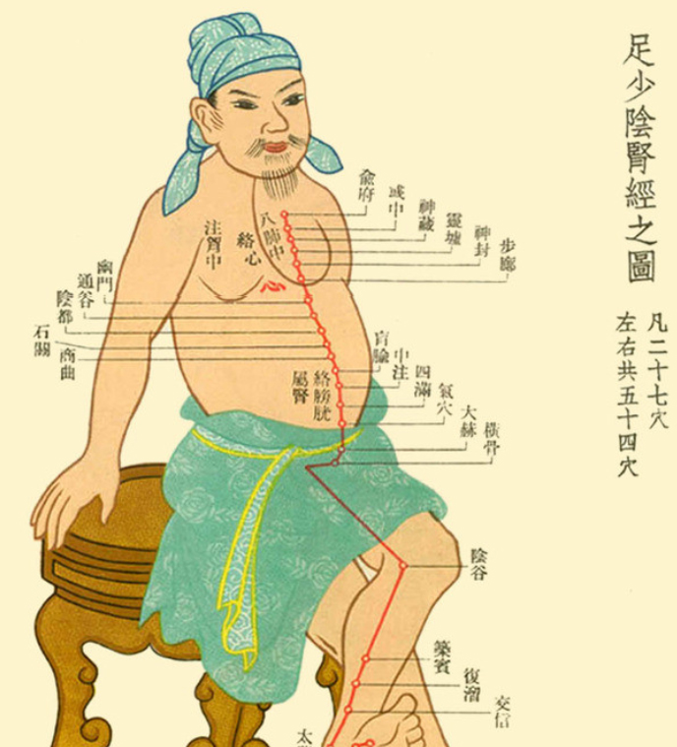
Sea of Marrow
The Kidney is said to govern the Bones, and engender the Marrow 腎主骨、骨生髓 腎藏精
To affect the Marrow, we can think of Foot Shaoyin
66.14-66.15 Water Minister/ Shui Xiang 水相, and Water Minister/Shui Xian 水仙
Also Shui fu DT.14, and Shen Guan 77.18.
Postnatal Strategies: Xia san huang and Tong shen, Zhong Bai

Slide 43
Gu Mai vs Bu Gu Mai
Pulse reflecting Du or Ren mai disease. Based off Chen Xiao Hui
Gu Mai meaning- Drum, strike, beat. Or Firm pulse
CXH primarily uses Gu Mai or Bu Gu Mai to indicate whether to needle Ren or Du channel. He views this as the most important
Gu Mai--- Ren Mai (indicates Evil qi exuberance in the interior), the pulse has force and agitated. Accumulation in the Yin.
Bu Gu Mai- Du Mai (indicates Zheng qi vacuity). disease lies in Qi vacuity
Gu Mai- Regardless of pulse strength, when pressing gradually from the skin surface down to the bone, the pulsation is clearly felt directly under the fingers throughout the entire process, without interruption
Bu Gu Mai– regardless of pulse strength, when pressing gradually from surface to bone, there is a level which no force is felt directly under the fingertips. Instead, the force is felt on the sides of the fingers with flicking sensation.

Slide 44
Quan Xi 全息 Holographic Model
The left cun kou governs Blood. This is Ren mai
The right cun kou governs Qi. This is Du mai.
The Ren and Du each has its own three sections. Based of a Quan xi/ holographic model 全息
Above the Diaphragm is the Upper
Below the diaphragm to the umbilicus is the Middle
Below the Umbilicus is the Lower
If one finds the 郁动 pulse in the Guan, with a Gu mai, we can look for Ren mai section in the middle

Slide 45
Tung acupuncture on “Ji 脊” and Nao 腦
To treat Neurological conditions in Tung, we can Guide the effect to the Central nervous system, this is reflected in the Tung categorization of “Substantial organs/ shí tǐ zàng qì 實體臟器”. Notice how certain points have a correspondence to an anatomical entity, be it the Uterus, the Bowels, the Sternum, the Spine, the Marrow, etc.
For Neurological medicine, we will focus on points that have a Spine/ Ji and a Brain/ Nao correspondence. One can also argue the Ji zhui/ vertebral correspondence 脊椎
Points with a focus on the Spine and Brain are numerable, and there’s different categories of strength within them.

Slide 46
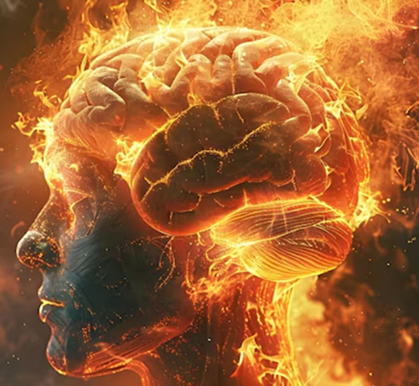
Brain correspondence
The points with a commanding channel 縂神經 correspondence to the Brain are Zheng Jin 77.01, Zheng Zong 77.02, and Zheng Hui 1010.01 and Hou Hui 1010.06. Qian hui 1010.05 has an Accessory 副神经 channel resonance.
Zheng jin is in Foot Taiyang, Taiyang channels enter the Brain.
Zheng Hui is in the Du Mai，the Sea of Yang
Additionally, Shui Xiang 66.14, Shui Xian 66.15, Zhen Jing Jing 1010.08 has a Brain anatomical region 腦解部
For Multiple Sclerosis and Myoasthenia Gravis, we can also think of Zheng Ji/ Correct the Spine 44.24 (points in the Hand Yangming). We can also think of Hui Zhui 44.02, located in Hand Shaoyang, with correspondence to the Vertebrae.

Slide 47
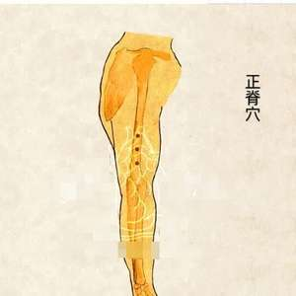
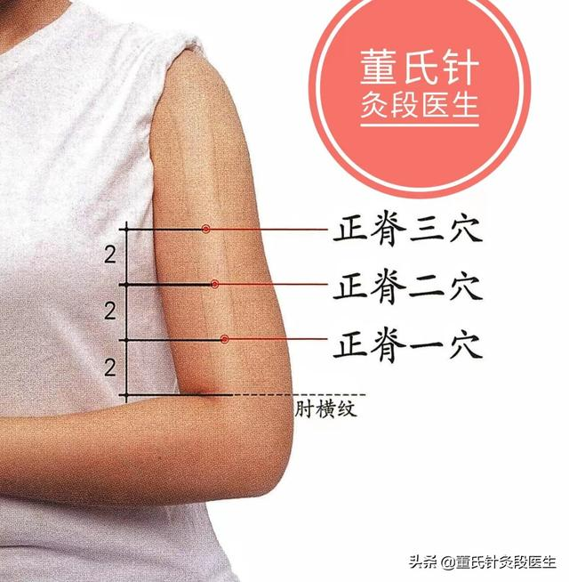
Zheng Ji 正脊

Slide 48
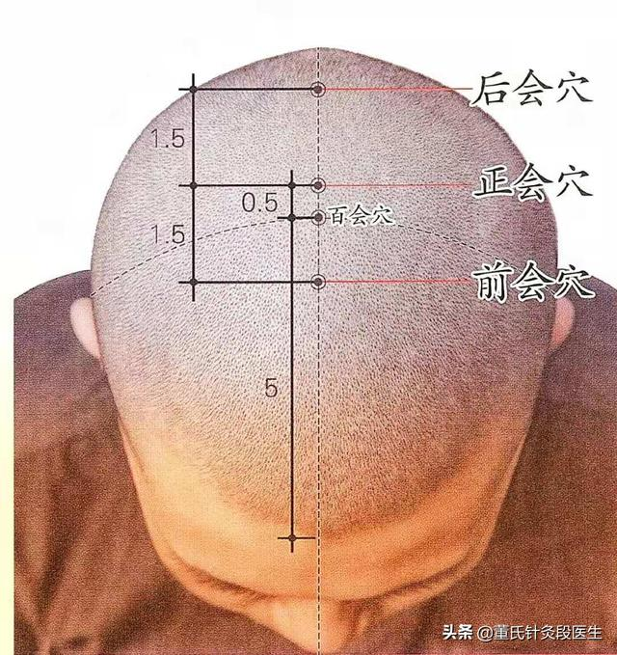
San hui
Treats the Primordial Shen 元神 residing in the Extraordinary Fu (i.e. the brain). Treats it via the Du mai. Highest point of yang.
Effect depends on Tonifying or Draining (with or against the channel), depth of insertion, and hand manipulation,
Can raise Yang or Quell yang (jue yin interior wind or Du mai yang exuberance and blood vacuity headaches)

Slide 49
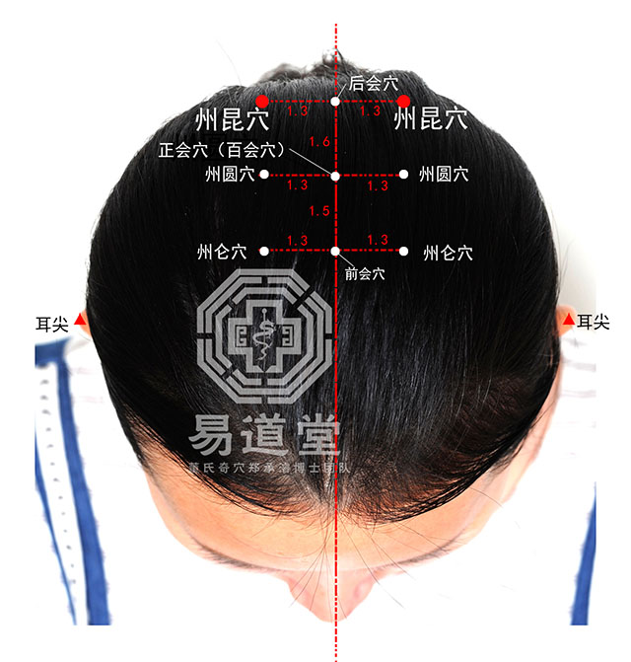
Zhou Yuan, Zhou Kun, Zhou Lun
1010.02-1010.04
州 Zhou Related to Taiyang
Form in Foot Yang
Function in Lung
Neurologic dysfunction, muscle weakness, with respiratory dysfunction. Dermatomyositis as an example, or Amyotrophic Lateral sclerosis.
For loss of hand function: Combine with Ling gu da bai
Loss of function of legs: Si ma, Zhong Jiu Li
Pain in limbs with swelling: Shui qu and Si zhi
Phlegm in the brain’s orifice: Combine with San zhong
Tumor in the brain: Wai san guan, add Shang Liu
Can Dao Ma with Zheng Hui 1010.01. Zheng Hui is better combined with Jian Zhong (brain-heart connection) and Zhou Yuan with Zhong Jiu Li (Lung connection)

Slide 50
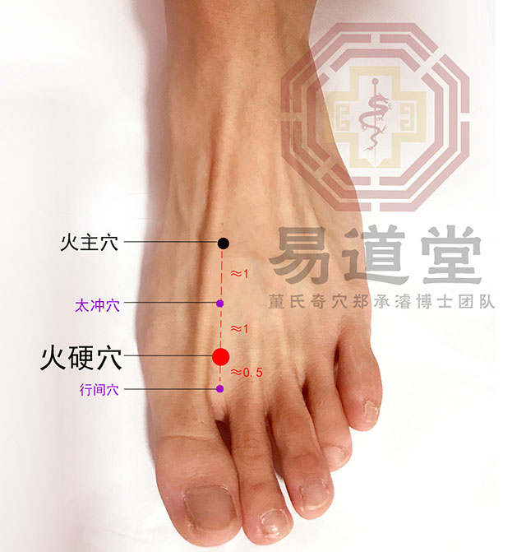
Huo Ying 火硬 and Huo zhu 火主
Form in Jueyin
Function in Heart and Liver (Huo ying 副之肝神经，支之心神经). Huo zhu exclusively the heart
Effuse warm blood into the brain, the liver vessel ascends to the vertex, Wood engendering Fire.
Fire desires softness
Huo ying treats Child disease affecting its mother 子病及母

Slide 51
CXH on Marrow needling
Suwen 55 《長刺節論》
When one suffers from "great wind" (dà fēng), the bones and joints heavy, and the beard and eyebrows fall out. This called "great wind." Needle the muscles for this reason, Sweat emerges for a hundred days. Then needling into the bone marrow; this again causes sweating for one hundred days. Altogether, two hundred days. Once the beard and eyebrows grow back, the needling is stopped.
病大風，骨節重，鬚眉墮，名曰大風，刺肌肉為故，汗出百日，刺骨髓，汗出百日，凡二百日，鬚眉生而止鍼
Great wind is a type of Leprosy 痲瘋
CXH remarks in the beginning of his acupuncture journey, he thought you could only needle the Qi caverns 氣 穴, then the Luo Mai 絡脈，then Arteries 動脈, then Bone 骨, also Zang fu 臟腑, and even the Marrow/ Sui 髓 could be needled.
He remarks seeing an older doctor, Zhang Ke Jia 張克家, grandfather of one his classmates, performing marrow needling on a Schizophrenic patient. He would needle Ya Men (Du 15), Tao dao (Du 13), an unnamed point below T2, and Da zhui (Du 14). These 4 points were often combined with others to Disperse wind, transform phlegm, calm the heart-shen, and foster qi and blood. The needing depth of this points was extremely high, especially Da Zhui and the unnamed point. He would needle underneath the Dura membrane 硬脊膜下 and upon reaching it the patient’s 4 limbs would often experience a twitch phenomenon 四肢抽搐象方

Slide 52
Gu Sui 骨髓 meaning
Chen Xiao Hui argues that the Bone marrow is in fact the Ji sui 脊髓/ Spinal cord.
Suwen states Piercing into the spinal marrow between the vertebrae causes hunchback (spinal deformity).(刺脊間中髓，為伛。Prohibitions on Needling《素問·刺禁》）
The bones are the residence of the marrow骨者，髓之府。 Essential Subtleties of the Pulse《素問·脈要精微論》
All types of marrow are associated with the brain.“諸髓者皆屬於腦。”Generation of the Five Viscera”《素問·五臟生成》
CXH states that it is routine for anesthesiologists 麻醉科醫生 to regularly needle the Stellate Ganglion root 星狀神經根 and Spinal nerve root 脊神經根
Now this is not to say I am advocated for Spinal dura needling, however this is an informative exposition on the possibilities of what Classical Acupuncture entailed. If someone has the right training, right anatomical understanding, and in the right setting, then one can expand one’s needling anatomical limitations.
For Spinal cord needling, Chen Xiao Hui has his own methodology and process to work on deep spinal membranes.

Slide 53
Leg qi 脚氣
FOR ESSENCE STAGE of TREATMENT, for treating the Xian Tian 先天 (Prenatal)
Shen qi wan 崔氏八味丸：Cui’s Shi’s Bawei Wan : Treats Legs ascending upward, with lower abdominal numbness 治腳氣上入，小腹不仁
Kidney deficiency, with concomitant Liver essence deficiency. Treats the Sea of Marrow. Wind stirring from Yin xu and water stasis. Dry blood water patterns.
Gui fu di huang tang
Gui zhi replaced with Rou gui, more focused on warming the Yang. Less dryness, more cold water.
Can also consider Li Ke’s 李可 Powder to Cultivate the Source and Consolidate the Root (Pei Yuan Gu Ben San 培元固本散) which treats All types of Severe deficiency syndromes that do not recover after prolonged depletion, including congenital insufficiency, aging and degenerative decline, and immune deficiency治一切久损不复之大虚证，先天不足，衰老退化，免疫缺陷
Tāipán (胎盘) — 1–2 placentae, Lùróng (鹿茸) 30–50g, Hóngshēn (红参) — 50–100g, Wǔlíngzhī (五灵脂) — 30–50g, Sānqī (三七) — 50–100g, Hǔpò (琥珀) — 30–50g. Can also take Reishi spore powder

Slide 54
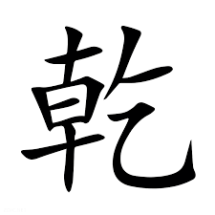
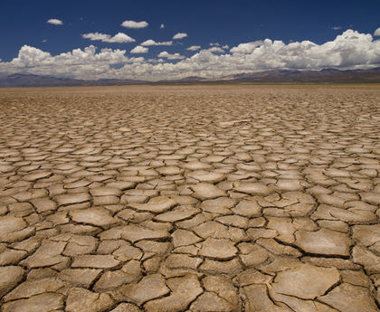
Chronic Taxation and blood stasis
Like believed that in cases of great deficiency following long-term damage, there is always blood stasis entangled with the deficiency. In cases of extreme deficiency, the body may not be able to accept tonics; reckless supplementation can actually lead to qi stagnation and blockage — in other words, trying to go fast may cause failure. Therefore, he added Sānqī (Noto ginseng) to the formula, which both tonifies and promotes
Consider the Taxation formula: Da huang zhe chong wan, which can be used in Multiple Sclerosis with desiccated blood patterns (Gan Xue 乾血 )

Slide 55
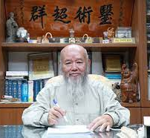
Lee Chen Yu’s 李政育 paralysis formulas
1. Supplement Qi and Invigorate Blood and Transform Stasis補氣活血化瘀法
Bu Yang Huan Wu Tang or Huang Qi Gui Zhi Wu Wu Tang ：補陽還五湯、黃耆五物湯劑類
2. Dual Qi and Blood supplementation, and unblock the Luo Method 氣血雙補活血通絡法:
Shi Quan Da Bu tang or Shi Quan Huo Luo Tang 十全大補湯（或十全活絡湯）
3. Supplement the Kidney method: 補腎法 (Kidney governs the sea of Marrow).
You gui yin or Zuo Gui Yin 右歸、左歸飲劑類
Methods 4 and 5 are subsets of Method 3
4. Warm Kidney Yang 溫補腎陽法
You Gui Yin and Shen Qi wan variants
5. Nourish Kidney Yin 滋養腎陰法：
Qi Ju Di Huang wan or Zuo Gui Yin 杞菊地黃丸或左歸飲等

